Slide 1
The Cognitive Security Fabric
Engineering High-Reliability Autonomous Defense with LLM-Powered Agentic Systems

Slide 2
Speakers Profile
Pioneering the Vision: At EchoStar, I am leading the mission to build our secure 5G future, guiding the shift to intelligent, AI-powered defense on a Zero Trust foundation as a Sr Network Security Architect
Creating the Blueprint: I strongly believes in building an open and secure ecosystem for everyone. As a key contributor, I helps in creating the global blueprints for our industry—shaping Zero Trust standards at the Cloud Security Alliance and guiding security for the AI-RAN Alliance.
Sharing the Knowledge: A book author, inventor, and founder of Xecurity Pulse, I am passionate about empowering others. I shares practical knowledge to help develop the community of experts who will protect our connected world.
Industry Experience: 5G Security Lead - Comcast, Technical Director - Huawei, Core Network Lead - Ufone
Standards Contribution: 3GPP SA3, AI - RAN, GSMA, Free5gc
Happy to connect on Linkedin !!

Slide 3
Our Journey Today: A Blueprint for Autonomy
The Architectural Crisis: Exposing the fundamental flaws in our reactive defense posture.
The Cognitive Fabric Blueprint: Introducing a new paradigm for intelligent, autonomous security.
Making It Real: A case study on defeating a zero-day attack in seconds, not hours.
The Road Ahead: Charting the challenges and opportunities for our community.

Slide 4
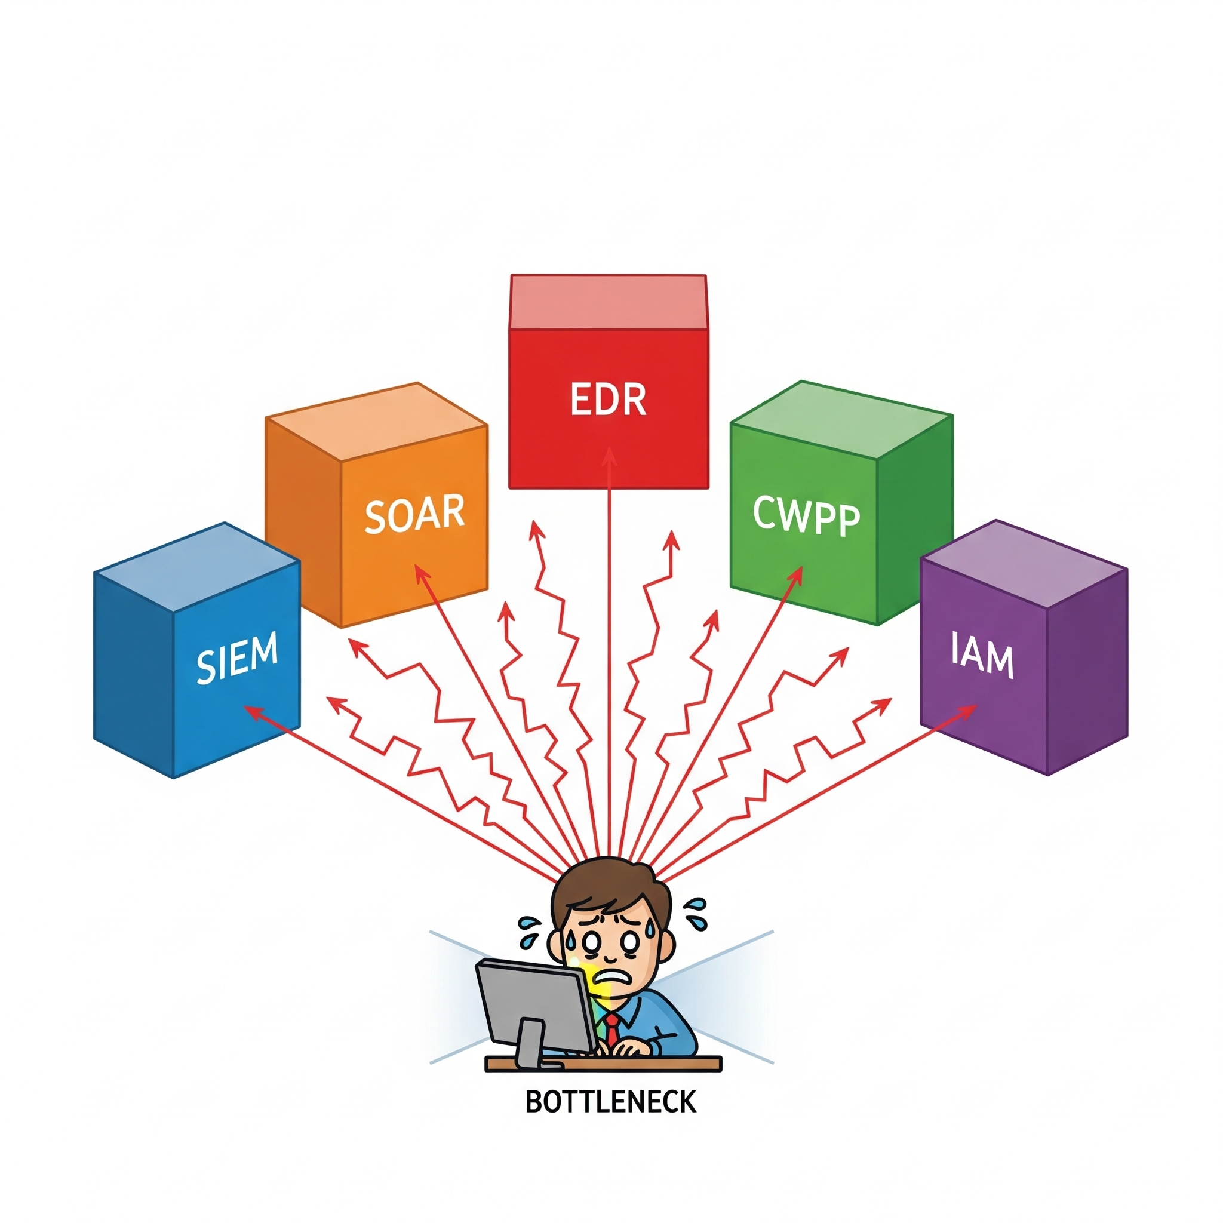
The Core Problem: A Brittle Fortress of Tools
Current Paradigm is Fundamentally Broken
  Fragmented & Tool-Centric: A collection of "best-of-breed" point solutions that don't share context.
  Reactive by Design: We wait for an alert, a signal of failure, before acting. Mean Time to Respond (MTTR) is our metric of defeat.
  Human-Scale Bottleneck: The cognitive load on SOC analysts is unsustainable. We cannot hire our way out of this problem.

Slide 5
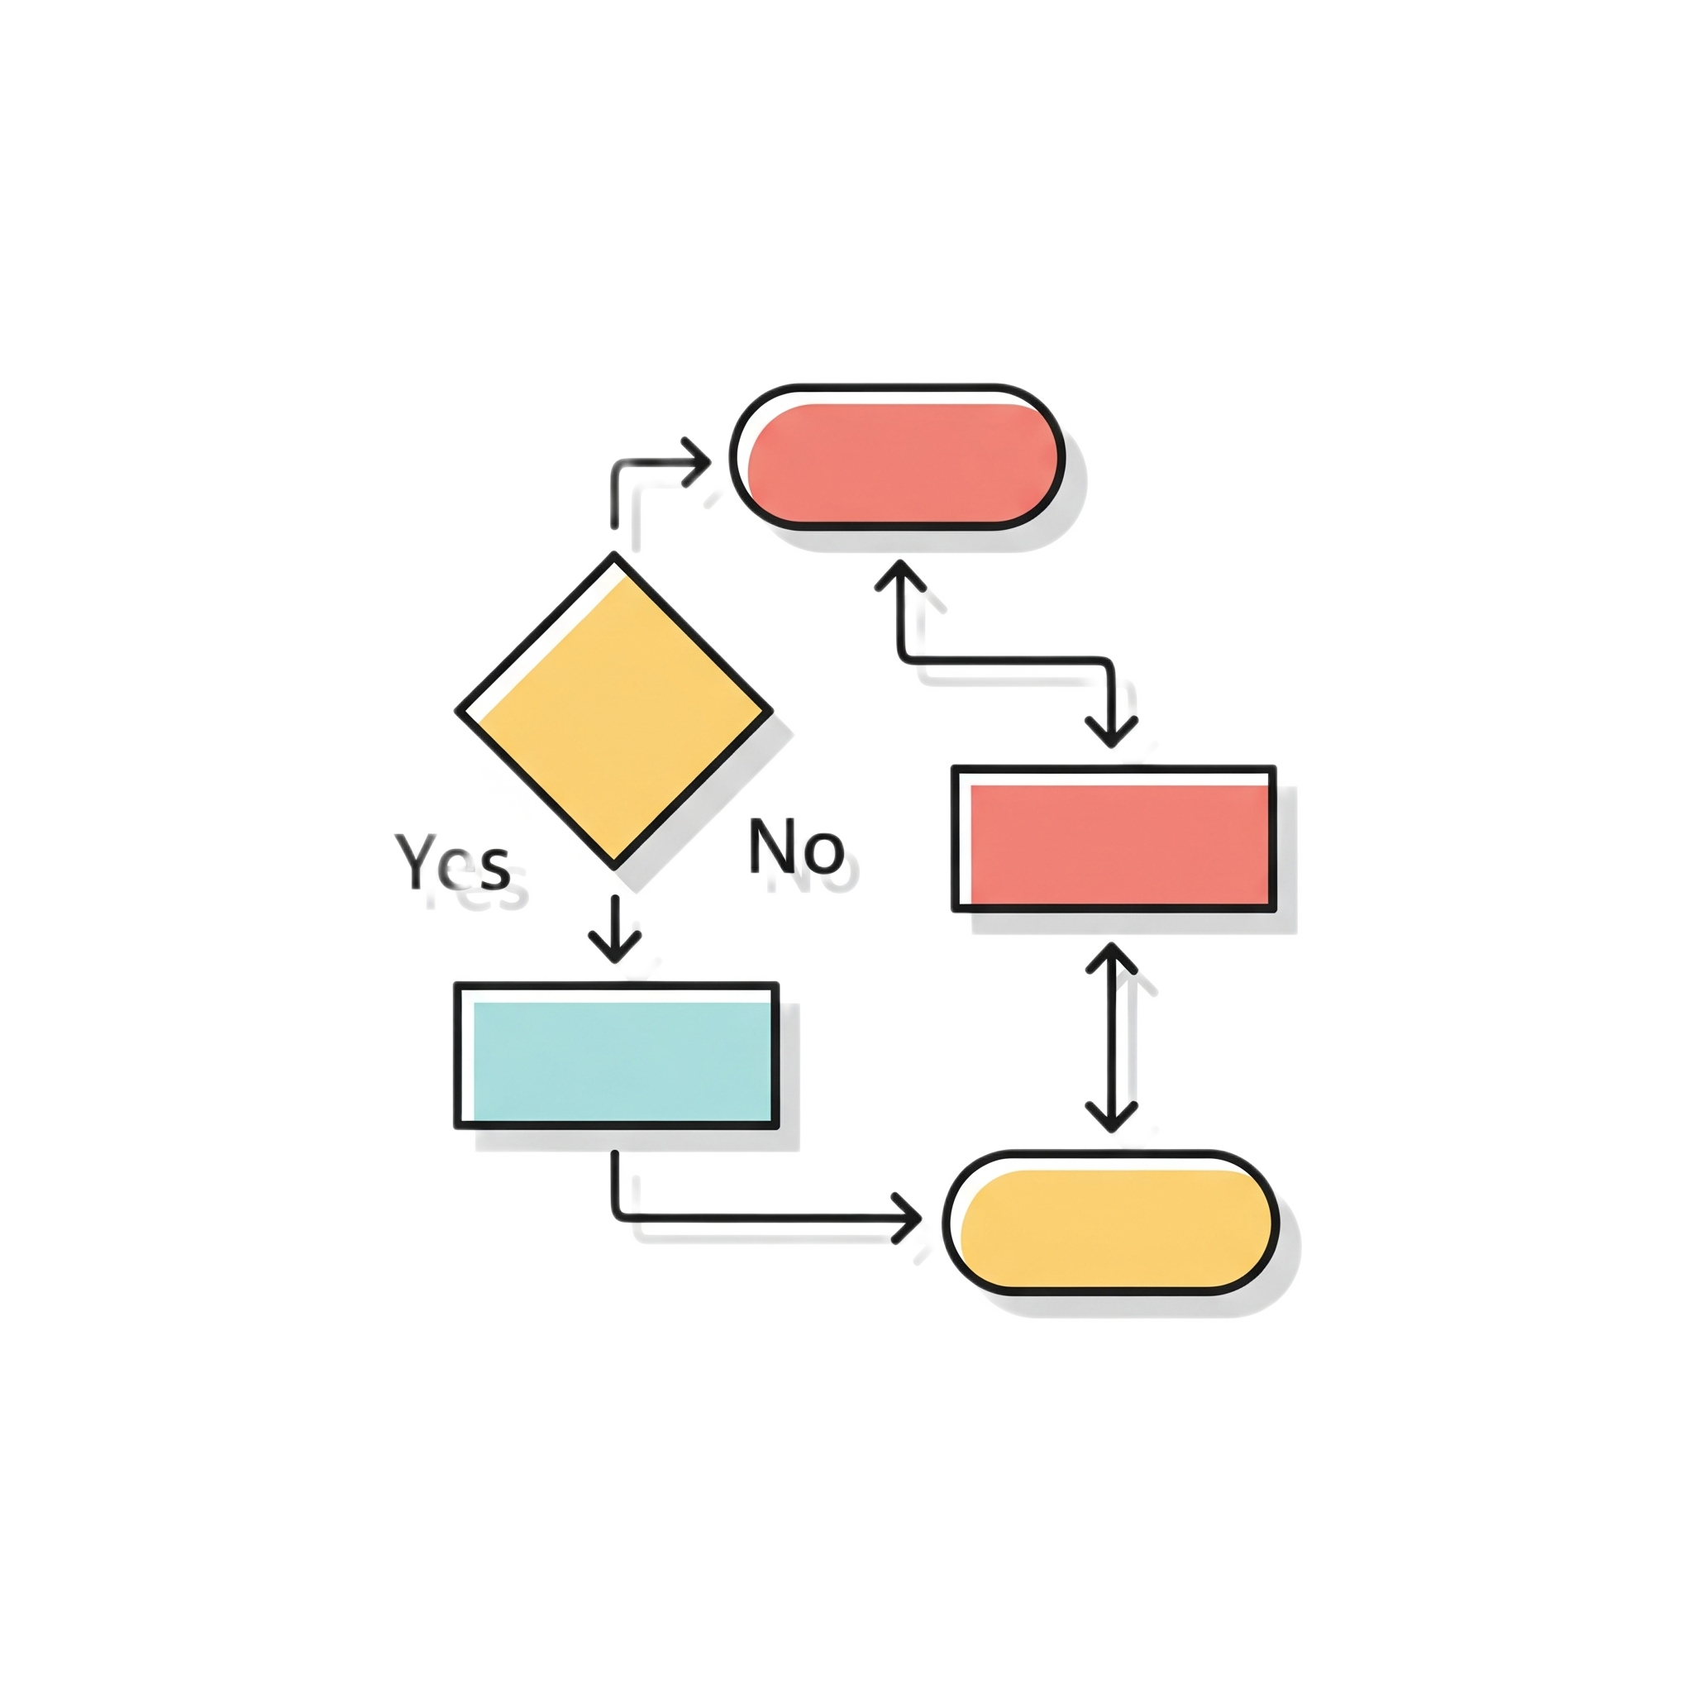

The Epistemological Shift: From Automation to Autonomy
Automation (The Present): IF event X, THEN execute script Y
Follows predefined playbooks.
Rigid, deterministic.
Fails against novel, zero-day threats.
It answers "How?"
Autonomy (The Future): GIVEN goal Z, ACHIEVE outcome
Understands intent and pursues goals.
Adaptive, emergent.
Reasons about unseen threats and formulates novel responses.
It asks "Why?" and "What if?"

Slide 6
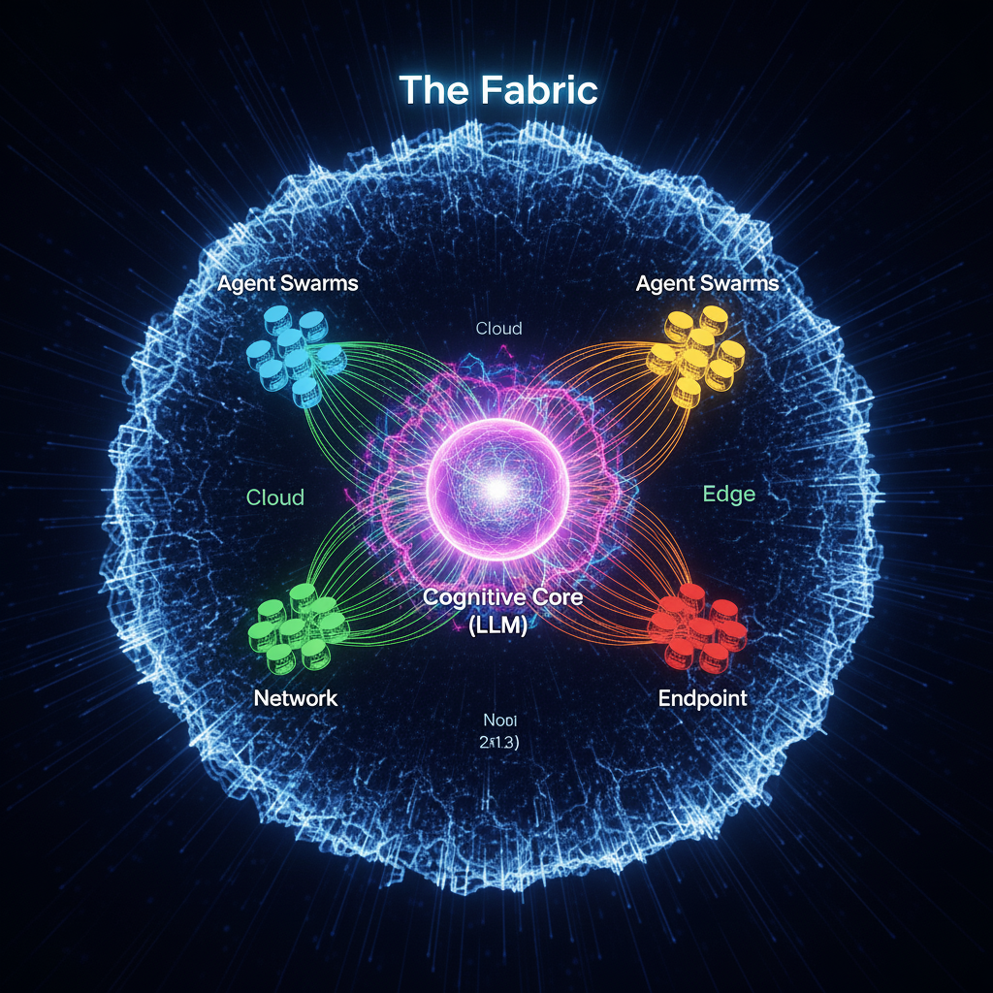
The Cognitive Security Fabric
A self-orchestrating, unified defense system that functions like a biological organism.
Two Core Components:
The Strategic Brain (LLM): Performs high-level reasoning, planning, and synthesis.
The Tactical Nervous System (Agents): Executes adaptive actions locally, translating strategy into reality.
Result: A system that moves from fragmented alerts to holistic, goal-oriented defense.

Slide 7
Layer 1: The Strategic Brain (The LLM Reasoning Layer)
Function: Continuous, high-level situational awareness.
Key Capabilities:
Semantic Threat Modeling: Understands an attacker's intent from CVEs, blogs, and dark web chatter, not just their IOCs.
Hypothesis Generation: "Given the new Log4j-like vulnerability, I hypothesize our exposed Kubernetes APIs are the most likely entry point."
Goal Formulation: Generates clear, high-level goals like:
Goal: Achieve "Containment" for asset group "crown-jewels-db" against threat actor "FIN7-profile".

Slide 8
Layer 2: The Tactical Nervous System (The Agentic Executors)
Function: Translate strategic goals into localized, adaptive action.
Agent Characteristics:
Specialized: Agents for Networking, Cloud, Identity, Forensics, etc.
Goal-Oriented: Given a goal (e.g., "deny access to asset Y"), they determine the best local action (ACL, security group change, session termination).
Collaborative: Agents can form "squads" to tackle complex, multi-domain tasks without a rigid, central script.

Slide 9
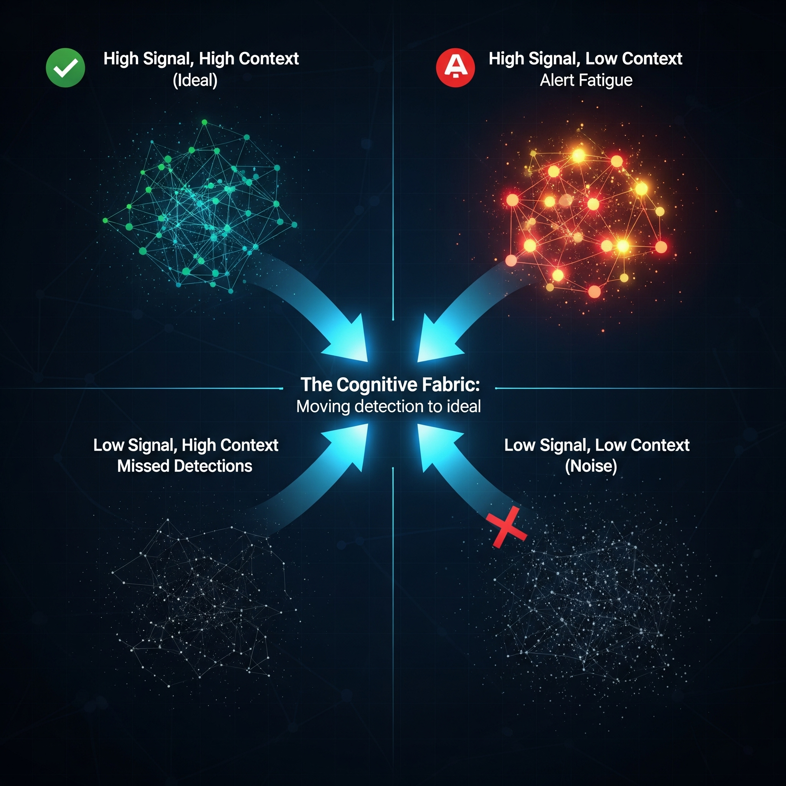
Defining Quality in Security (Qsec​)
Traditional Quality: Low False Positive Rate (FPR).
Versus
Cognitive Fabric Quality: High Contextual Relevance.
Semantic Filtering: The LLM understands the story of an attack, connecting low-fidelity signals (a login failure, a new process) into a high-fidelity narrative.
Business Alignment: Differentiates between a developer testing a tool and a genuine threat actor by understanding business context (is_prod_env, user_role, time_of_day).
$Q_{sec} = f(\text{Context}, \text{Signal}, \text{Business_Impact})$

Slide 10
Engineering Reliability in Response (Rsec​)
High-Reliability is about delivering correct, consistent outcomes at scale, under pressure.
Immune to Fatigue: The Fabric operates at machine speed, 24/7/365.
Repeatable & Auditable: Every decision and action is logged and explainable.
Graceful Degradation: Even if one agent fails, the system can re-route and adapt, unlike a single point of failure in a human process.
Feature | Human-Driven SOC | Cognitive Security Fabric
Scalability | Linear (add more people) | Exponential (add more agents)
Consistency | Variable (fatigue, skill gaps) | algorithmic precision)
Speed | Minutes to Hours (MTTR) | Milliseconds to Seconds (MTTA)
Learning | Siloed | continuous learning
Use case: Zero-Day Containment | Sequential playbook execution after manual correlation. High dwell time | Autonomous, parallel response across endpoint, network, and identity. Minimal dwell time

Slide 11
Case Study : Defeating a Zero-Day in 10 Seconds
ORCID
Riverfront Lab
5G Security Lab

Slide 12
Anatomy of a Response: Two Worlds Compared
Legacy SOC Response
1. Reactive Alert An alert fires from a single, siloed tool.
2. Manual Investigation An analyst must manually correlate
data across multiple tools ("swivel chair" analysis).
3. Playbook-Driven Response A rigid, pre-defined script is followed once the threat is confirmed and escalated.
4. Sequential Containment Actions are performed one by one, often with manual handoffs between teams.
OUTCOME: MTTR: 25 MINUTES
Cognitive Fabric Response
1. Holistic Synthesis All signals (logs, telemetry, alerts) are ingested and analyzed together in real-time.
2. Autonomous Reasoning The LLM brain understands the attack narrative, forms a hypothesis, and sets a strategic goal.
3. Coordinated Agent Action A "squad" of specialized agents is dispatched to achieve the goal with local intelligence
4. Parallel Containment Actions across endpoint, network, and identity are executed simultaneously.
Isolate Host, Revoke Creds, Block Network
OUTCOME: MTTR: 10 SECONDS

Slide 13
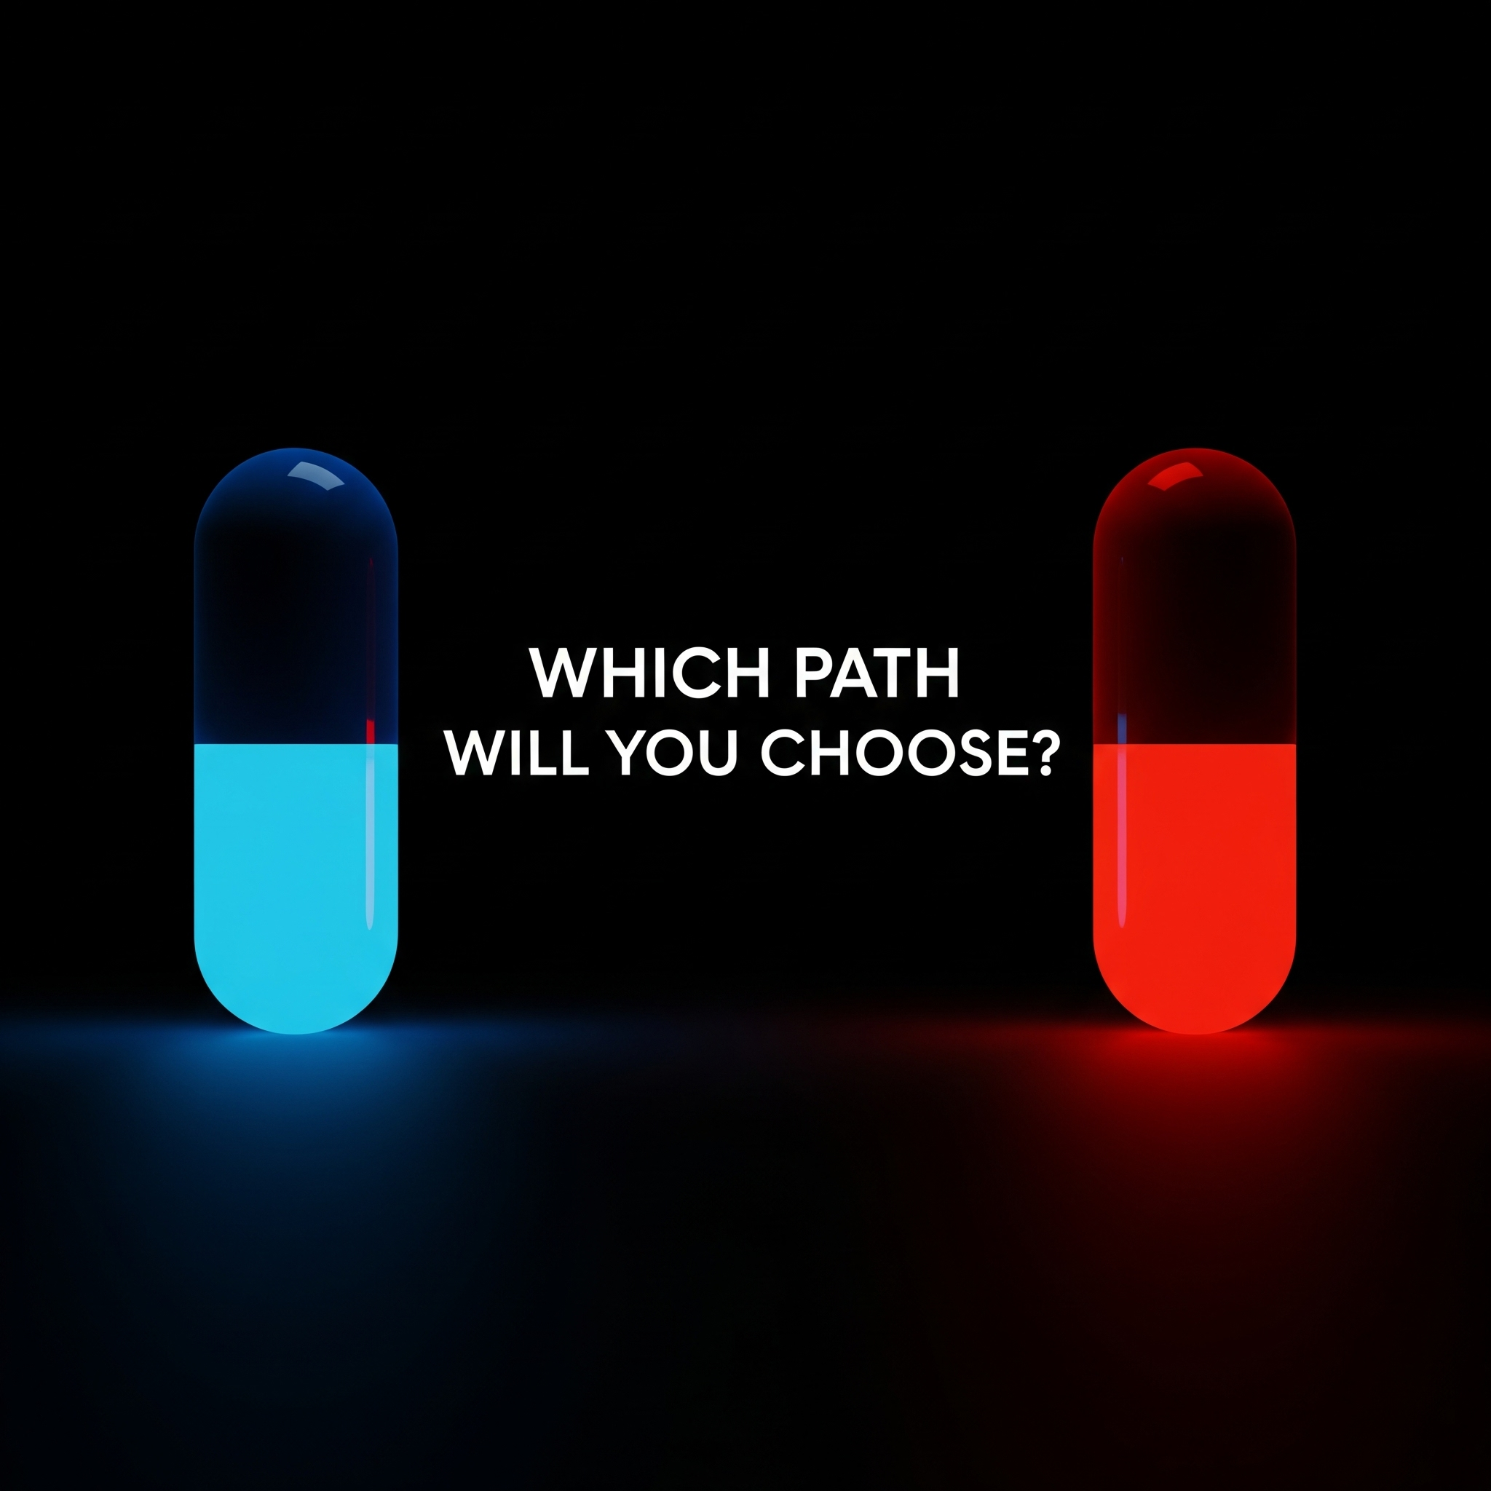
The Crossroads: Our Choice for the Next Decade
The Blue Pill: Incremental Automation
More Dashboards, More Alerts
Faster SOAR Playbooks
Bigger SIEM Data Lakes
Result: Perpetually one step behind.
The Red Pill: True Autonomy
Solving AI Alignment for SecOps
Engineering Explainable Reason
Building Adversarially Robust Models
Result: A future where defense moves first.

Slide 14
Thank You
ORCID
Riverfront Lab
5G Security Lab

