Slide 1

2025 CQR INTERNATIONAL WORKSHOP
Illinois Institute of Technology, Chicago, IL
Sessions on
Communications Quality, Reliability & Security
October 7 – 8, 2025

Slide 2
2025 CQR INTERNATIONAL WORKSHOP
General Program Co-Chairs
Alana Scott Abby Knowles
Ericsson ASKTech Works

Slide 3
Welcome and Thank You
Keynote Speakers
Panel Members
IEEE CQR Officers, Advisory Board
2025 Organizing Committee
Session Chairs and Speakers
Distinguished Attendees
Friends and Family

Slide 4
2025 CQR INTERNATIONAL WORKSHOP
Session 1
NextGen Mobile Networks
Kevin Krantz

Slide 5
2025 CQR INTERNATIONAL WORKSHOP
BREAK

Slide 6
2025 CQR INTERNATIONAL WORKSHOP
Session 2
Security, Quality & Reliability
Justin Perkins, CTIA

Slide 7
2025 CQR INTERNATIONAL WORKSHOP
BREAK

Slide 8
2025 CQR INTERNATIONAL WORKSHOP
Executive Panel:
Operationalizing Emerging Technologies
Panel Chair: Abby Knowles, ASKTech Works

Slide 9
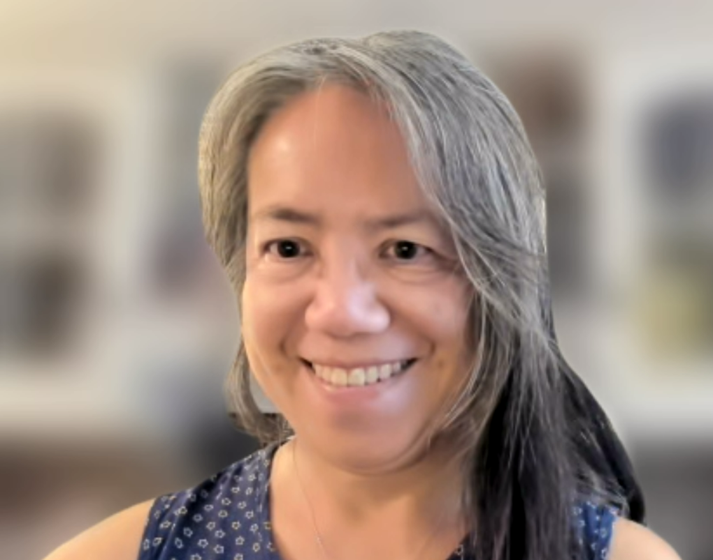
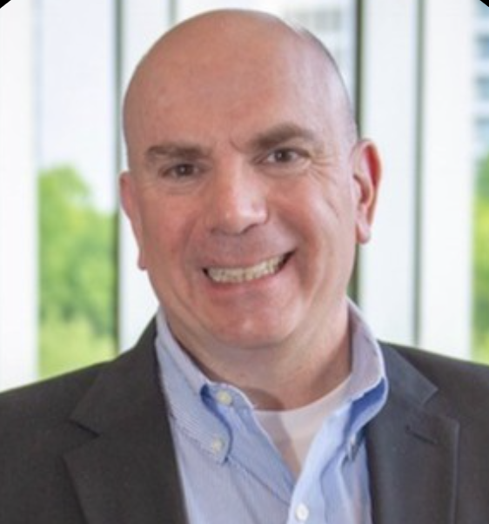
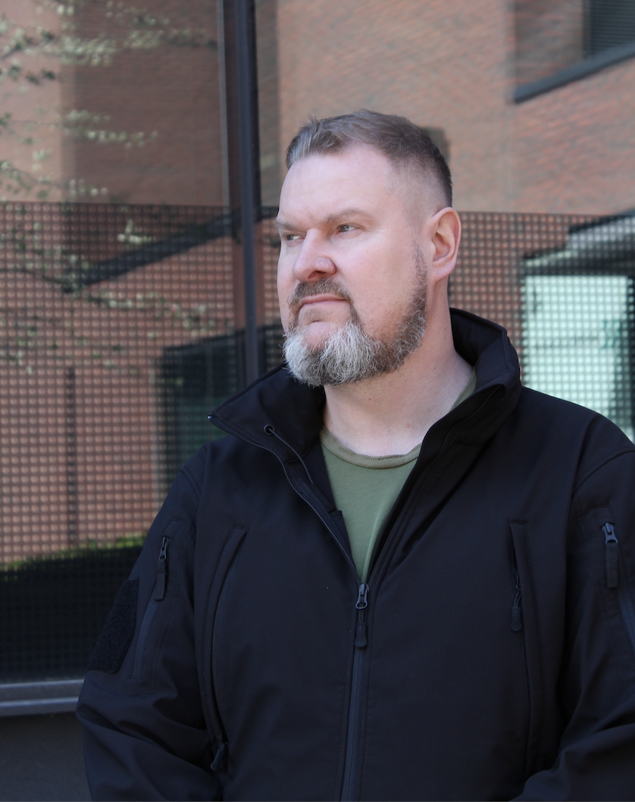

2025 CQR INTERNATIONAL WORKSHOP
Executive Panel:
Anne Lee
CTO & Sr. Research Scientist
AI Research Labs - Nokia Labs
Michael Paradise
VP-Netwk Tech Operations
AT&T
Pasi Hurri
CEO
BaseN
Hardik Patni
Accts Director - North America
LabLabee

Slide 10
2025 CQR INTERNATIONAL WORKSHOP
Day 1 Closing Remarks
Abby Knowles, ASKTech Works

Slide 11
2025 CQR INTERNATIONAL WORKSHOP
RECEPTION

Slide 12
2025 CQR INTERNATIONAL WORKSHOP
Day 2 WELCOME
Alana Scott, Ericsson

Slide 13
2025 CQR INTERNATIONAL WORKSHOP
CQR Awards &
Technical Committee Meeting
Chris Mayer

Slide 14
2025 CQR INTERNATIONAL WORKSHOP
BREAK

Slide 15
2025 CQR INTERNATIONAL WORKSHOP
Session 5
Panel: High Performing Networks & Systems
Moderator: Abby Knowles, ASKTech Works

Slide 16
2025 CQR INTERNATIONAL WORKSHOP
BREAK

Slide 17
2025 CQR INTERNATIONAL WORKSHOP
Panel: The Future of Quantum
Internet & Implications for 6G
Moderator: Justin Perkins, CTIA

Slide 18
2025 CQR INTERNATIONAL WORKSHOP
Workshop Closing Remarks
Abby Knowles, ASKTech Works

Slide 19
2025 CQR INTERNATIONAL WORKSHOP

