Slide 1
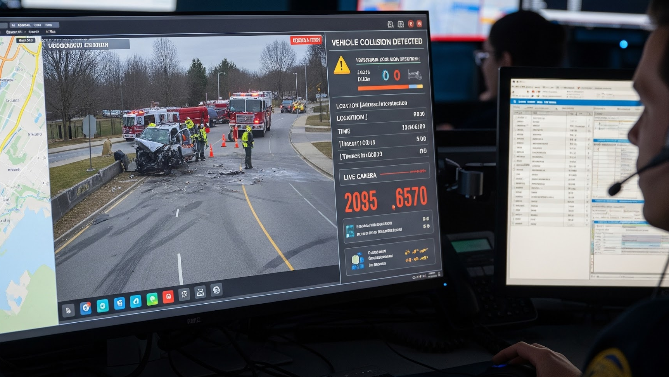

IEEE Real Time Communications Conference
Real-Time Alerts for 911 and First Responders
Presented By: Darryl Keeton, Founder and President of

Slide 2
THE OPPORTUNITY
Google. (2025). Gemini (2.0 Flash) Image generated in response to Next Generation 911 real-time alerts prompts. https://gemini.google.com/

Slide 3


WHAT IS NEXT GENERATION 9-1-1
NG911 is a digital, internet protocol -based system that will replace the analog 911 infrastructure.
NG911 includes the hardware, software, data and all the procedures and policies that relate to answering every emergency request for help.
https://www.123.net/news/next-generation-911/

Slide 4
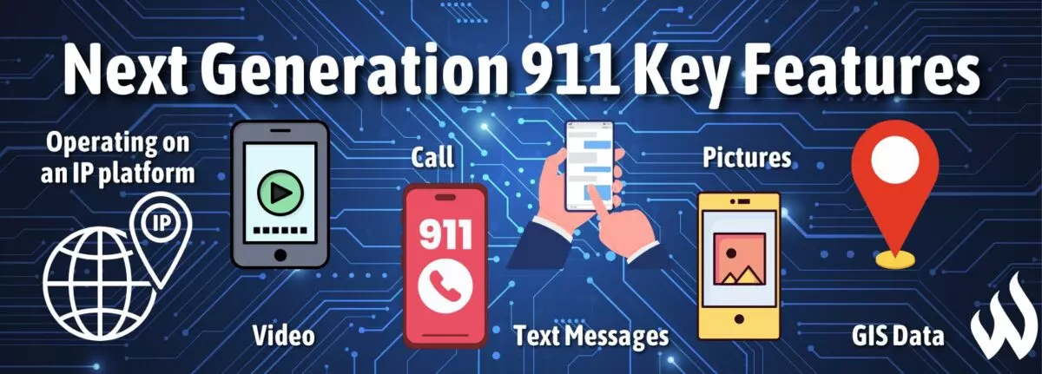
WHAT IS NEXT GENERATION 9-1-1
https://wfca.com/preplan-articles/next-generation-911/

Slide 5
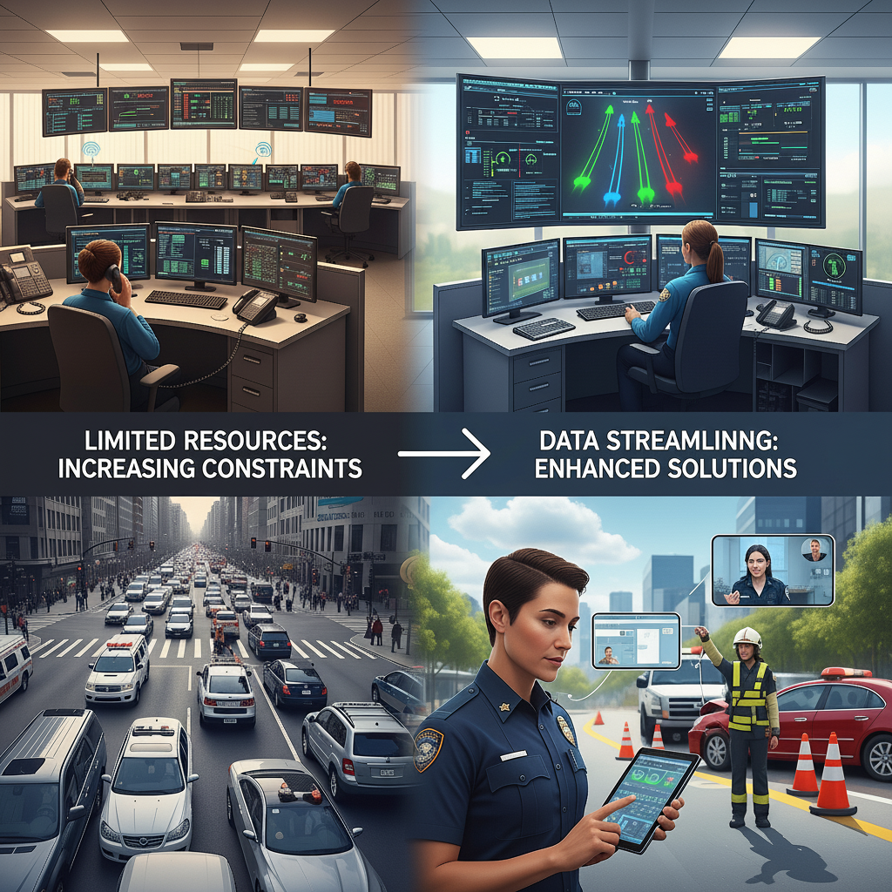
WHAT’S CURRENTLY HAPPENING
With limited resources becoming an increasing constraint for public safety answering points (PSAP) centers and Public Safety First Responders related to traffic and road safety, how can real-time data streamline events, improve post-care communication, reduce response times, and facilitate effective scene management
Google. (2025). Gemini (2.0 Flash) Image generated in response to Next Generation 911 real-time alerts prompts. https://gemini.google.com/
Notes:
Limited resources from Police Officers to 911 Center Callers
Inaccurate information leading to delayed response times and scene management
In accurate locations
Not know your way through buildings, campus or entertainment district
Post crash care

Slide 6

WHERE WE NEED TO GROW
Benefits of Real-Time Alerts
Effective scene management
Enhanced situational awareness
Location based data (GPS and address)
Post-Crash Care
Google. (2025). Gemini (2.0 Flash) Image generated in response to Next Generation 911 real-time alerts prompts. https://gemini.google.com/

Slide 7
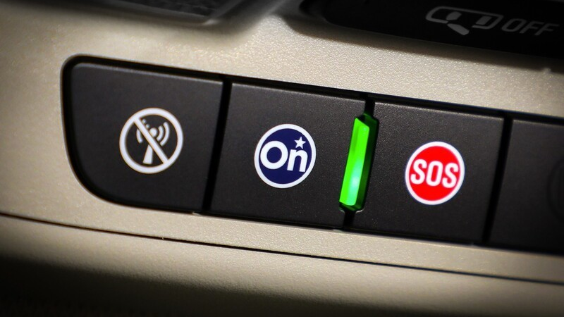

https://share.google/images/ThqarmmMcMdq3JD8C
Notes:
GM OnStar is collaborating with RapidDeploy, a public safety technology company, to integrate OnStar's Automatic Crash Response (ACR) data with Next Generation 911 (NG911) systems, enabling direct transmission of vehicle telematics and crash details to 911 call centers in specific areas, and enhancing emergency response by providing critical information faster and more accurately. This initiative focuses on improving the efficiency and effectiveness of the emergency response process by leveraging OnStar's vehicle technology and RapidDeploy's mapping and data integration capabilities for NG911.
How it Works:
Automatic Crash Detection: OnStar's Automatic Crash Response (ACR) system detects a severe vehicle crash, even if the driver cannot call for help themselves.
Telematics Data Transmission: The ACR system gathers crucial data, including the vehicle's location, make, and model, as well as other details about the crash.
Direct Delivery to 911 Centers: This telematics data is sent directly to 911 emergency call centers (ECCs) through a partnership with RapidDeploy, a company specializing in integrating this type of data into NG911 systems.
Enhanced Emergency Response: Instead of relying on a potentially delayed verbal relay of information, this data provides dispatchers with detailed information immediately, allowing them to send the appropriate responders and equipment more quickly and efficiently.
Benefits of the Next Gen 911 Integration:
Faster Response Times:
Direct data delivery reduces the time it takes for 911 centers to receive information and initiate a response.
Improved Accuracy:
Critical details like precise location and vehicle information are provided to responders more accurately than through traditional methods.
More Informed Decision-Making:
Dispatchers can make more informed decisions based on the real-time data from the vehicle.
Enhanced Safety:
Ultimately, the integration aims to improve the safety of individuals involved in crashes by ensuring faster and more effective emergency assistance.

Slide 8
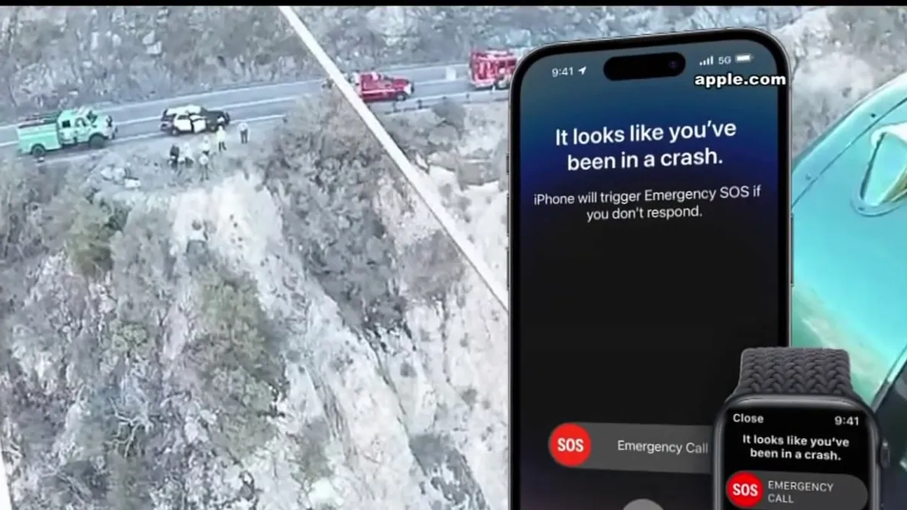
https://www.nbclosangeles.com/news/national-international/iphone-crash-detection-saving-lives/3107545/

Slide 9
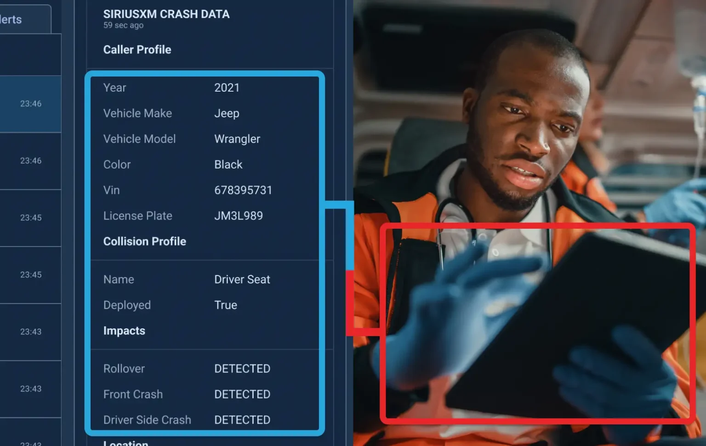

https://rapidsos.com/case-study/siriusxm-connect/

Slide 10

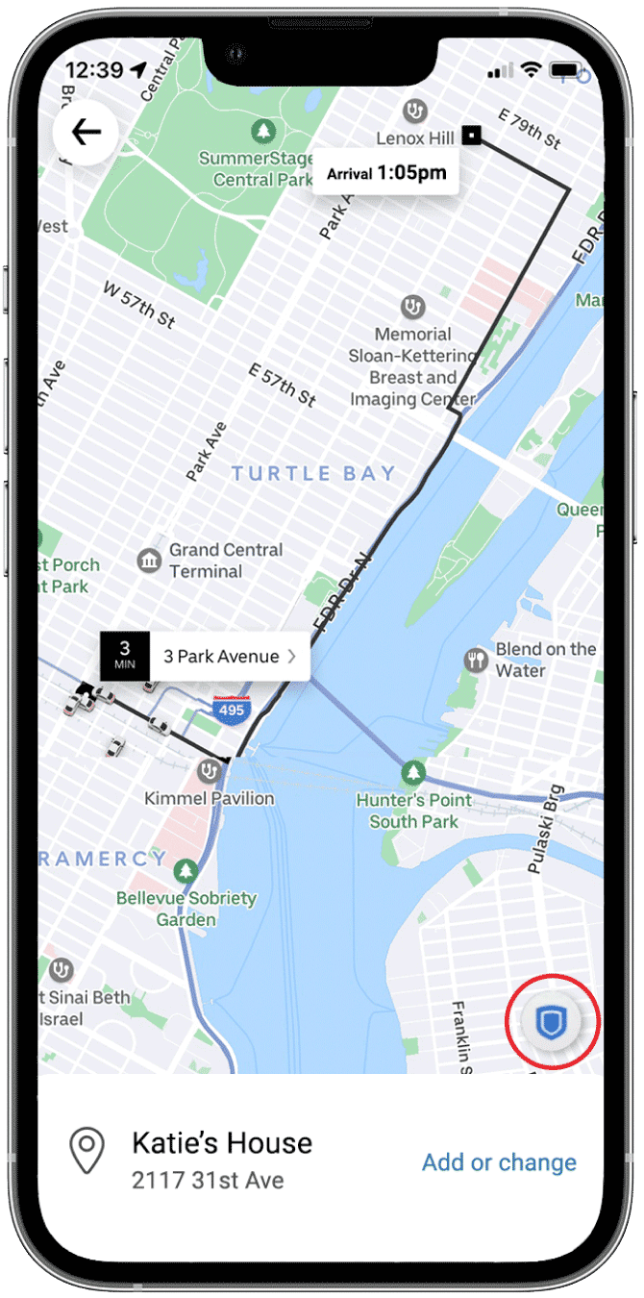
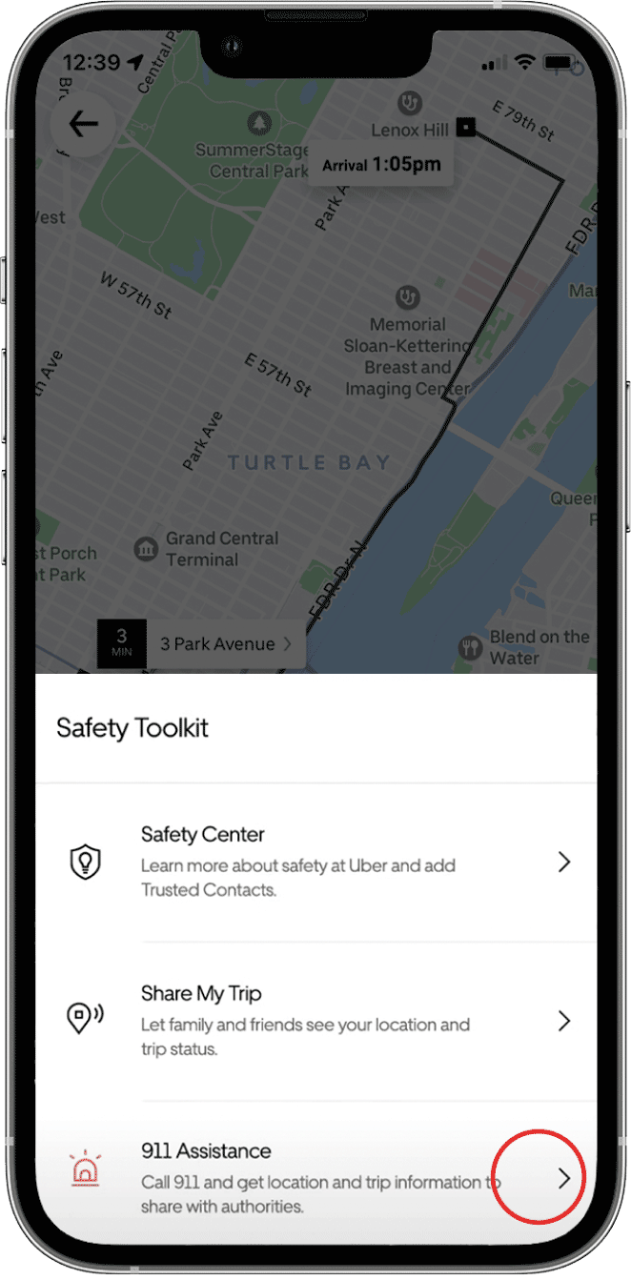
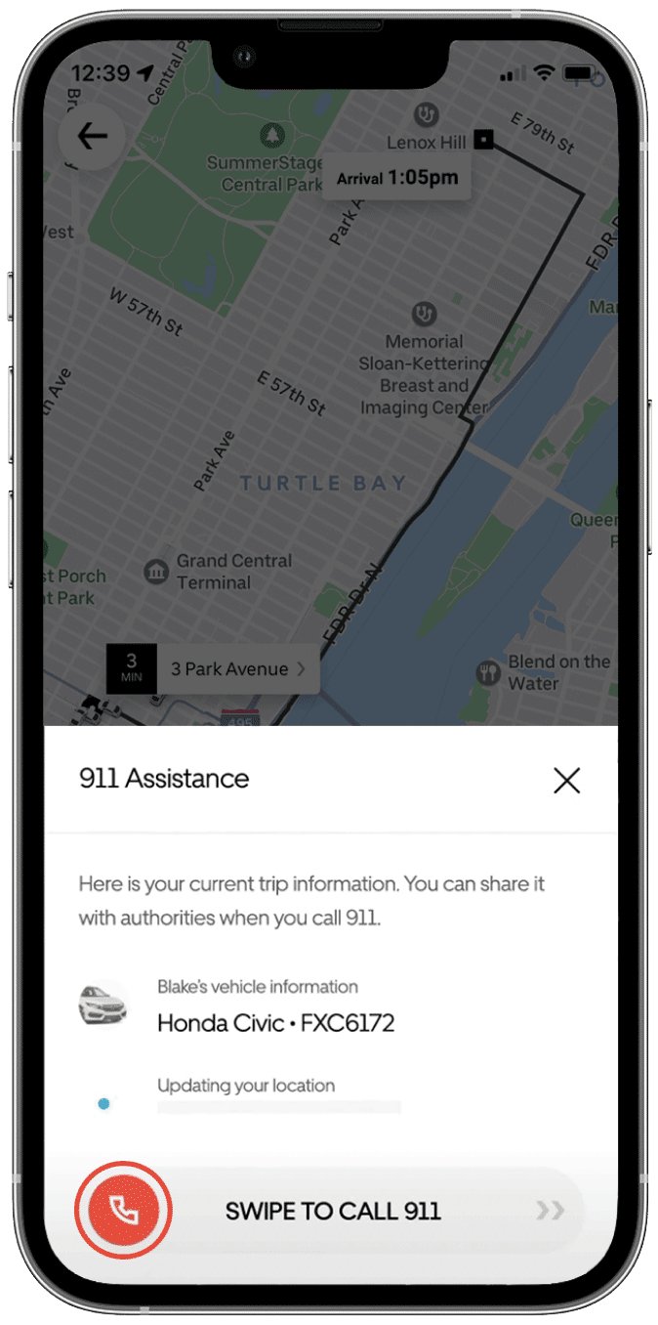
https://rapidsos.com/case-study/uber/

Slide 11
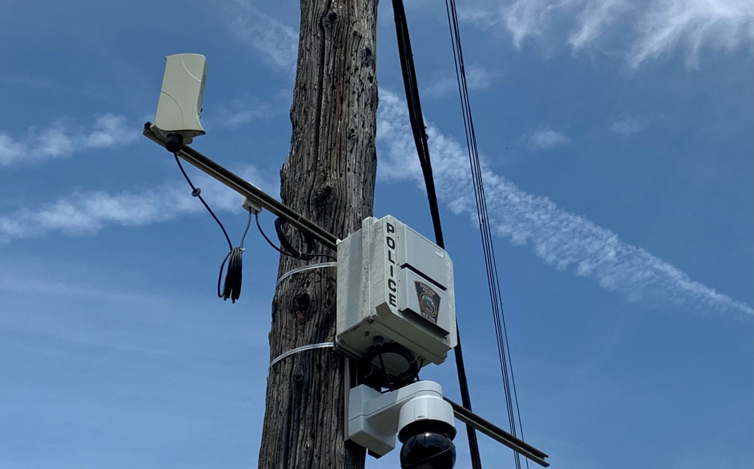

https://www.syracuse.com/crime/2022/07/report-shotspotter-wastes-officers-time-provides-little-help-in-court-targets-overpoliced-communities.html

Slide 12
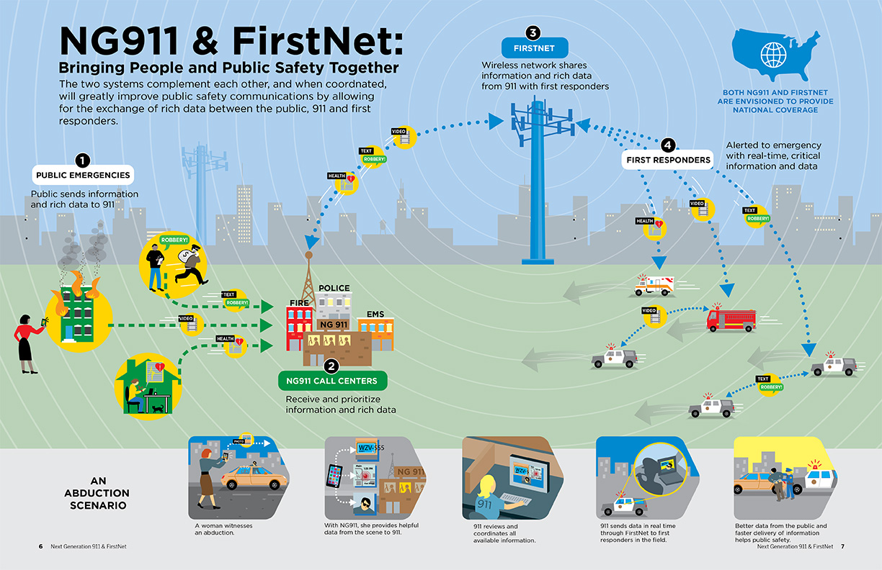
https://www.sealevel.com/2024/09/13/what-is-ng911/

Slide 13
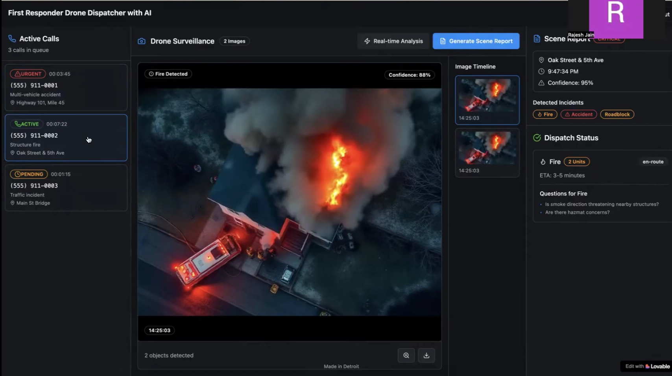
First Responder Drone Dispatcher with AI
https://devpost.com/software/first-responder-drone-dispatcher

Slide 14
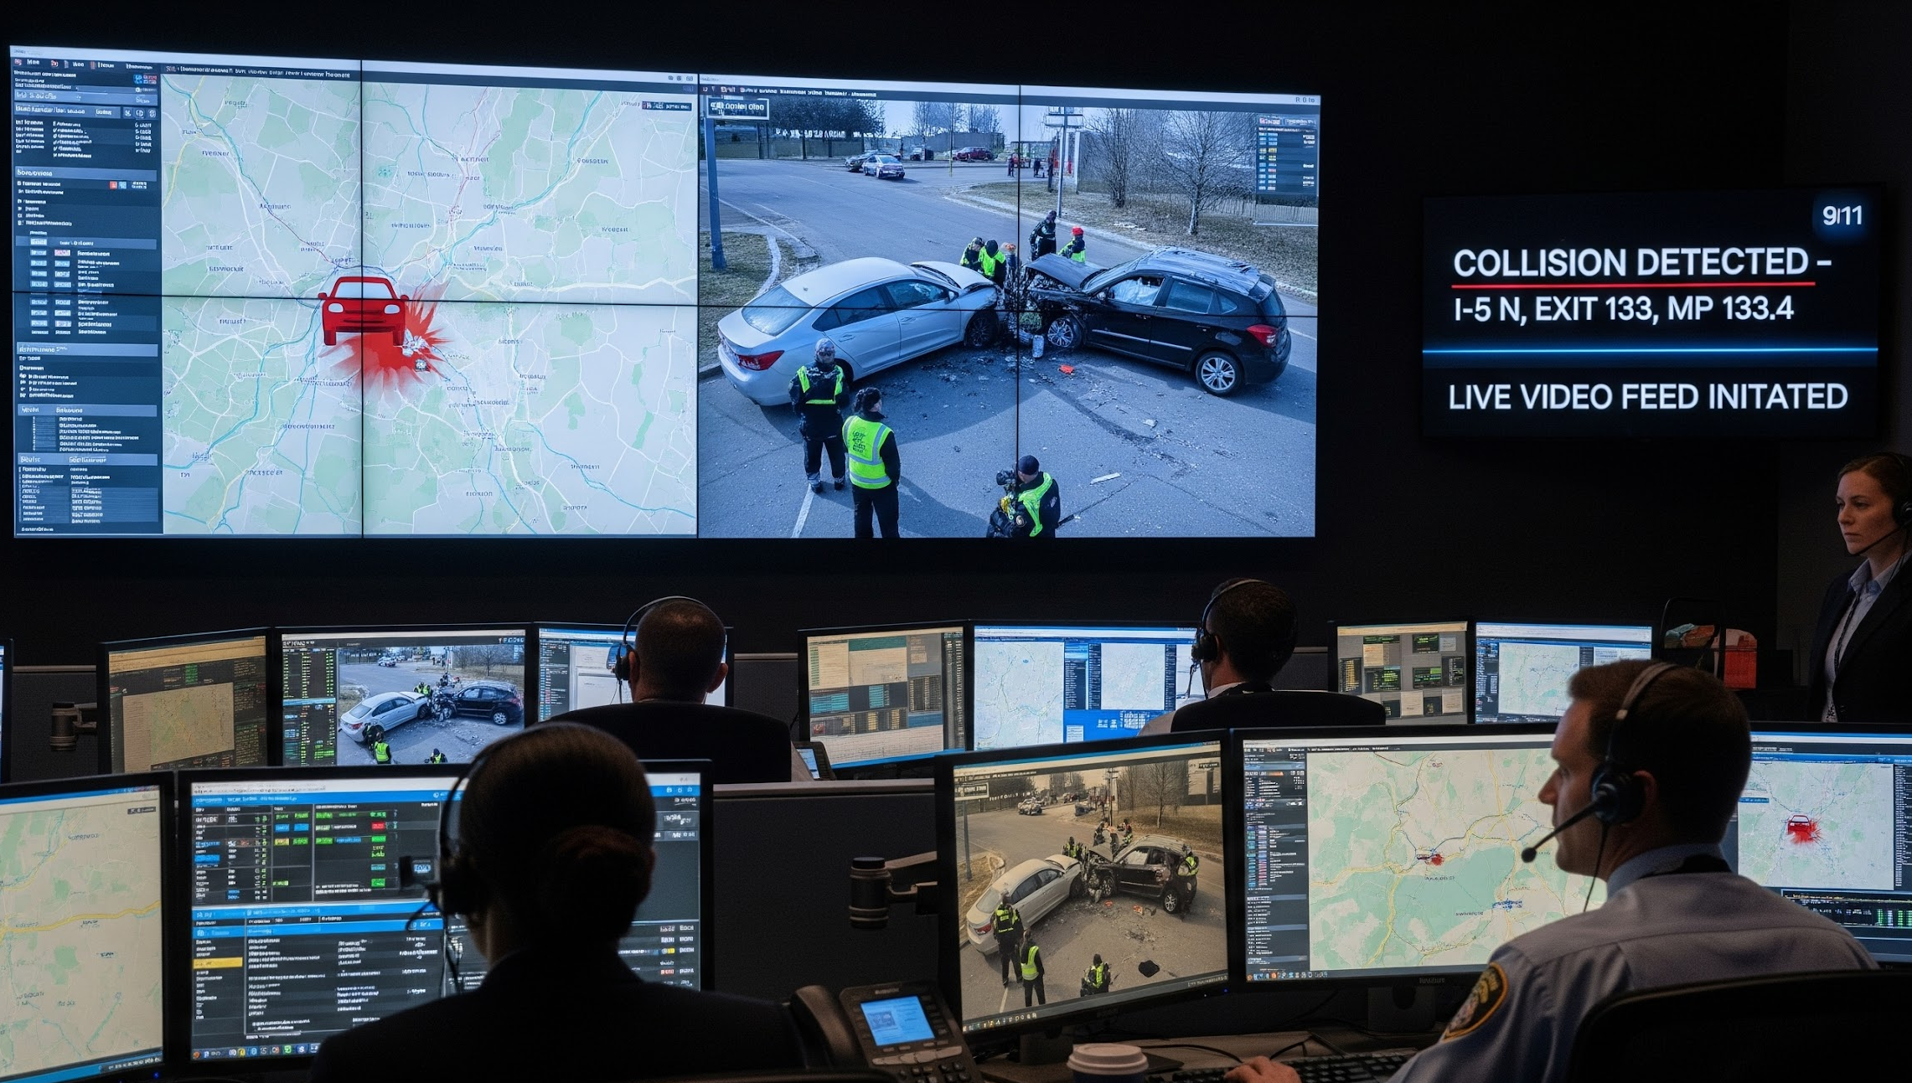
REAL-TIME COLLISION DETECTION
Google. (2025). Gemini (2.0 Flash) [Image generated in response to real-time collision detection in 911 center]. https://gemini.google.com/

Slide 15
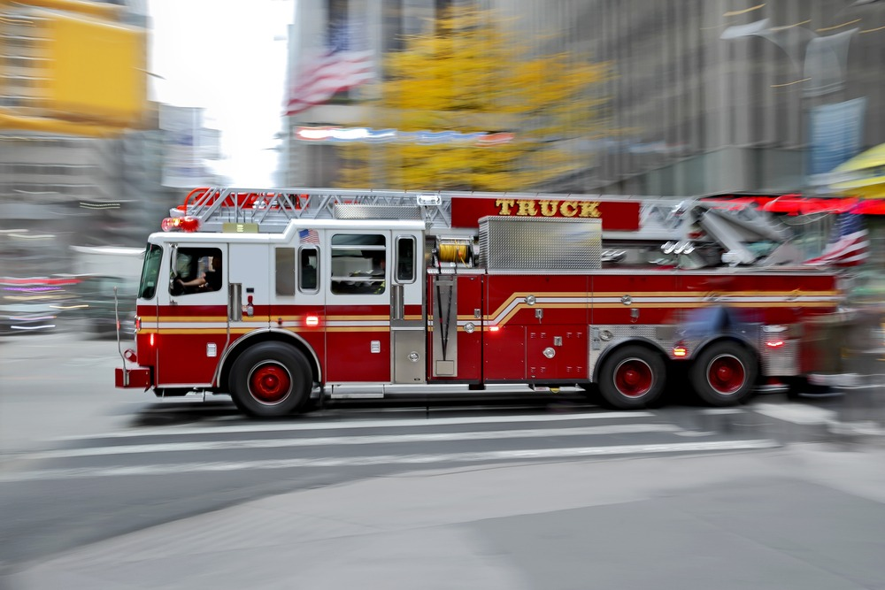
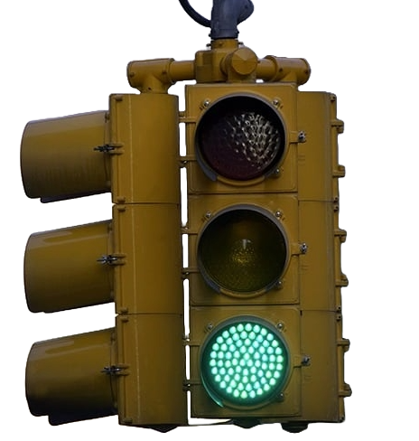
EMERGENCY VEHICLE PREEMPTION
Google. (2025). Gemini (2.0 Flash) [Image generated in response to real-time collision detection in 911 center]. https://gemini.google.com/

Slide 16
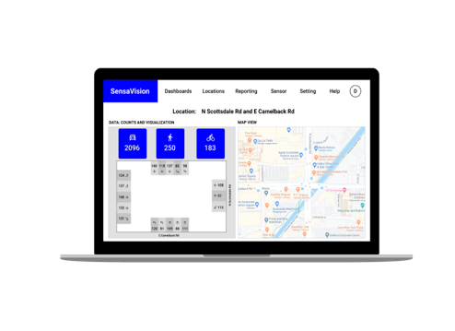
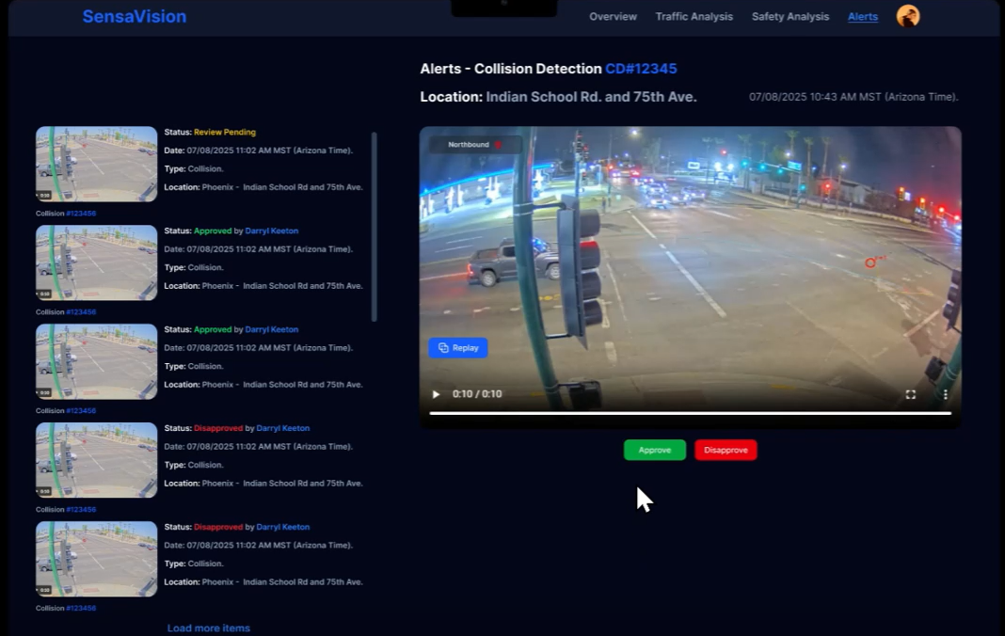
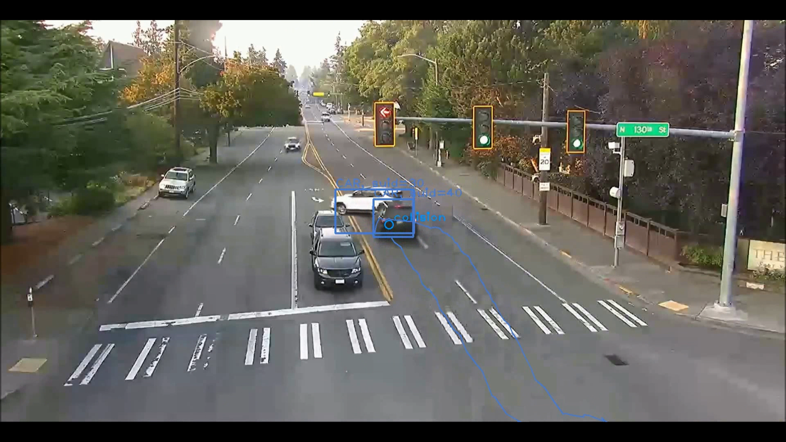
THE SOLUTION
SENSAVISION
“Proactively Advancing Safer and Smarter Roads.”
SensaVision is a state-of-the-art computer vision AI data and analytics platform developed to improve transportation and urban planning to save lives.
SOLUTION
Proprietary and Confidential Information @ 2025 Sensagrate, INC. All rights reserved.
Notes:
Automatic vehicle collision detection alerts to 911 centers Public Safety Answering Point (PSAP) with notifications and digital dispatch (NG911) through Over the Top Providers (OTTPs).
Access to 100,000 cameras across the US in 48 States
Target high risk, high collision locations (intersections, highways, corridors)
Improve Post-Crash Care communication with effective scene management and GPS location by identify type of vehicles involved and which apparatus to send.
Teaming with OTTPs for 911 CADs (Computer-Aided Dispatchers) to meet the Safe System Approach through providing Crash information to first responders, and Transportation Information Management to DOTs.
The data and analytics helps improve and empower a faster and smarter emergency response and improve post crash care and enable NG911 initiatives.

Slide 17
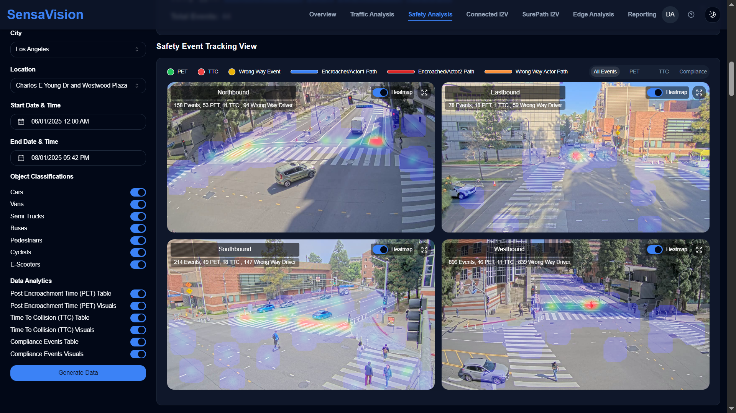

CASE STUDY
SMART INTERSECTIONS
SensaVision Use Cases
Vulnerable Road Users Detection and Tracking Real-time Collision Detection Near-Miss Collision Analysis Automated 911 Crash Detection Signal Phase Analysis License Plate Recognition and Car Make and Model Detection Infrastructure-to-Vehicle Communication Readiness Emergency Vehicle Traffic Signal Preemption
SMART INTERSECTIONS
Proprietary and Confidential Information @ 2024 to 2025 Sensagrate, INC. All rights reserved.

Slide 18
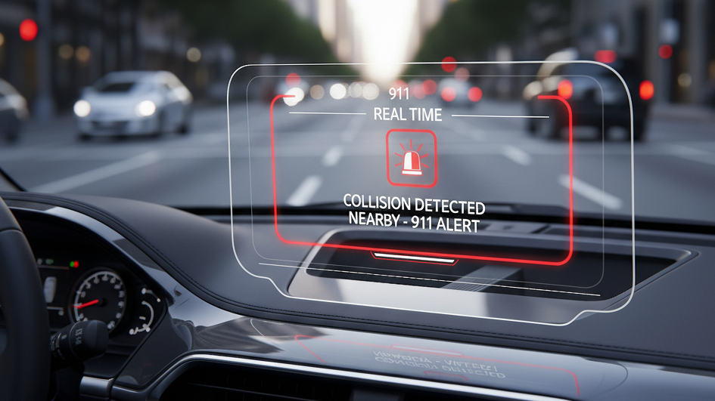
VEHICLE-TO-EVERYTHING (V2X) COMMUNICATION
Google. (2025). Gemini (2.0 Flash)[Image generated in response to real-time collision detection in 911 center prompt. https://gemini.google.com/

Slide 19
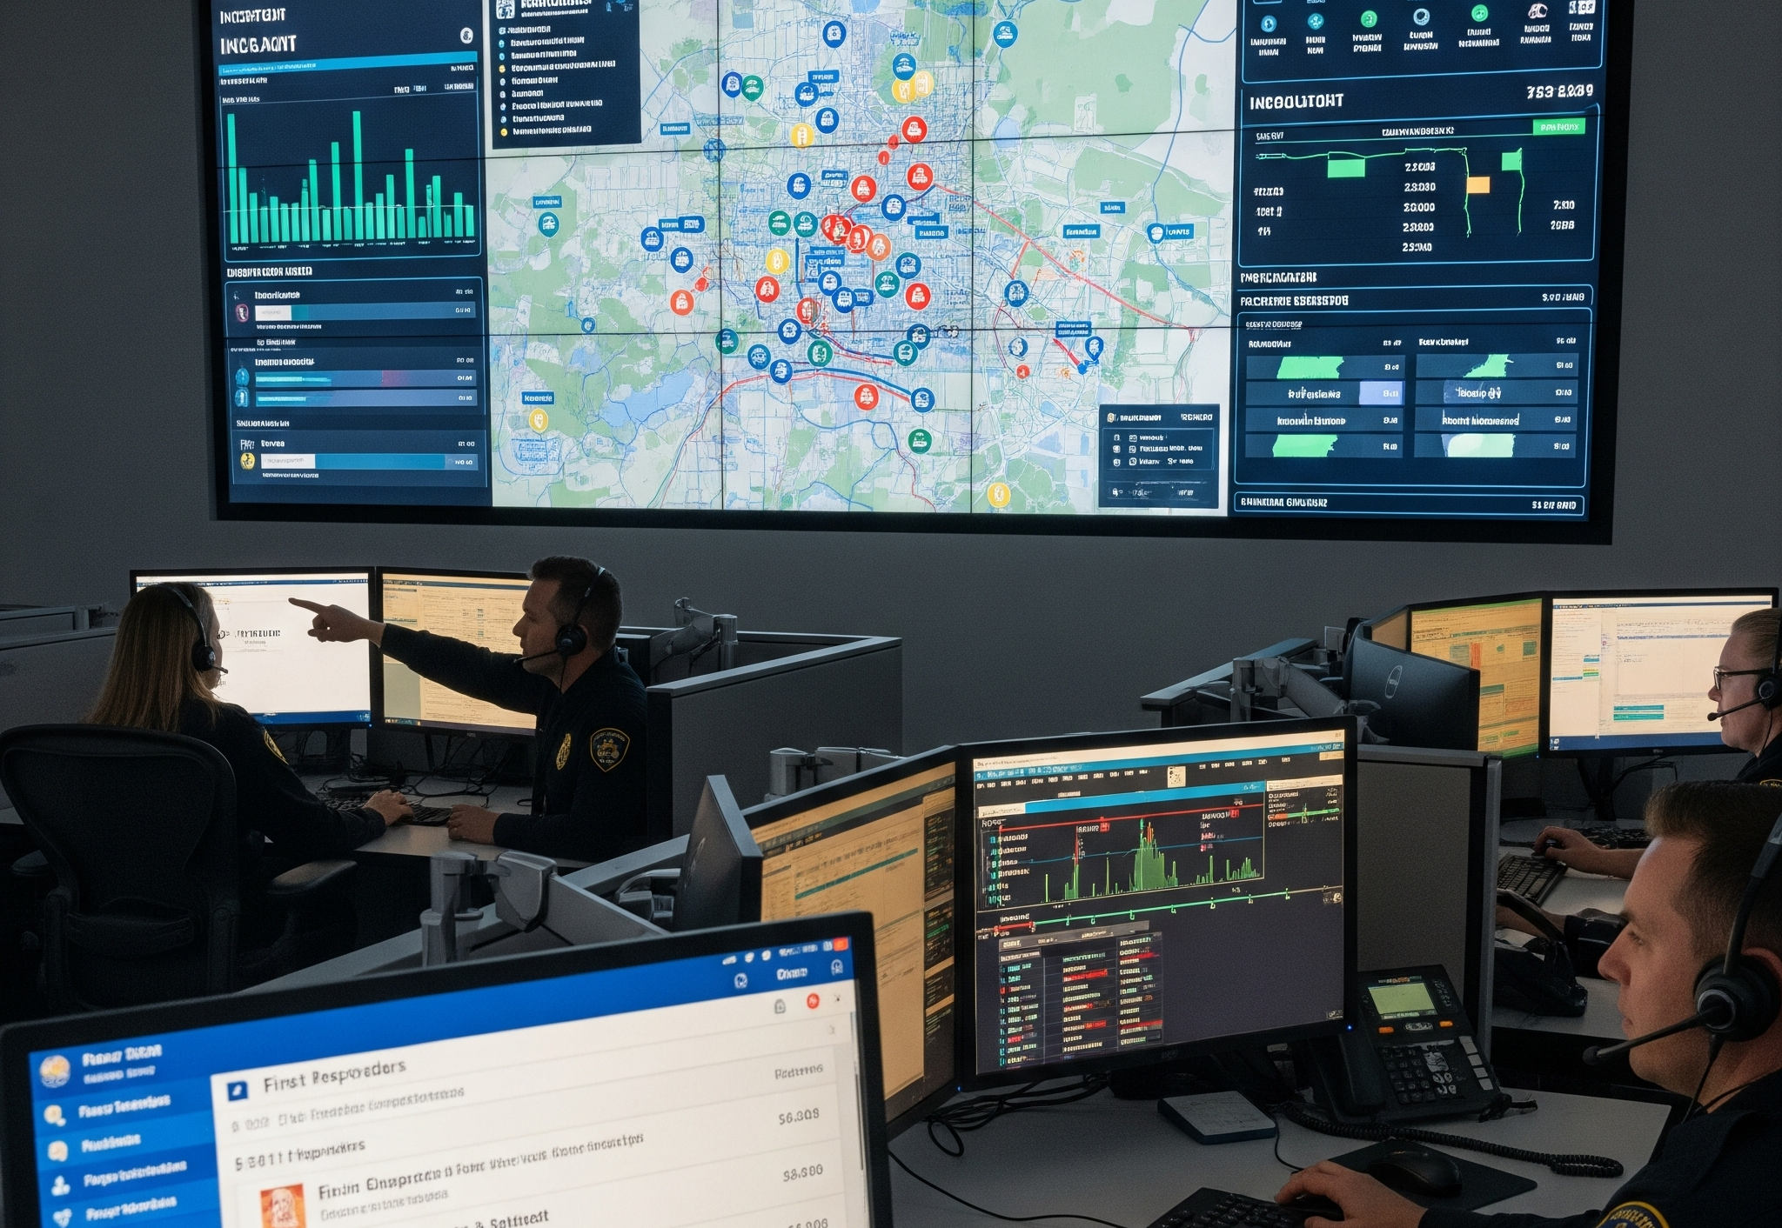
Q&A
Google. (2025). Gemini (2.0 Flash)[Image generated in response to real-time collision detection in 911 center prompt. https://gemini.google.com/

Slide 20
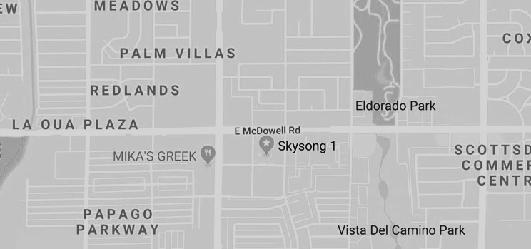






THE FUTURE OF SMARTER AND SAFER ROADS
Darryl Keeton, Founder and President
www.sensagrate.com
Scottsdale, AZ 85257
Proprietary and Confidential Information @ 2025 Sensagrate, INC. All rights reserved.

