Slide 1
Enhancing Autonomous Vehicle Perception with Synthetic Data: Tackling Class Imbalances in Critical Scenarios
Dr. Chandra Jaiswal
North Carolina Agricultural and Technical University Greensboro, NC, USA
Programmable Real-Time Networks and Applications
10/07/2025
Notes:
Good afternoon — I’m Dr. Chandra Jaiswal, and today I’ll show how synthetic perception can literally save lives in real-time mobility

Slide 2
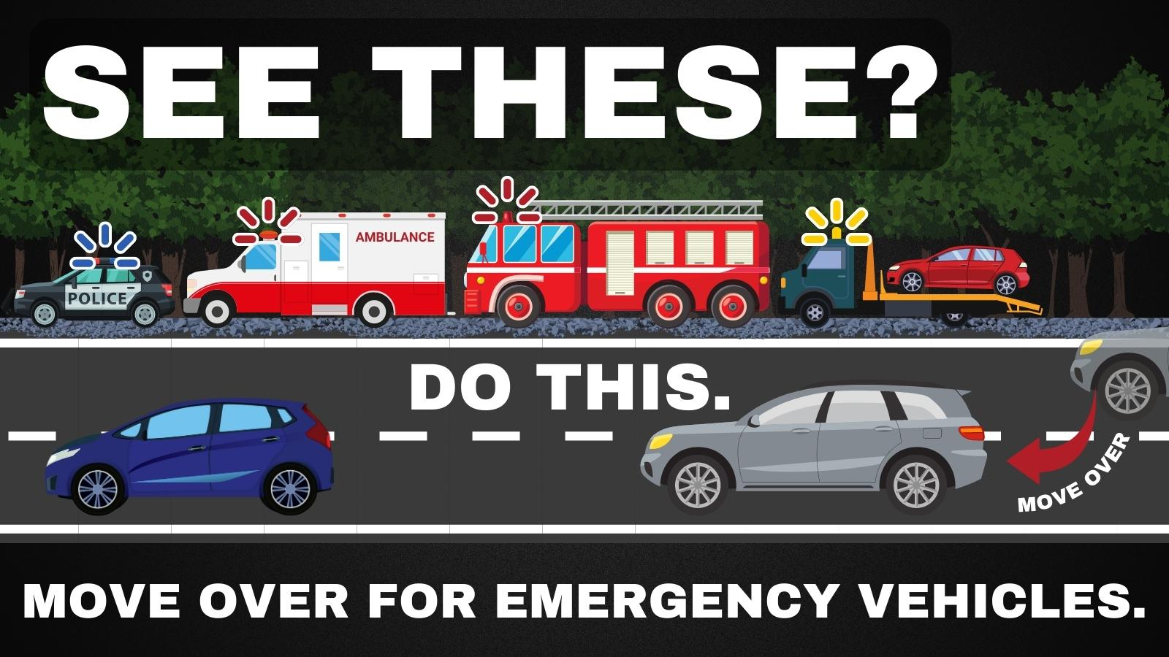
Why Emergency Medical Services(EMS) Identification?
High risk to EMS crews: 1,312 fatalities (1992–2011, NIOSH) and ~4.8 crashes per 100k responses.
Every minute counts: Urban response is 8–14 min; cutting 1 minute could save up to 10,000 lives/year (NHTSA).
AV perception gap: >50% of AVs misidentify EMS vehicles in urban occlusion/low-visibility tests (2020 study).
Notes:
The National Institute for Occupational Safety and Health (NIOSH) reported that from 1992 to 2011, there were 1,312 fatalities among EMS personnel in the U.S. due to vehicle-related incidents.
EMS vehicles are involved in traffic accidents at a rate of about 4.8 per 100,000 responses
The average EMS response time in urban areas is typically between 8 to 14 minutes. Delays can be critical, as each minute of delay in providing medical care can decrease the chances of survival for patients, particularly in cases of cardiac arrest and severe trauma
A study by the National Highway Traffic Safety Administration (NHTSA) found that a 1-minute reduction in EMS response time could save up to 10,000 lives annually in the United States
A 2020 study found that over 50% of AVs tested in urban environments struggled to correctly identify EMS vehicles, especially in scenarios with occlusions or poor visibility
Source: National Highway Traffic Safety Administration, part of the U.S. Department of Transportation: Move Over: It's the Law | NHTSA

Slide 3
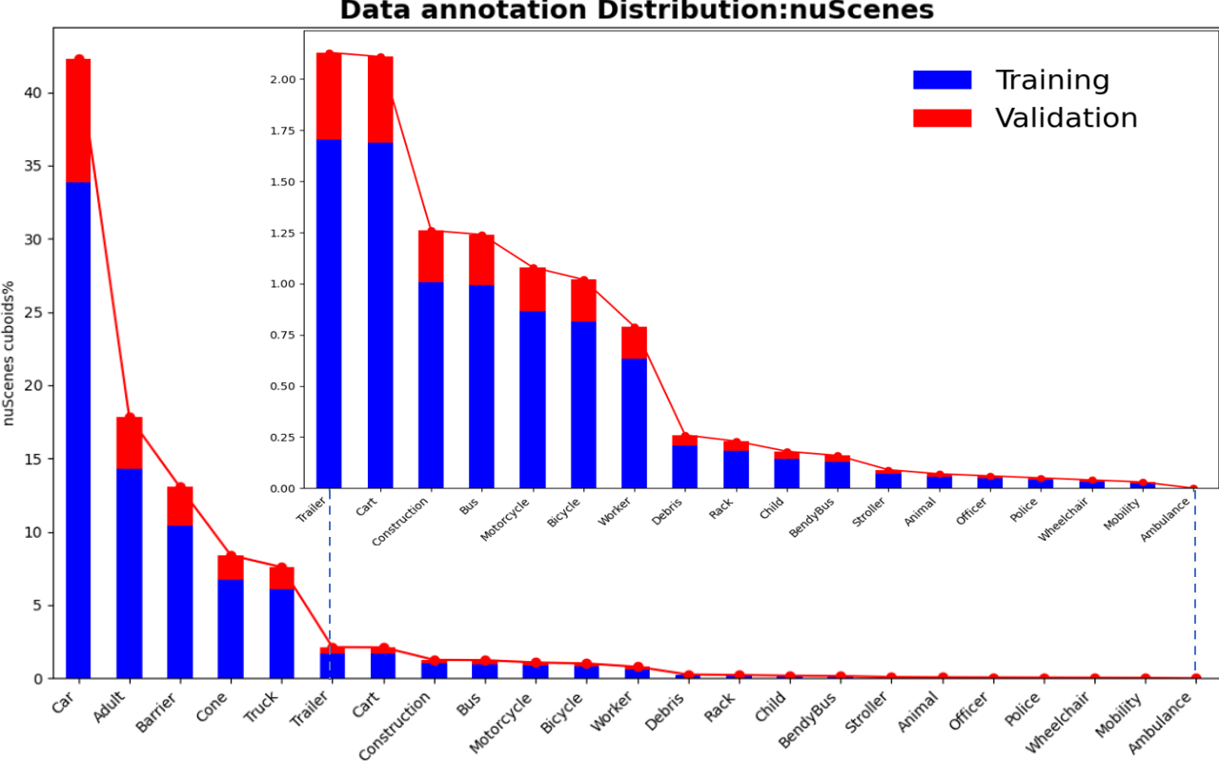
Current Challenges with the EMS Identification:
Data gap & labels: Public datasets lack EMS examples, often with no distinct EMS class and imbalanced/inconsistent annotations.
Model blindness: Too few EMS samples in training → weights don’t learn EMS features → misses/misclassifications.
Perception limits & fix: Forward-only FOV misses EMS from cross-traffic/behind; add multi-view sensing and siren/audio cues to trigger reliable detection.
Notes:
NuScenes Data
Most of the publicly available datasets do not include enough EMS vehicles.
Imbalance annotation of these vehicles.
There is no separate class for these EMS vehicles.
Missed in training, so model weight parameters don’t have the EMS.
Forward Field of View (FOV) doesn’t identify the EMS coming from other directions.
New Idea for using the sound to identify the EMS(Why Emergency Vehicle Detection is Vital for the Autonomous Future (cerence.com)

Slide 4

Fixing EMS Data Scarcity (CARLA → KITTI)
Society,
Road Safety, Economic
Impact?
Simulate EMS-rich scenes (CARLA)
Auto-label EMS objects
Package in KITTI (with calibration)
Train & Validate
Notes:
Simulate EMS-rich scenes (CARLA): generate the missing long-tail (ambulance/police/fire) across weather, lighting, and occlusion.
Auto-label EMS objects: high-quality class/3D boxes for RGB + LiDAR, then quick QA.
Package in KITTI (with calibration): a consistent format that the 3D stack can ingest immediately.
Train & Validate: blend synthetic + real in MMDetection3D (PointPillars/SECOND/3DSSD) to rebalance classes, boost EMS AP/mAP, and approach <100 ms perception latency for real-time use.
Synthetic Data: Artificially generated data used to mimic real-world scenarios, crucial for training models when real-world data is limited or difficult to obtain.
Annotation: The process of labeling synthetic data with relevant information, such as object classes and locations, to train machine learning models.
KITTI Dataset: A standard benchmark dataset for autonomous driving used to ensure that synthetic data is formatted and labeled consistently for effective model training.
Simulation: An open-source simulation environment that generates realistic driving scenarios and synthetic data for autonomous vehicle research.
Training Deep Learning Models: Using the annotated and formatted synthetic data to improve the performance and generalization of autonomous driving models.

Slide 5
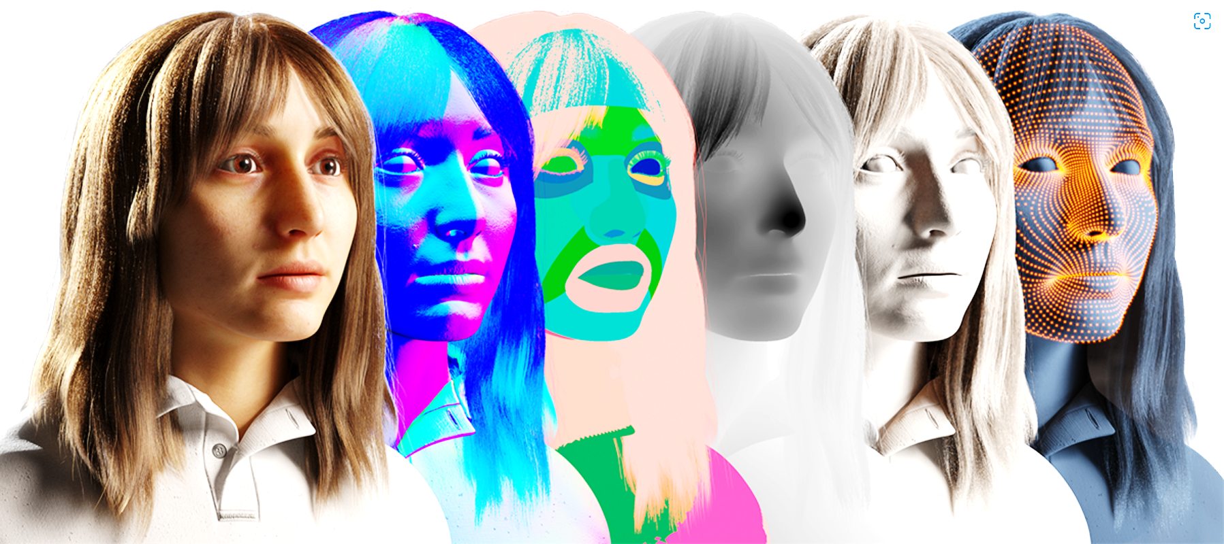
Previous Approaches — Data Generation
Physics-based simulation in various engines; realism & exact replication can be hard.
GANs / neural rendering learn distributions but need seed data and can be unstable.
Cut-paste compositing is fast/cheap, but weak on scene context & realism.
Notes: “These generated data help, but they’re not targeted to EMS and often don’t give me controllable edge cases.”
Fig: https://synthesis.ai/synthetic-data-guide/
Notes:
Synthetic Data Generation
The use of synthetic data began in the 1960s, initially for generating simple line drawings for computer vision algorithms [1],[2].
Over time, it evolved to serve as test sets for algorithms like the Lucas-Kanade optical flow method [3].
With the development of deep learning, synthetic data has expanded its applications beyond computer vision, becoming a training source in fields such as neural programming [4], bioinformatics [5], and natural language processing [1],[6]. Below are some more famous approaches.
Physics-based Simulations:
Faces hurdles in achieving accurate replication.
Generative Adversarial Networks (GANs) and neural network-based rendering^{[7]} methods.
Excel at learning accurate data distributions.
GANs confront issues with unstable convergence^{[8]}, necessitate existing datasets.
Ineffective when authentic images are unavailable.
Cut-paste ^{[9]} is an alternative method for placing object cut-outs onto random backgrounds.
Simple to implement.
Lacks contextual awareness.
Hindering its ability to simulate objects within a scene realistically.

Slide 6
Process Pipeline
Offline Work: Build the EMS focused dataset & model
CARLA
Sensors
(RGB/LiDAR
KITTI
Calib
MMDet3D
Model
Eval
Online : On Car Runtime(<100 ms end-to-end)
Camera
LiDAR
Perception Ego Vehicle(Trained Model)
Encode Event(CAN)
ECU(Consume event)
Action
Notes:
Electronic Control Units (ECUs) in Vehicles/Controller Area Network (CAN) Bus(SAE build)
ECUs are embedded systems designed to control various vehicle functions, such as fuel injection, airbags, air conditioning, and power steering)
ECUs communicate with each other via the CAN bus, which facilitates the flow of information between them. This communication is crucial for the proper functioning of various vehicle systems)
Synthetic data, a significant player, particularly when objects are in a trailing situation in a Public data set, offers unique insights and potential for innovation.
EMS is the Key backbone for the city to function properly.
CARLA provides the possibility of domain adoption for various variations.
EMS vehicles are spawned with a fair contribution to the traffic in CARLA.
Ego vehicle was spawned, and sensor data were recorded.
These sensor raw data were processed to format in 3D object detection model dataset.
Later, this can be used for various 3D deep learning models.
Spawn the Cars/Bikers/Pedestrians and EMS vehicles in CARLA.
Keep the distribution of EMS vehicles count with a fair presence.
Spawn the Ego vehicle and attach the camera and LiDAR to the Ego vehicle.
Set the CARLA into synchronous mode so that the Client controls it.
Have control of the CARLA world tick.
Capture the raw sensor data with each tick.
Add all the calibration matrices to Convert this raw data to 3D KITTI format.

Slide 7
CARLA Towns with Towns features and focus
Town 1 | A small, simple town with a river and several bridges.
Town 2 | A small simple town with a mixture of residential and commercial buildings.
Town 3 | A larger, urban map with a roundabout and large junctions.
Town 4 | A small town embedded in the mountains with a special "figure of 8" infinite highway.
Town 5 | Squared-grid town with cross junctions and a bridge. It has multiple lanes per direction. Useful to perform lane changes.
Town 6 | Long many lane highways with many highway entrances and exits. It also has a Michigan left.
Town 7 | A rural environment with narrow roads, corn, barns and hardly any traffic lights.
Town 10 | A downtown urban environment with skyscrapers, residential buildings and an ocean promenade.

Slide 8
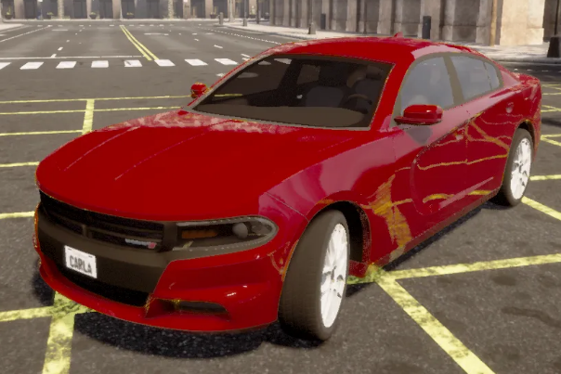
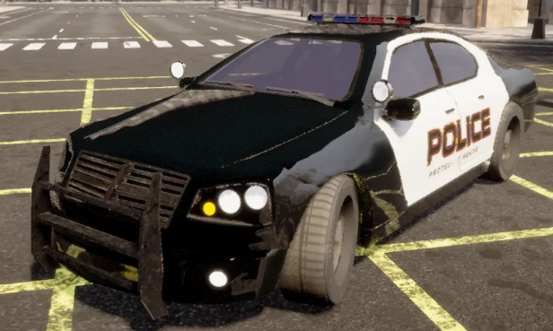
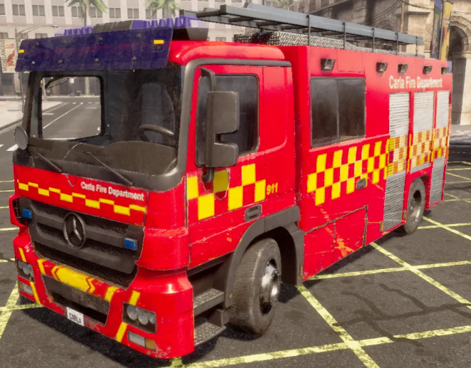
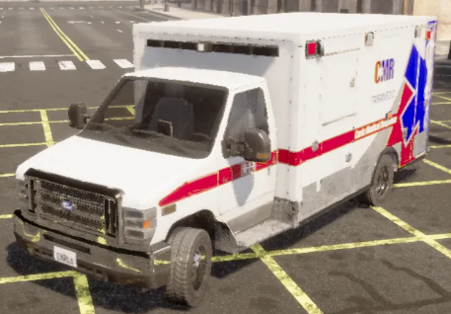
Sample from Carla
The samples from CARLA illustrate that structural and shape similarities can enhance the model’s ability to generate more accurate predictions semantically closer to the ground truth.
Car Dodge - Charger 2020
Dodge - Police Charger
CARLA Motors - Firetruck
Ford - Ambulance

Slide 9
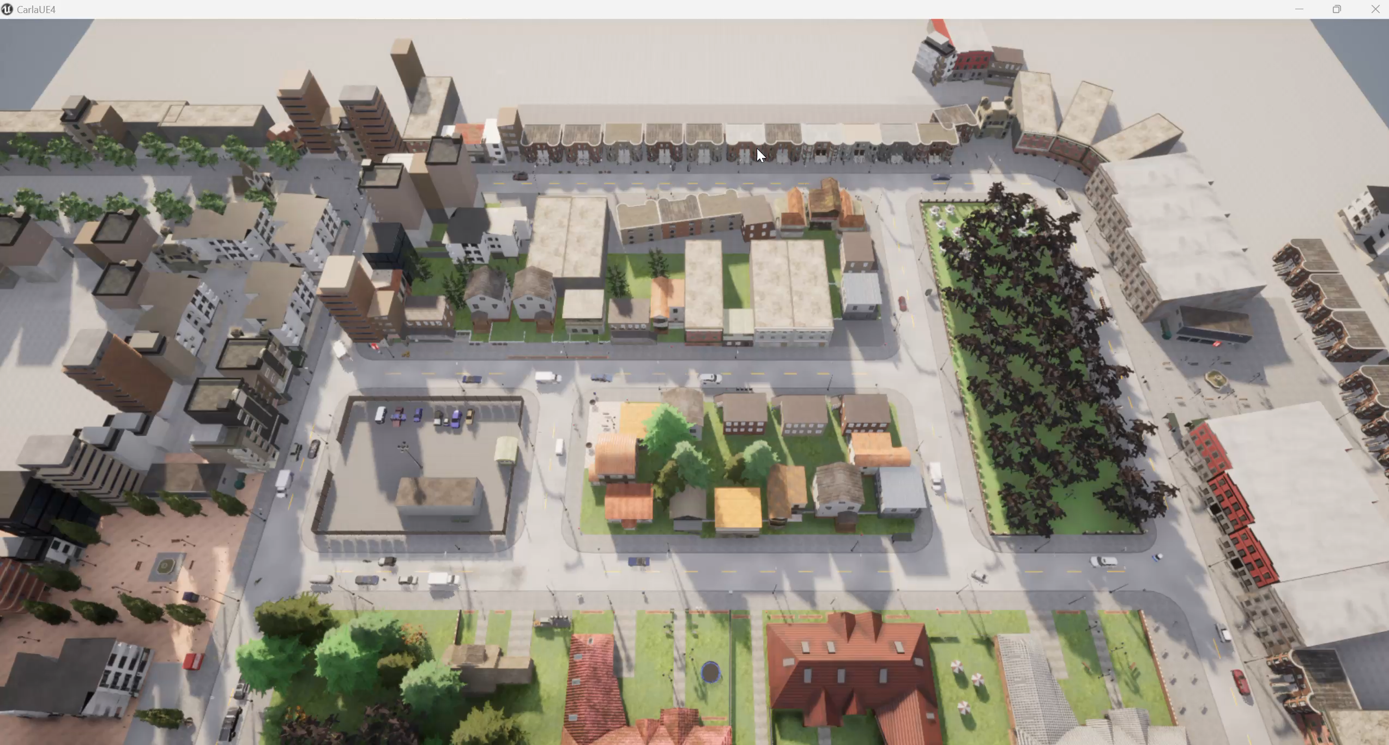
Recording during Simulation Running

Slide 10
Distribution of objects and classes for the investigated Categories
Group Category | Total Objects | Class | Distribution in the Map | Class Percentage | Group Percentage
Vehicle | 27 | Vehicle | random | 33.75 | 50%
 | 13 | Vehicle | specific | 16.25
EMS Related Object | 10 | Ambulance | Random | 12.5 | 25%
 | 10 | Police | Random | 12.5
Pedestrian | 20 | Walker | Random | 25 | 25%

Slide 11
Data Collection → KITTI Packaging
Collection in CARLA
Sensors: RGB camera + LiDAR; camera & LiDAR poses saved per frame
Execution: Autopilot for vehicles/bikers & EMS (ambulance/police); 3,000 frames/town, every 3rd saved to reduce near-duplicates
Scene hygiene: pedestrians not on AI control; heavy vehicles removed to reduce incident zones; all spawned objects saved with 3D boxes
KITTI Formatting
Scope filters: objects ≤150 m, inside LiDAR FOV, with occlusion flags (0, 1, 2, −1)
Per-frame bundle:
calibration (cam/LiDAR),
image,
labels (class + 2D/3D boxes, trunc/occ),
LiDAR .bin
Notes:
Data collection involves setting up sensors in the CARLA simulator to capture relevant information in the KITTI format, including:
RGB camera images
LiDAR point clouds
A total of 3000 frames were ticked for each town.
Every 3rd frame was saved to avoid duplicate frames without many changes.
The camera position and LiDAR position for each frame were saved.
All the spawned objects in the scene were saved with their bounding boxes position.
Auto Pilot Mode was enabled for the following
Vehicle/Bikers
Ambulance/ Police
Ego Vehicle
AI control was not used for the Pedestrians due to slowness and traffic incidents.
As part of our efforts to enhance the Auto Pilot mode and reduce accident zones, heavy-size vehicles were removed from the scene. This action was taken to create a smoother and safer driving environment for autonomous vehicles.
vehicle.carlamotors.carlacola
vehicle.carlamotors.european_hgv
vehicle.mercedes.sprinter
vehicle.mitsubishi.fusorosa
Raw data collected were processed to capture
All objects within 150 meters
Within the LiDAR FOV.
With their occluded status.
0→ Fully Visible
1→ Partly Occluded
2→ Largely Occluded
-1→ Unknown or fully blinded.

Slide 12
Model Training
Models Training
Synthetic Data
The MMDetection3D was used to train the data with the following models.
Point pillar.
3DSSD
SECOND
The model was evaluated using the KITTI dataset.
Start
Trained Weight
KITTI data
Model Evaluation
AP Comparison
End
Notes:
MMDetection3D is an open-source toolbox designed for 3D object detection tasks.
Built on top of the MM Detection framework.
Provides the state-of-the-art algorithms and tools for 3D detection using data from various modalities, such as point clouds and images.
The MMDetection3D was used to train the data with the below model.
Point pillar.
3DSSD
SECOND
The model was evaluated on the KITTI data set
Install the MMDetction3D.
Train the dataset generated from Carla Town 12.
Evaluate the AP Performance on the synthetic data set.
Evaluate the performance of the KITTI 3D dataset.
Compare these and share the observation

Slide 13
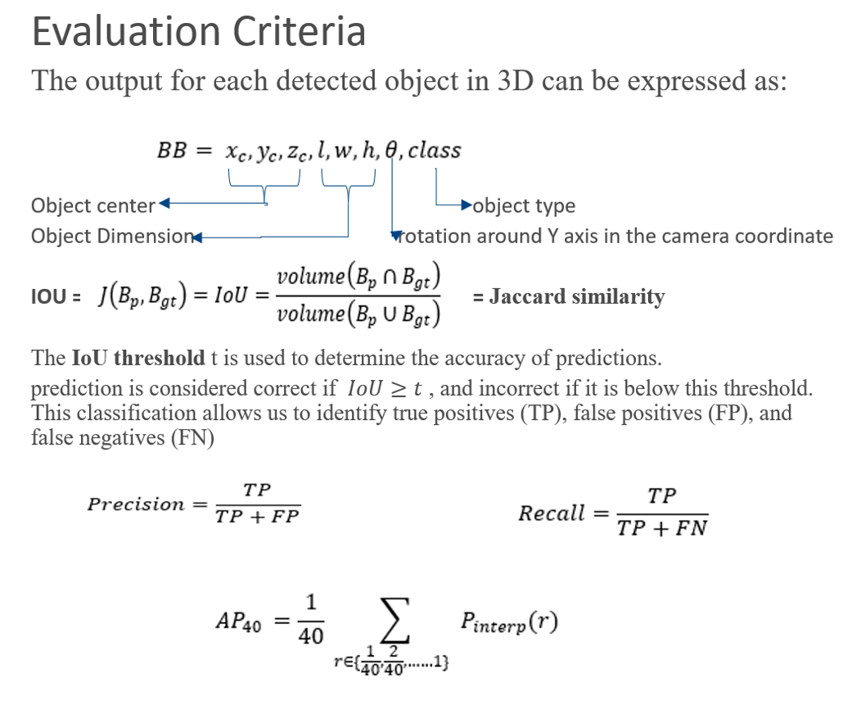
Evaluation
Notes:
A prediction is considered correct if IoU ≥ t (chosen threshold). This lets us count:
TP (true positives): predicted boxes matching GT with IoU ≥ t
FP (false positives): predicted boxes without a matching GT (or IoU < t)
FN (false negatives): ground truths with no matched prediction
The Precision-recall trade-off reflects the balance between these two metrics. Producing many bounding boxes may lead to high recall but can decrease precision, as it might include more false positives. Conversely, predicting fewer bounding boxes that the model is confident about can increase the precision but may lower the recall, as it might miss some relevant objects. Balancing these metrics is essential, making selecting an appropriate IOU threshold crucial. When plotting precision against recall on a curve, the area under the curve(AUC) is an important metric that includes both high precision and recall.
Average Precision(AP) is typically used to calculate the Area Under the Curve(AUC). In the KITTI benchmark, a 40-point interpolation is employed, which means that the precision-recall curve is interpolated at 40 equally spaced points.

Slide 14
Results
Data Collection for Investigated Towns
Each consecutive third frame was saved.
A total of 41,842 objects were captured. Individual class contribution is shown below:
Frames → 3,000
Cars → 21,747
Ambulance → 10,103
Bikers → 5,151
Police Car → 4,449
Pedestrians → 204
Not classified →188
This Dataset has been made Public with the Journal in Data in brief https://doi.org/10.1016/j.dib.2024.111221
Data identification number: https://doi.org/10.5281/zenodo.13824217
Direct URL to data: https://zenodo.org/records/13824218
Town | Frames | Cars | Ambulance | Bikers | Police | Pedestrian | Don't Care
1 | 1000/3000 | 2,414 | 989 | 550 | 264 | 118 | 17
2 | 1000/3000 | 5,418 | 2,141 | 531 | 653 | NA | 9
3 | 1000/3000 | 1,324 | 611 | 717 | 315 | 49 | 25
4 | 1000/3000 | 993 | 191 | 946 | 205 | 95 | 7
5 | 1000/3000 | 2,036 | 808 | 294 | 514 | 24 | 111
6 | 1000/3000 | 2,743 | 784 | 949 | 845 | 141 | 15
7 | 1000/3000 | 3,385 | 2,958 | 428 | 851 | NA | 4
10 | 1000/3000 | 3,434 | 1,621 | 736 | 802 | 204 | NA
Total |  | 21,747 | 10,103 | 5,151 | 4,449 | 204 | 188

Slide 15
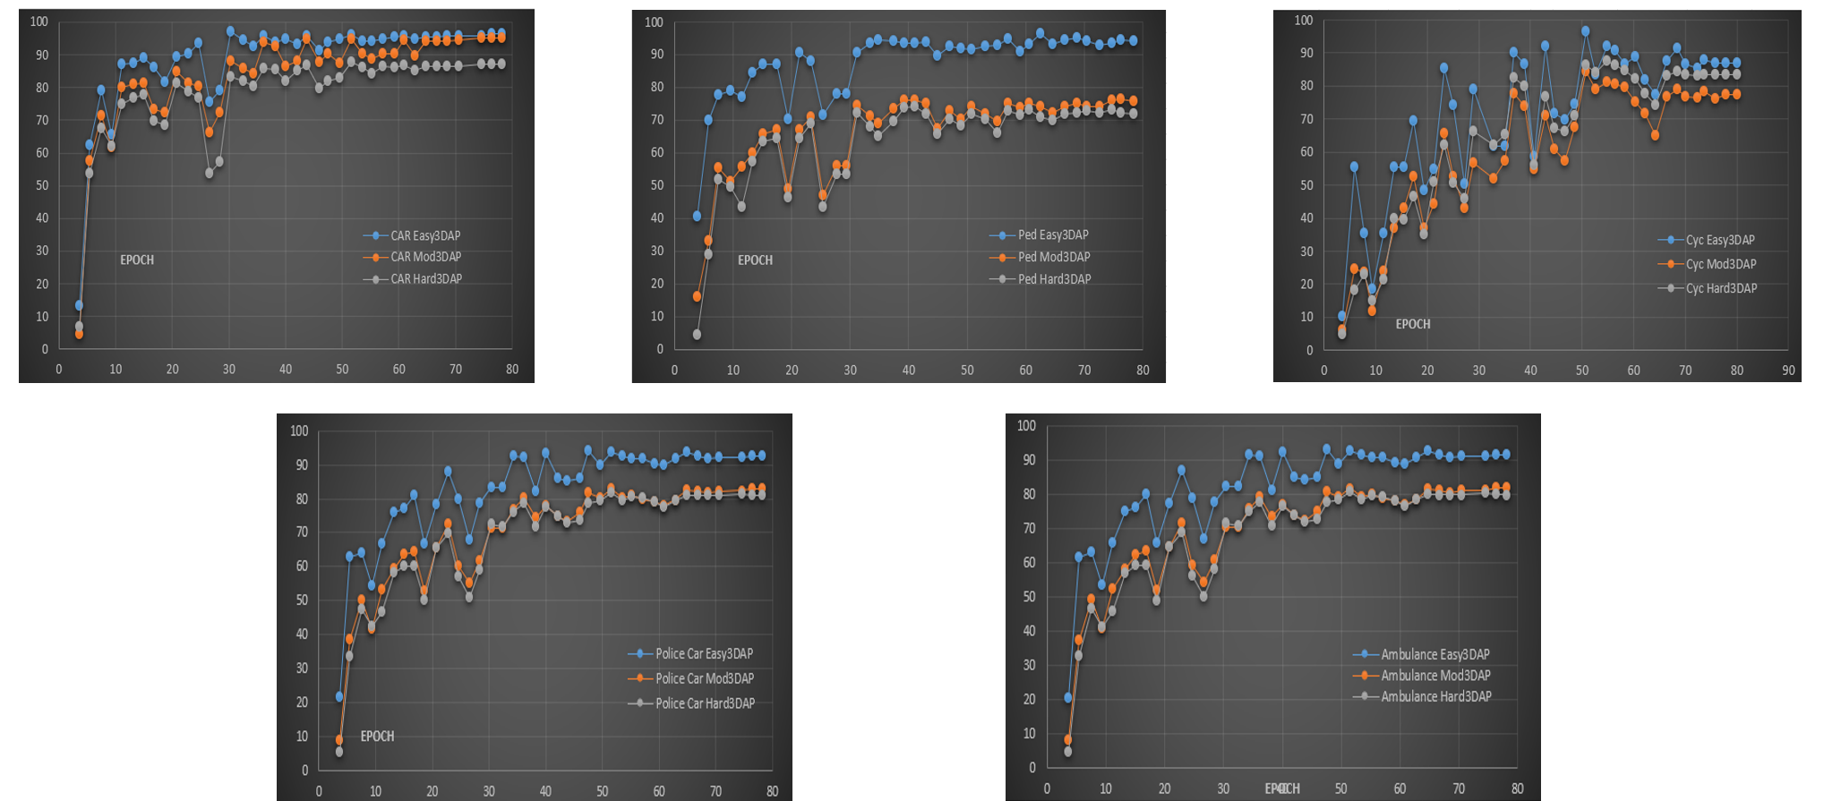
Results
Point Pillars
Dataset objects and splitting distribution

Slide 16
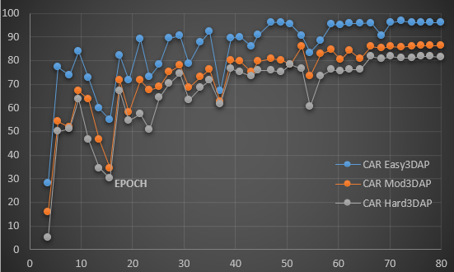
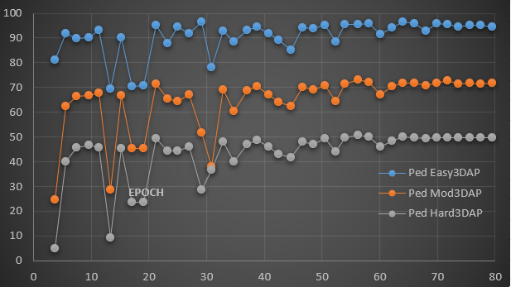
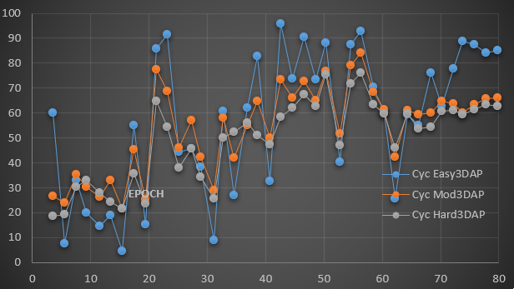
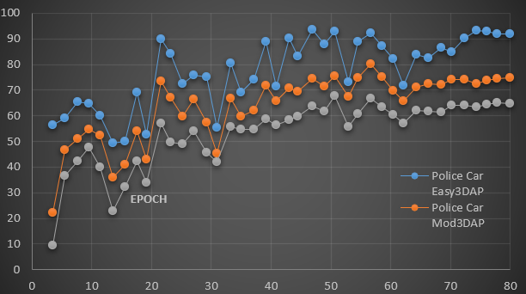
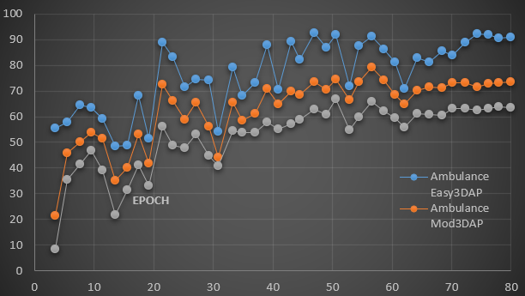
Results
Second

Slide 17
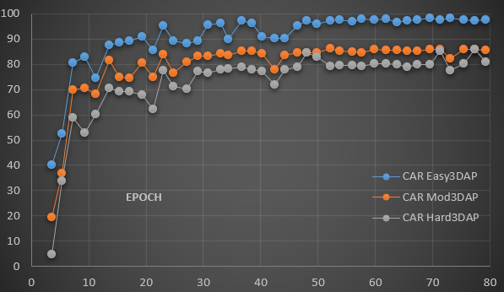
Results
3DSSD

Slide 18
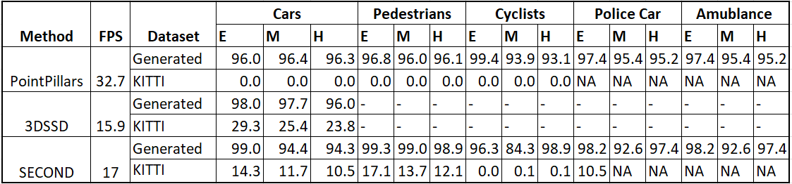
Results
Object Detection Methods Outcomes based on Synthesized Dataset and KITTI Validation Set

Slide 19
Observation and Conclusion- Data-Centric Impact & RTC Relevance
Stronger training signal: faster early-epoch convergence and better generalization with domain randomization → fewer EMS/rare-object misses.
Fix the long tail: reproducible CARLA→KITTI EMS set fills the public benchmark gap, and serves as a generator to rebalance classes toward distribution neutrality.
Why RTC cares: more reliable, stable detections (fewer false negatives/oscillation) reduce reprocessing and decision stalls — easier to meet tight latency budgets without changing the RTC stack.
Notes:
We observed quicker learning early in training and better robustness when we randomized weather/lighting/occlusion.
Public datasets lack a true EMS benchmark; our CARLA→KITTI flow acts as a repeatable source of EMS examples and a tool to rebalance the dataset.
The net effect is steadier perception outputs. That stability helps real-time systems meet latency targets because there’s less back-and-forth from false negatives or uncertain detections.
Sensors → Perception → Decision → Video Stream → WebRTC Channel → Remote Operator
Annotate latency numbers (e.g., “< 100 ms inference budget”).
RTC engineers, perception is another low-latency stream. This pipeline integrates with WebRTC’s real-time loop for safety supervision

Slide 20
Q & A

