Slide 1

Coverage Above and Beyond
T-Satellite

Slide 2
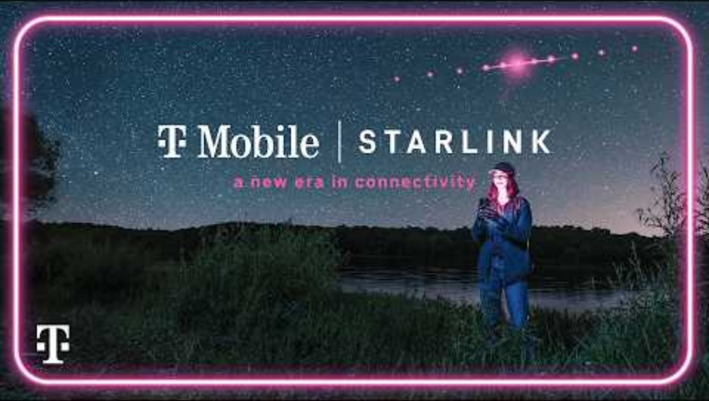

Slide 3
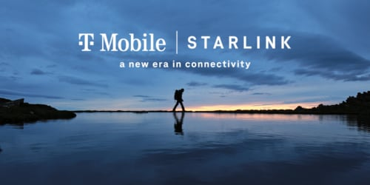

Slide 4


LEO Satellites Used to Provide Coverage
Constellation of satellites moving at 17,500 miles per hour (ii)
It takes about 90 minutes to complete an orbit of the planet. (ii)
3GPP LTE Technology
SpaceX will broadcast T-Mobile’s PCS Spectrum (Band 25). Specifically, the PCS G-block 1910-1915MHz and 1990-1995MHz will be used under a spectrum lease agreement.(iii)
First group of satellites with Direct to Cell capability launched January 2nd, 2024 and 6 days later the 1st successful txt messages were sent and received. (iv)
T-Satellite Beta Service Launch: February 9th, 2025. the first and only space‑based mobile network in the U.S. that automatically connects to your phone in areas no cellular network reaches. (v)
T-Satellite Commercial Launch: July 23rd, 2025. (vi)
17,500 mph
~220 miles (i)
Source: https://www.pcmag.com/news/to-improve-starlink-speeds-spacex-wants-to-orbit-satellites-closer-to-earth
Source: http://Space.com/low-earth-orbit
Source: https://docs.fcc.gov/public/attachments/DA-23-338A1.pdf
Source: https://api.starlink.com/public-files/DIRECT_TO_CELL_FIRST_TEXT_UPDATE.pdf
Source: https://www.t-mobile.com/news/network/t-mobile-starlink-beta-open-for-all-carriers
Source: https://www.t-mobile.com/coverage/satellite-phone-service

Slide 5
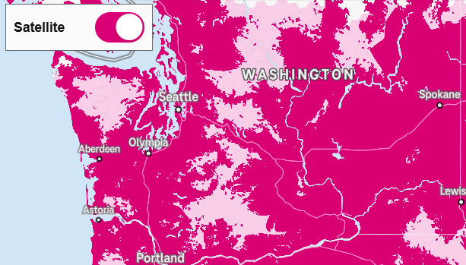
How can Direct to Cell Satellite Coverage help?
T-Mobile Coverage: Washington State
There are geographical areas where terrestrial wireless networks just simply are not able to cover!
National Parks do not typically allow wireless network infrastructure (power, backhaul, towers) to be built.
Mountain passes and recreational areas have historically been difficult to cover due to the terrain and heavy tree foliage.
Providing coverage to these areas would be beneficial to mobile customers and could provide life saving connectivity.
T-Mobile 4G/5G Coverage
North Cascades Hwy
Satellite SMS Coverage
Olympic
National Park
Source: T-Mobile 4G/5G Coverage Map, February 2025
https://www.t-mobile.com/coverage/coverage-map

Slide 6




NTN is complementary (not a mobile network replacement)
The amount of spectrum allocated to NTN vs terrestrial is a major contributor when comparing system capacity.
Terrestrial Mobile Networks are able to increase capacity by adding more cells (sites) to densify the capacity of the network.
NTN networks have an advantage of providing coverage over wide areas, however the capacity per square mile is fixed.
NTN has challenges providing additional capacity if the traffic demand is localized.
Mobile Network Density
NTN Fixed Coverage Grid
Rural Areas
All Areas
Urban
Dense Urban

Slide 7
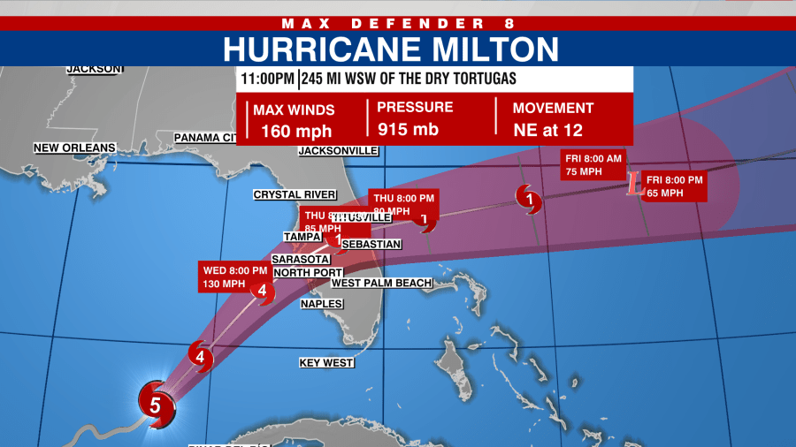
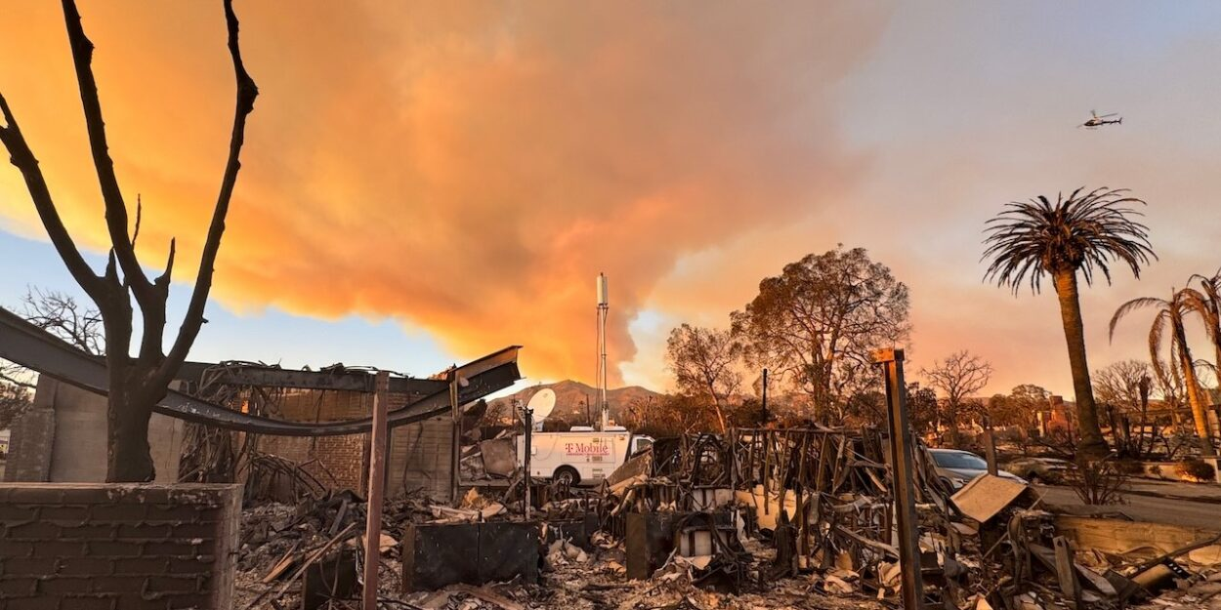
Service Offering and Emergency Coverage Enablement
Hurricane Milton near Florida (Oct. 2024)
Vision to provide text message coverage, including Text to 911 and WEA practically everywhere in continental US, Hawaii, parts of Alaska, Puerto Rico and territorial waters. (i)
In Florida over the first 48 hours, the service was used to broadcast over 120 Wireless Emergency Alerts (WEA) from public safety agencies — hurricane warnings, evacuation notices, flood warnings — both in advance of Milton and when it made landfall. It has also enabled over 100K SMS messages to be sent and received. (ii)
T-Mobile’s Starlink Direct-to-Cellular was enabled in the greater Los Angeles area. During the 1st week have served approximately 198,000 users, sent/received around 96,000 SMS messages and transmitted 21 wireless alerts (WEA). (iii)
Wild Fires near Los Angeles (Jan. 2025)
Source: https://www.t-mobile.com/news/un-carrier/t-mobile-takes-coverage-above-and-beyond-with-spacex
Source: https://www.t-mobile.com/news/network/hurricane-milton
Source: https://www.t-mobile.com/news/network/t-mobile-stands-prepared-as-wildfires-impact-southern-california

Slide 8

Devices with the service will continue to grow
Satellite networks work differently from traditional cellular networks, so to ensure the best possible experience, smartphones need to be satellite optimized. We’re collaborating with our handset partners to optimize as many smartphones as possible, starting with newer devices.
These devices will work with T-Mobile Starlink (this list will be updated over time in 2025) (i):
Apple iPhone 14 and later (including Plus, Pro & Pro Max)
Google Pixel 9 (including Pro, Pro Fold, & Pro XL)
Motorola 2024 and later (including razr, razr+, edge and g series)
Samsung Galaxy A14, A15, A16, A35, A53, A54
Samsung Galaxy S21 and later (including Plus, Ultra and Fan Edition)
Samsung Galaxy X Cover6 Pro
Samsung Galaxy Z Flip3 and later
Samsung Galaxy Z Fold3 and later
REVVL 7 (including Pro)
WEA also made available to non-optimized devices regardless of carrier.
Source: https://www.t-mobile.com/coverage/satellite-phone-service
Notes:
https://www.t-mobile.com/coverage/satellite-phone-service

Slide 9





Text to 911
Routing to a local PSAP or Text Relay center is supported
“Callback” number and precise location is supported
The Text Relay center covers cases where Text to 911 service to a PSAP is unavailable
Device location unavailable
PSAP serving the area is not text capable
Text Relay center confirms incident information including location and brokers communication with PSAPs as needed
“This emergency text session is over satellite. The user cannot place a voice call. Messages may be delayed.”
PSAP Routing
MNO
Text Control Center (TCC)
PSAP
SCS
Text Relay
Text to 911 Path
Voice 911 Path

Slide 10
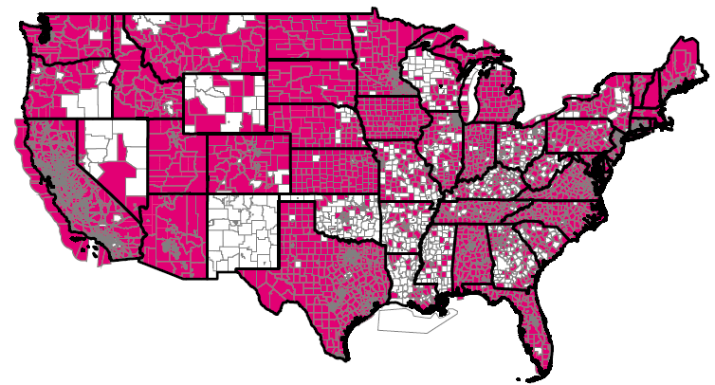
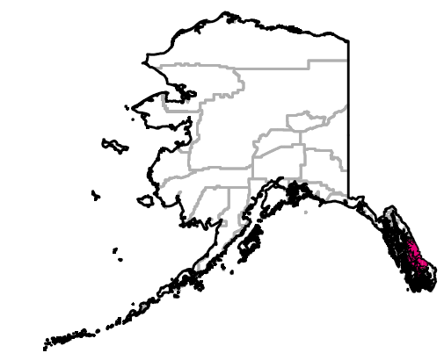

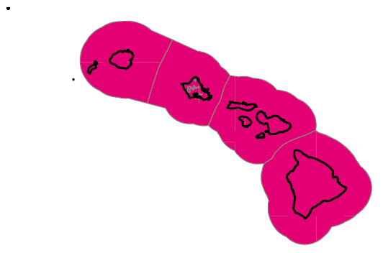
Text to 911 Service PSAP Readiness
Current Availability
PSAP Counts
Approximately 5,100 primary PSAPs Nationwide
85% support Text to 911 service
No additional preparation required from PSAP to receive SCS Text to 911
Roaming Support
T-Mobile Text to 911 is supported regardless of home terrestrial coverage if device location is available
PSAPs must submit an RFS

Slide 11
Thank You

