Slide 1
6G – The Next Generation of Connectivity
Eric Hagerson

Slide 2
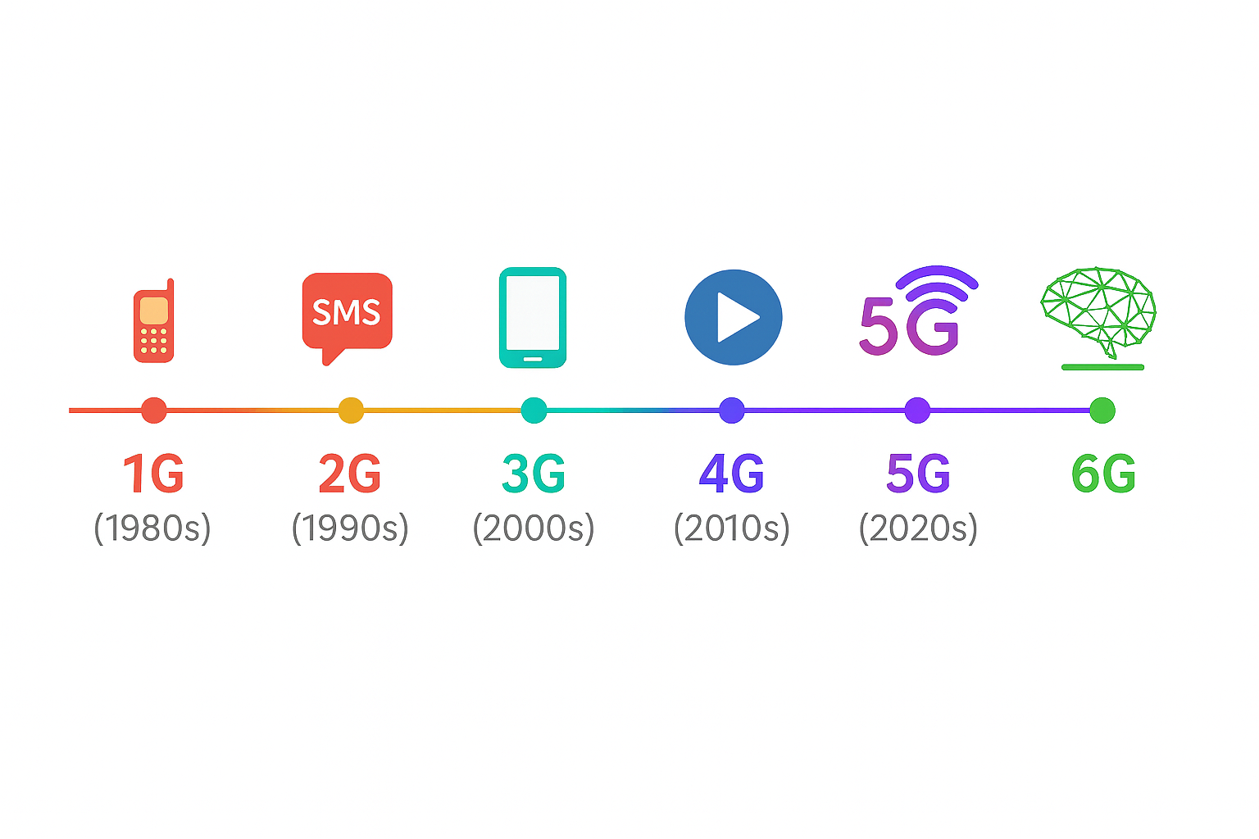
Mobile Networks Evolution
1G (1980s): Analog voice
2G (1990s): Digital voice + SMS
3G (2000s): Mobile internet
4G (2010s): Broadband + apps economy
5G (2020s): High speed, low latency, IoT
6G (2030s): Intelligence + immersion

Slide 3
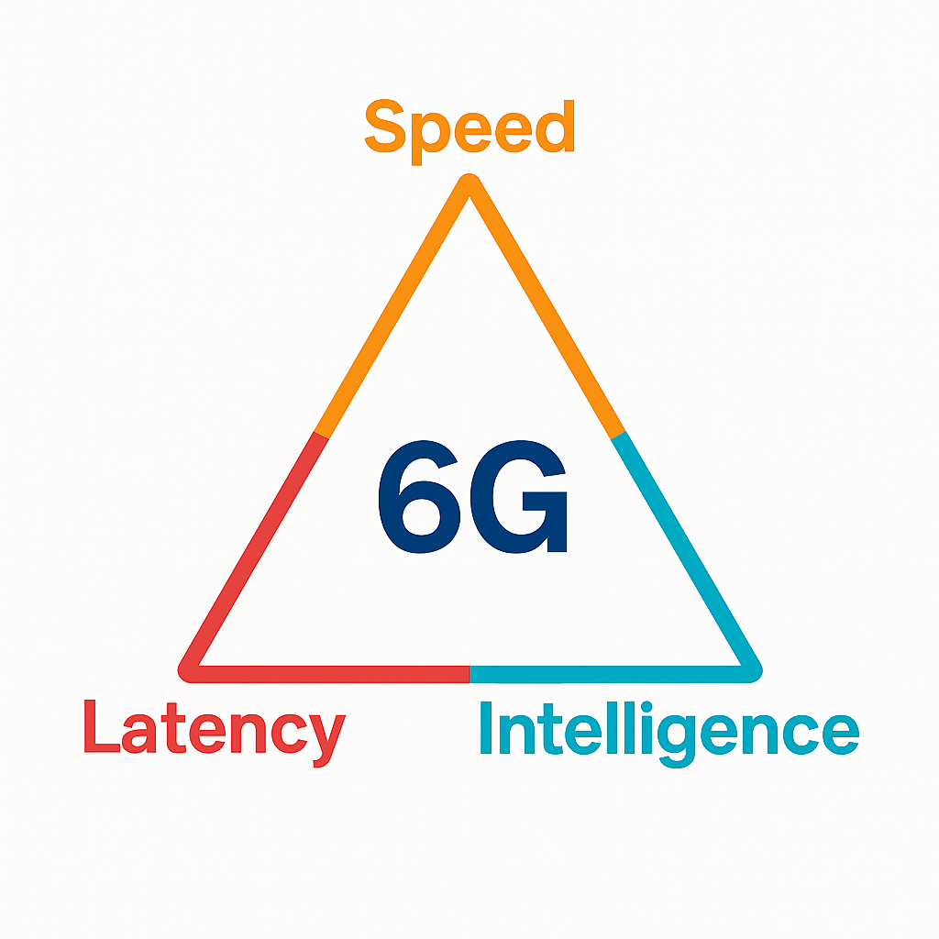
What is 6G?
Up to 1 TBPS Speeds
Sub-MS Latency
Upper Mid-Band Spectrum
AI-Native Architecture
Fusion:
    Physical
    Digital
    Biological

Slide 4
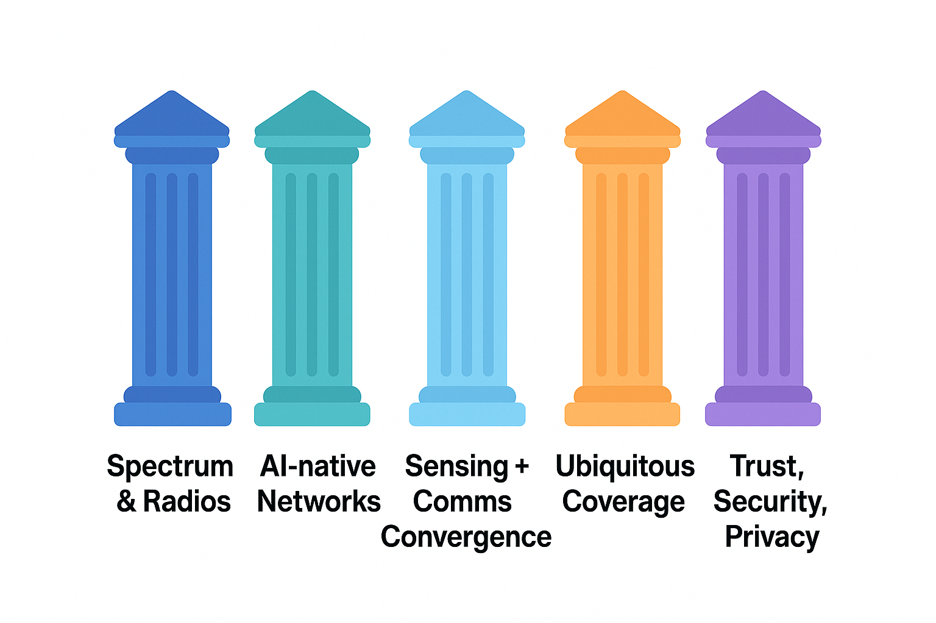
Core Technology Pillars

Slide 5
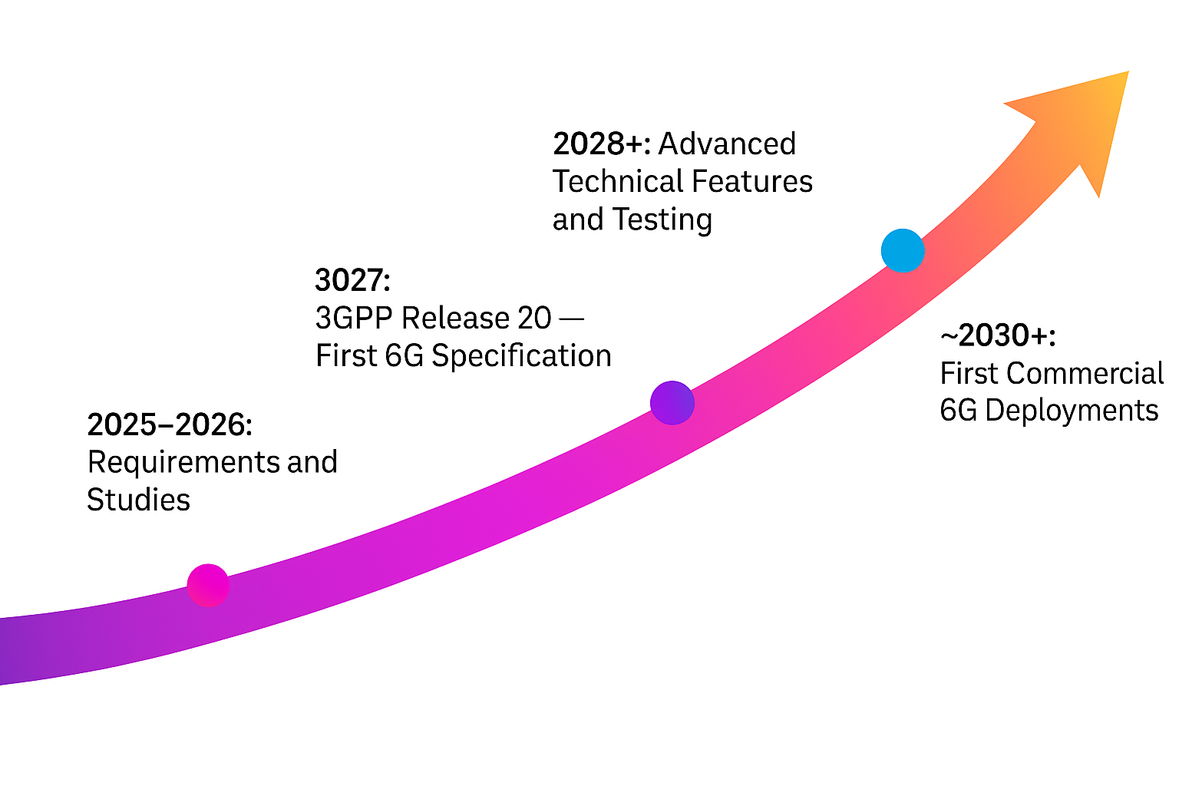
Standardization Efforts

Slide 6
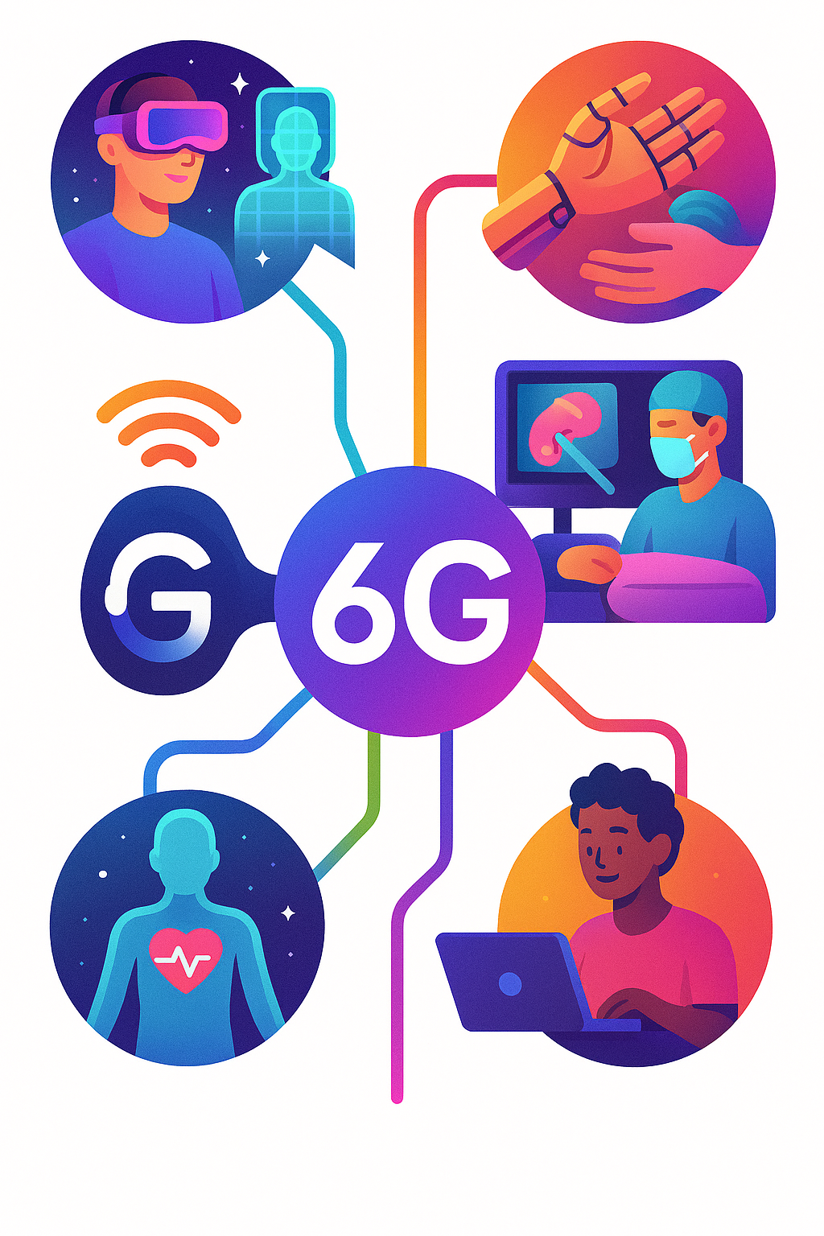
Use Cases
Immersive XR & Holography
Tactile Internet
Remote Surgery
3D Digital Modeling
  Cities
  Factories
Body-area Health Sensors
Further Close Digital Divide

Slide 7

Challenges & Considerations
Spectrum Harmonization
Propagation Issues
Energy Consideration
Security, privacy, trust
Business models & cost

Slide 8

Conclusion
6G is more than faster 5G
New Intelligence Integration Paradigm
Ubiquitous Connectivity

