Slide 1

Wi-Fi Threat Detector
Deep Learning + RF Fingerprinting Framework
Anees Fatima, Dr. Mohammad salam
Dept of CIMST
Chicago state university

Slide 2


Motivation and Problem Statement
Common Wireless Threats Include:
MAC Address Spoofing: Enables identity obfuscation and unauthorized access.
Rogue Access Points: Deceive legitimate clients and facilitate man-in-the-middle attacks.
Beacon and Probe Flooding: Conduct denial-of-service (DoS) attacks via excessive management frames.
Passive Sniffers: Exploit open-channel communication for unauthorized monitoring.
Limitations of Conventional IDS Approaches:
Predominantly operate at the network or transport layers.
Rely on protocol-based signatures, which are susceptible to spoofing and evasion.
Lack visibility into the physical-layer, rendering them ineffective against stealthy RF-based threats.
The widespread adoption of wireless technologies in IoT, smart cities, and critical infrastructure has greatly expanded the attack surface. Wi-Fi, as the dominant protocol, is especially vulnerable due to its open broadcast nature and weak physical-layer security.

Slide 3

Research Objective
Primary Objective
To develop a real-time, physical-layer intrusion detection framework for Wi-Fi networks by leveraging RF fingerprinting in conjunction with deep learning architectures.
Key Contributions
Utilization of unique RF signal characteristics (CSI, RSSI, spectrograms) for device and behavior profiling.
Implementation of a hybrid CNN-LSTM model to capture both spectral and temporal patterns.
Achieving low-latency, high-accuracy detection using commodity hardware (e.g., SDRs and Intel 5300 NICs).
The system aims to enhance wireless security under Zero Trust principles, where no device is inherently trusted, and continuous verification is essential.

Slide 4

Threat Model
Adversarial Capabilities
Operates within proximity of the target wireless environment.
Employs MAC spoofing, traffic injection, and SDR-based impersonation (e.g., HackRF, WiFi Pineapple).
Launches rogue AP deployments, probe/beacon floods, and passive signal interception.
Defensive Architecture
Passive RF monitoring via SDR and CSI-enabled devices.
Classification of malicious patterns using deep learning-based analysis at the physical layer.
No active probing or dependency on existing network infrastructure.

Slide 5
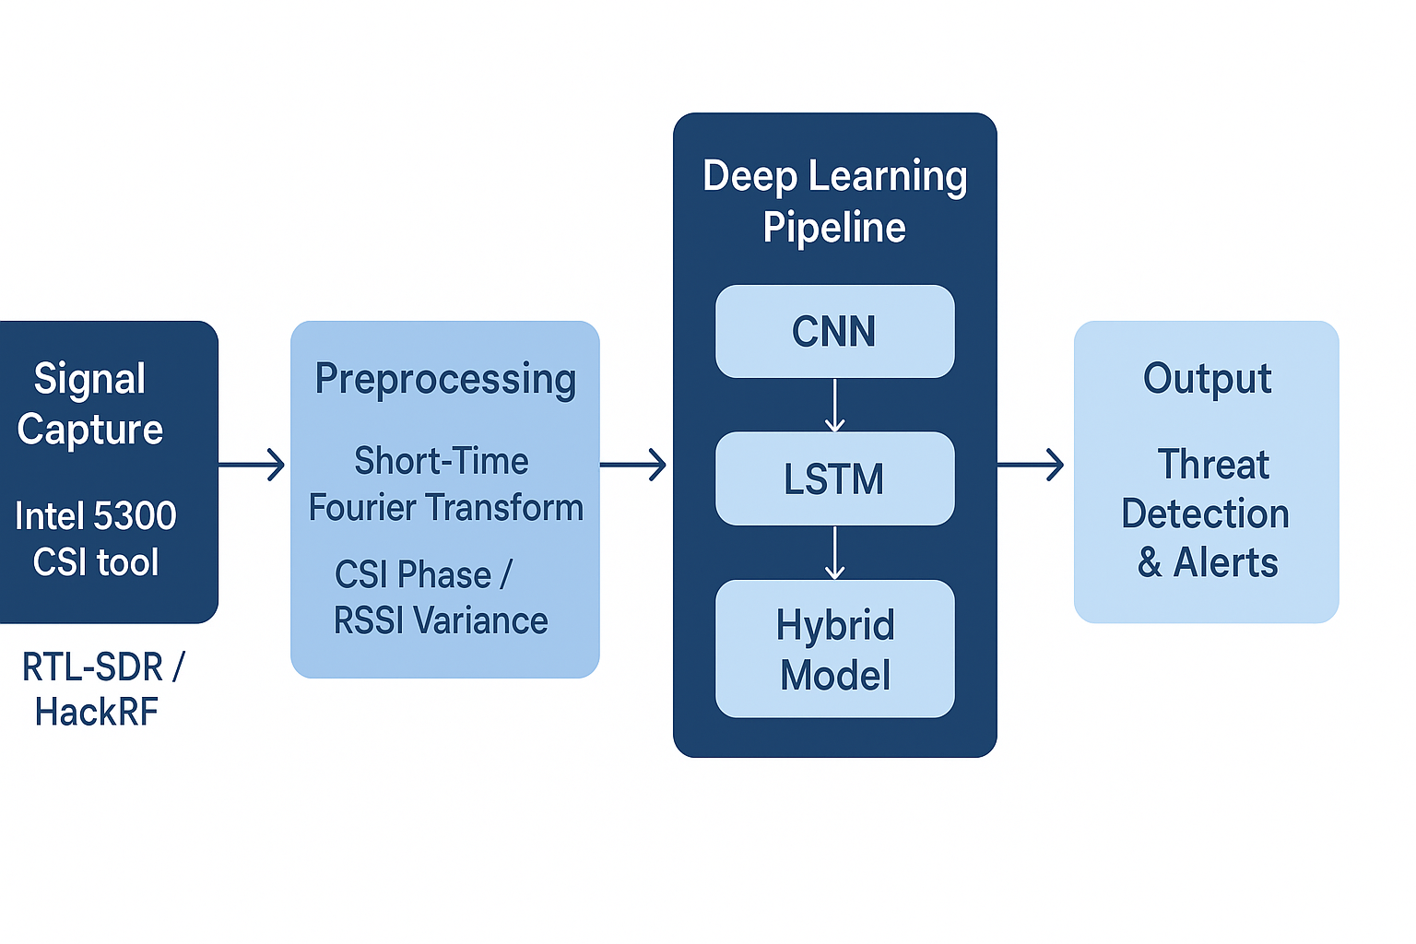
System Architecture

Slide 6

Methodology
Data Acquisition
10,000+ RF samples collected across benign and malicious devices.
Signals captured include I/Q data, CSI amplitude/phase, and RSSI metrics.
Preprocessing and Feature Engineering
Spectrogram generation using STFT for CNN input.
Extraction of time-series features for LSTM processing (e.g., CSI phase difference, variance).
Normalization and data augmentation applied to ensure model robustness.
Model Design and Training
Hybrid CNN-LSTM architecture trained using supervised learning.
Evaluation via 5-fold cross-validation to prevent overfitting and ensure generalization.

Slide 7

Experimental Setup
Dataset Composition
Benign Devices: IoT sensors, smartphones, laptops operating under normal conditions.
Attack Scenarios:
  MAC spoofing
  Rogue access points
  Beacon/probe flooding (DoS)
  Passive sniffing via SDRs
Hardware
Signal Capture
  Intel 5300 NIC for CSI extraction
  RTL-SDR and HackRF for I/Q sampling
Computation
  Intel i7 processor
  32GB RAM
  NVIDIA RTX 3060 GPU
  Software Stack
GNU Radio for SDR control
TensorFlow and PyTorch for model training and inference
Flask for real-time alert dashboard and visualization

Slide 8
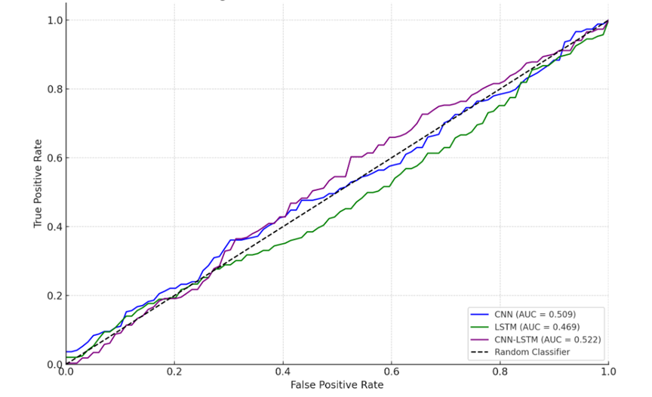
Results and Performance Evaluation
Observations
The hybrid model demonstrates superior performance due to its ability to concurrently extract spatial and temporal patterns.
Maintains low latency, enabling real-time application.
Model | Accuracy | Precision | Recall | Latency
CNN Only | 98.2% | 97.9% | 97.5% | 210 ms
LSTM Only | 97.5% | 96.8% | 96.9% | 290 ms
CNN + LSTM (Hybrid) | 98.9% | 98.5% | 98.8% | 240 ms
AUC-ROC Curves

Slide 9
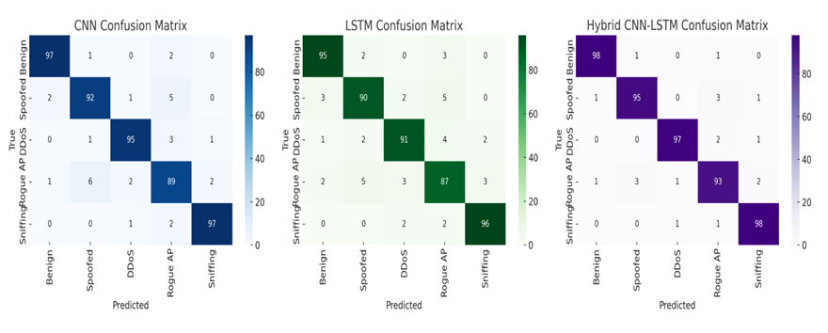
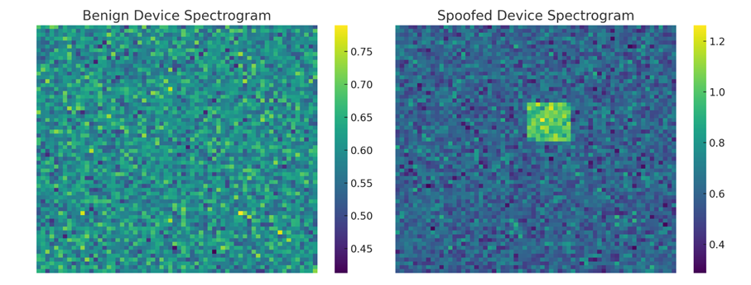
Confusion Matrices for three models
Spectrogram Heatmaps (Benign vs. Spoofed)

Slide 10
Comparative Analysis with Existing Solutions
Technique | Spoofing Resistant | Accuracy | Latency
Signature-Based IDS | ✗ | ~70% | ~50 ms
MAC/IP Anomaly Detection | ✗ | ~85% | ~100 ms
WiFi Threat Detector | ✔ | 98.9% | ~280 ms
Unlike protocol-level IDS solutions, the proposed approach offers resistance to spoofing and identity obfuscation by analyzing non-replicable physical-layer characteristics.

Slide 11



Real-World Application Scenarios
Smart Home Networks
Detection of unauthorized or spoofed IoT devices
Protection against device impersonation
Smart Cities and Infrastructure
Securing public wireless services (EV chargers, drones, traffic systems)
Identification of rogue transmitters or jammers
Enterprise Environments
Real-time detection of rogue APs and sniffers
Integration with SIEM for automated mitigation

Slide 12

Discussion
Strengths of the Proposed Framework
Effective detection of stealthy and spoofed attacks using physical-layer analysis.
High classification accuracy across heterogeneous devices and environments.
Compatible with commercial off-the-shelf (COTS) hardware, ensuring deployment feasibility.
Identified Limitations
False positive rates may increase in highly congested RF environments.
Dependence on specialized signal capture equipment (e.g., SDRs, CSI-capable NICs).
Future Research Directions
Edge deployment for low-latency local inference.
Federated learning to enable distributed model training while preserving privacy.
Integration of directional antennas for geolocation and threat triangulation.

Slide 13

Conclusion
This research presents a novel intrusion detection framework, WiFi Threat Detector, that integrates RF fingerprinting with deep learning to secure wireless communications at the physical layer.
Key Achievements
Achieved 98.9% detection accuracy with real-time responsiveness (<300 ms).
Demonstrated resistance to common Wi-Fi threats such as spoofing, rogue access points, and passive sniffing.
Offers a scalable and deployable solution that strengthens wireless network defense under a Zero Trust model.

Slide 14
References
Zeng, K., et al., “Physical Layer Authentication for Wireless Security,” IEEE Transactions on Wireless Communications, 2021.
Liu, Y., et al., “RF Fingerprinting Using CSI and Deep Learning,” IEEE TMC, 2022.
Alshammari, R., “WiFi Threat Detection in IoT,” IEEE IoT Journal, 2023.
Bhuyan, M.H., et al., “Survey of Intrusion Detection Systems in Wireless Networks,” IEEE Communications Surveys & Tutorials, 2020.
WiFiLeaks Presentation, Black Hat USA, 2023.

Slide 15

THANK YOU

