Slide 1


Reliable Information is critical to communication reliability: Reliable AI, AI for Reliability
Jason W. Rupe, PhD
CableLabs Distinguished Technologist
Reliability Society President
Notes:
Reliable information is critical to communications reliability
The reliability of information is becoming a most important aspect of reliability in communication networks and especially the services these networks support. As we turn over network optimization to AI-based automation, introducing stochasticity and releasing control of more network functions for the benefits of automation and speed, we open networks to new failure modes and attack vectors dependent on the reliability of the information used. Further, as networks provide deeper connections to many more devices and enable AI, including GAI, deeper into services and our lives, reliable information is depended upon even more. It is time to formalize practices for information reliability assurance.

Slide 2

Stories from communications/cable
AI tools for network reliability
Reliable AI vs Explainable AI
GAI reliability
Information Reliability (IR)

Slide 3
Reliable AI and AI for Reliability
A journey in the cable industry
Not unlike your own

Slide 4
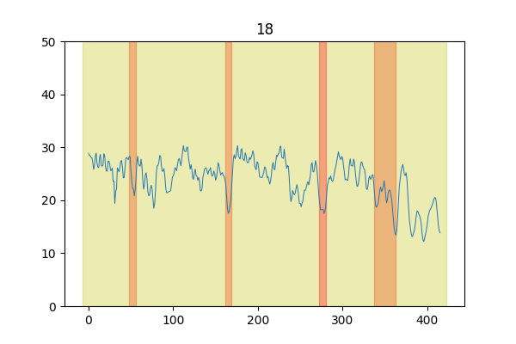
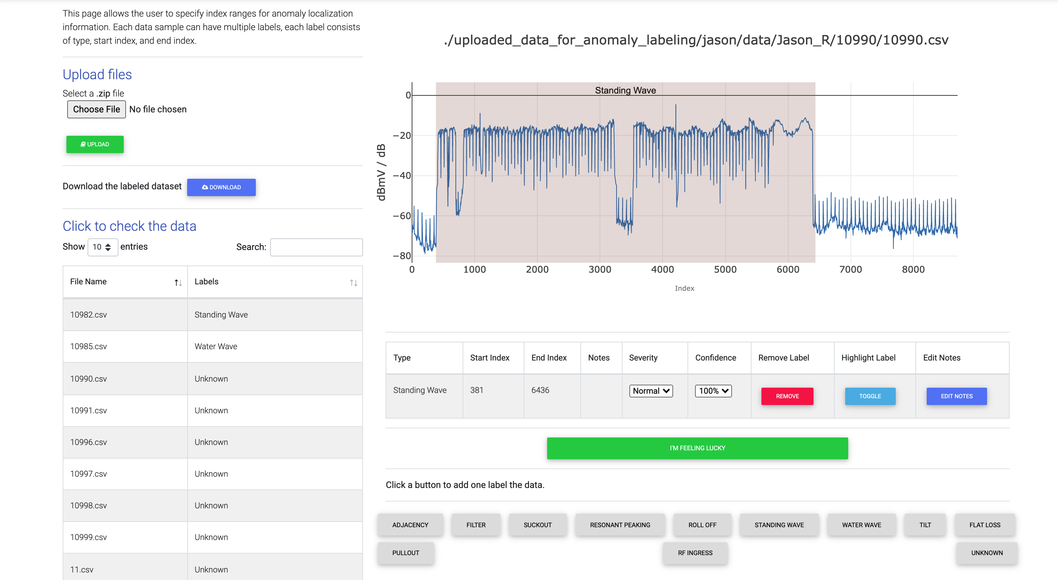
AI Tools for Network Reliability
Anomaly detection in spectrum capture and RxMER per subcarrier: the start of a journey back to where we started
J. Zhu, K. Sundaresan, J. Rupe, “Proactive Network Maintenance using Fast, Accurate Anomaly Localization and Classification on 1-D Data Series,” 2020 IEEE International Conference on Prognostics and Health Management (ICPHM), 2020.
R. Cassandro, J. W. Rupe, Z. S. Li. `` Enhancing Impairment Detection in Full-Band Capture (FBC) Downstream Spectrum Data Using Unsupervised Learning Methods,” 2023 IEEE Global Reliability & Prognostics and Health Management (GlobalRel&PHM) Conference, Hangzhou, China, 2023, pp. 1-7.
Notes:
Data labeling tool screen shot

Slide 5
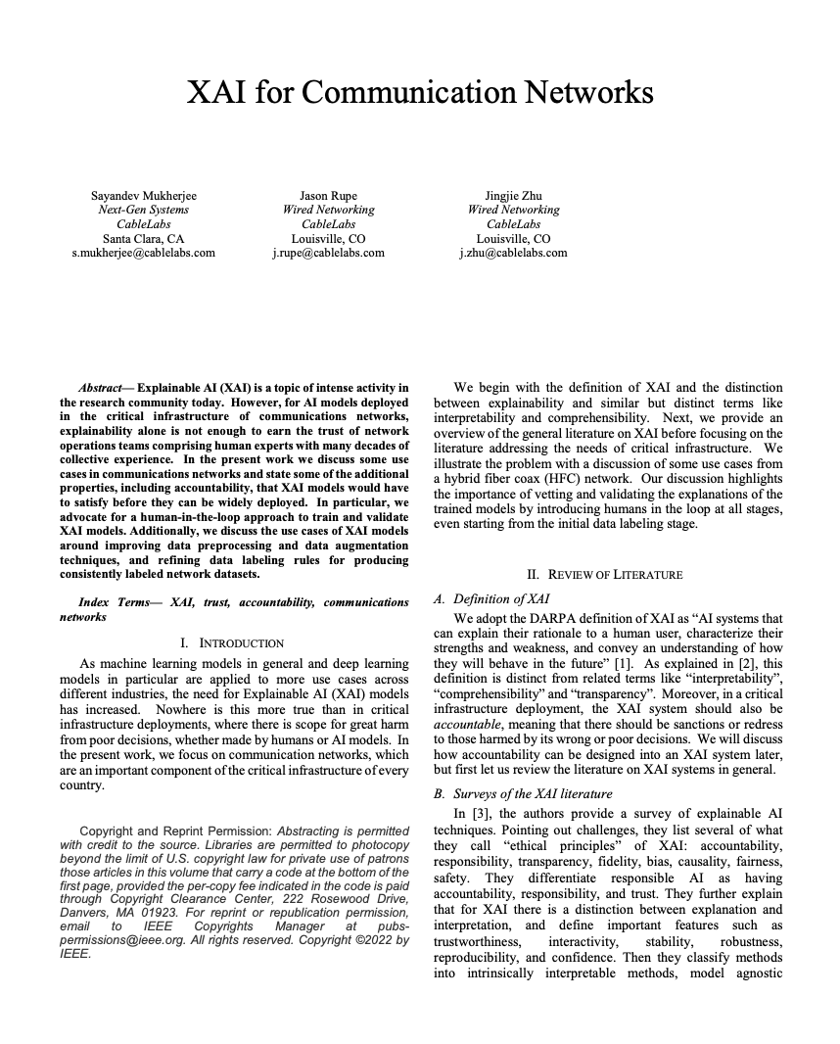
Reliable AI, Explainable AI
Garbage in, garbage out
XAI vs RatAI
XAI allows trust, verification, and thus reliability is improved
Room for trust and verify
Is fully explainable AI still AI?
S. Mukherjee, J. Rupe, J. Zhu, ``XAI for Communication Networks,” 2022 IEEE International Symposium on Software Reliability Engineering Workshops (ISSREW), 2022. (10.1109/ISSREW55968.2022.00093)
J. Rupe, J. Voas, ``Is critical thinking critical?,” Computer Magazine, 2025. (To Appear)
Notes:
XAI paper screen shot

Slide 6
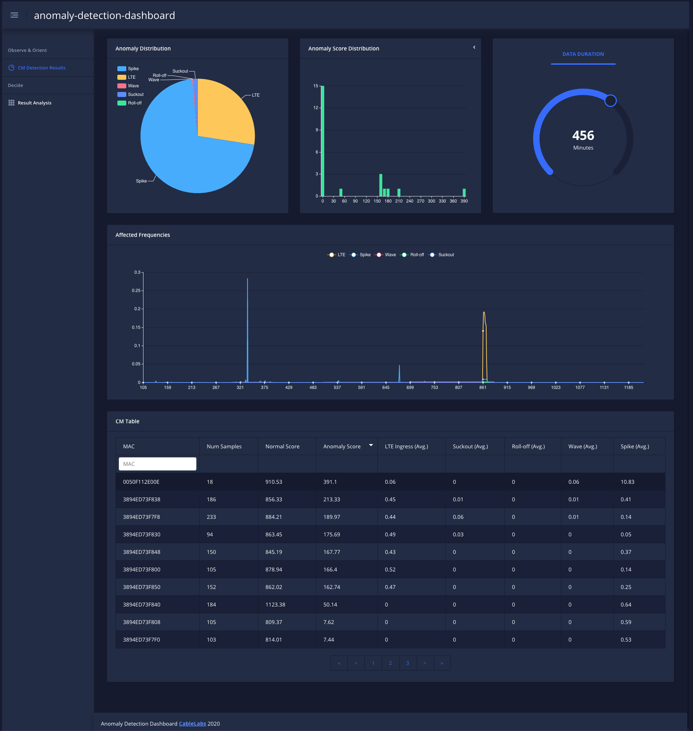
ProOps – Agentic before GAI
Dashboard Application
Work Queue
Workers
Data Stores
Act
Threshold Analyzer
Work Items
Work List
Actionable
Network Section
Stats, Trigger List, Cluster List
Control & Schedule
Decide
Trigger Analyzer
MAC
Config Server:
input files, monitoring
Orient
Decoded Data, Analysis Results
Observe
Extraction
MAC x Time
Logs
CCF
Raw PNM Data
Network
ProOps was developed to turn data into action for network ops.

Slide 7
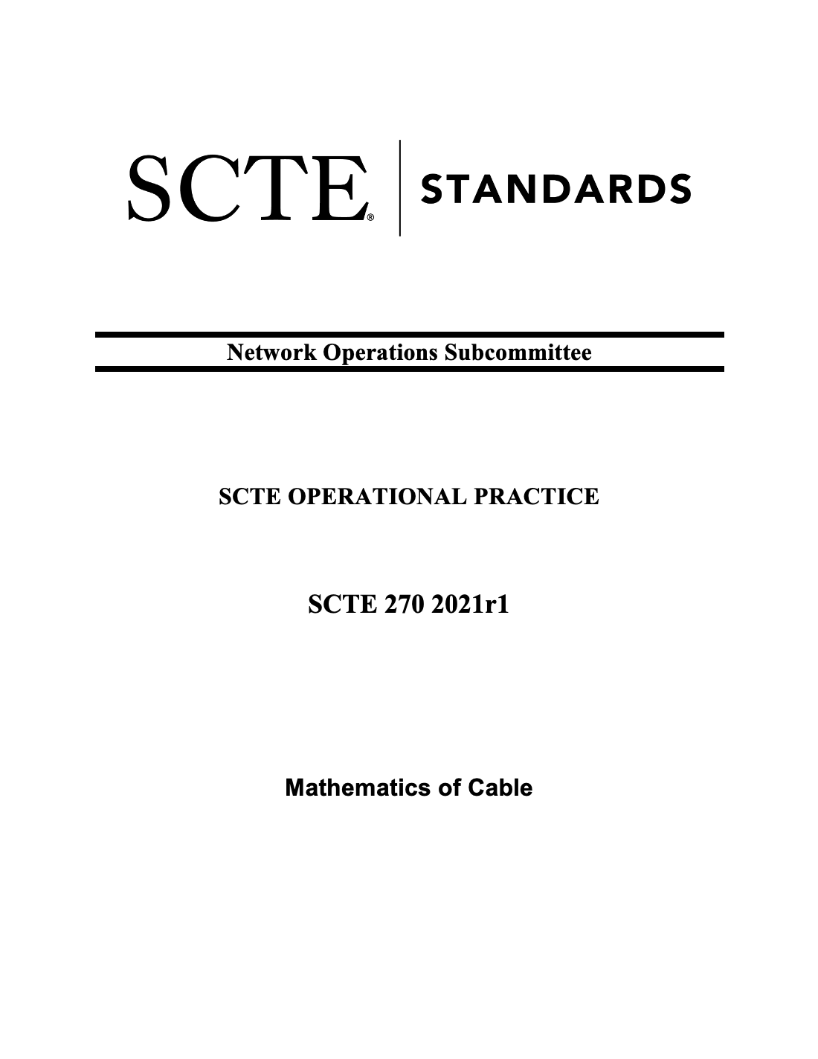
Generative AI Reliability
Automate what can be trusted, human in the loop for verification
Certification – turn to peer review(!), then close the loop
Agentic leads to explainability, reliability
Reliance is heavy on reliable, trustworthy, purpose-built information!
Human Q: | What is the peak voltage of a 80 volts peak-to-peak sine wave?
GAI A: | I did not find enough context from the given message to proceed. Please change the settings if you would like to continue without RAG.
Human A: | The peak voltage is 40 volts.
Peer Review: | See section 10.2. Arguably the model was right in that no DC value was given, so not enough context. It beat the human! WOW! Can you add the DC value and see if it figures it out please? Try "above and below a reference such as 0 volts or amps." and then again with a reference value 30. Then try "with a DC value of 0 volts or amps"
But what is the intent of the question and what makes a good and correct answer both good and correct?
Notes:
SCTE docs, certification workflow, Agentic troubleshooting tool

Slide 8
Better testing, better review
Q/A review 2.0
Stronger criteria
Poor wording/grammar
Incorrect details
Vague questions or requests
Non sequitur
Deliberate focus
Question type coverage
Correct
Clear
Informative
Instructive
Focused
Supported

Slide 9
ChatGPT says…
🟢 Level 1: Simple Factual Questions
🟢 Level 1: Simple Factual Questions
Question Types
Limiting and Expanding
﻿🟢 Level 1: Simple Factual Questions
﻿🟡 Level 2: Conceptual or Definition Questions
﻿🟠 Level 3: Analytical or Comparative
﻿🔵 Level 4: Contextual or Applied Questions
﻿🔴 Level 5: Open-ended or Speculative Questions
﻿⚫ Level 6: Meta or Philosophical Questions
﻿🔹 1. Scope
﻿🔹 2. Depth
﻿🔹 3. Context
﻿🔹 4. Perspective
﻿🔹 5. Constraints
﻿🔹 6. Timeframe
﻿🔹 7. Certainty

Slide 10
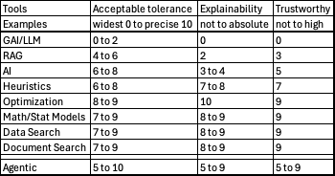
Suitability of methods (GAI, AI, other)
Bare GAI is great for generative tasks where humans can correct
RAG improves precision but not assured
Traditional methods are better suited for handling facts
Agentic architectures show promise as long as the LLMs are strictly controlled

Slide 11

Information Reliability and Critical Thinking
Information reliability (IR) is the state (probability being either 0 or 1) of the information's ability to meet its intended function adequately for a particular use instance at a specific time under determinable conditions.
Predictions of IR can be estimated [0,1].
Information used outside of its intended use is an unintended application of information or a misuse of information. It can be reliable for that intended use or unreliable.
Information is a major driving force in global economic markets.
Whether that information is true or false is unfortunately irrelevant (in many uses).
Perception is (perceived to be) more important than truth. (But this is demonstrably false!)

Slide 12
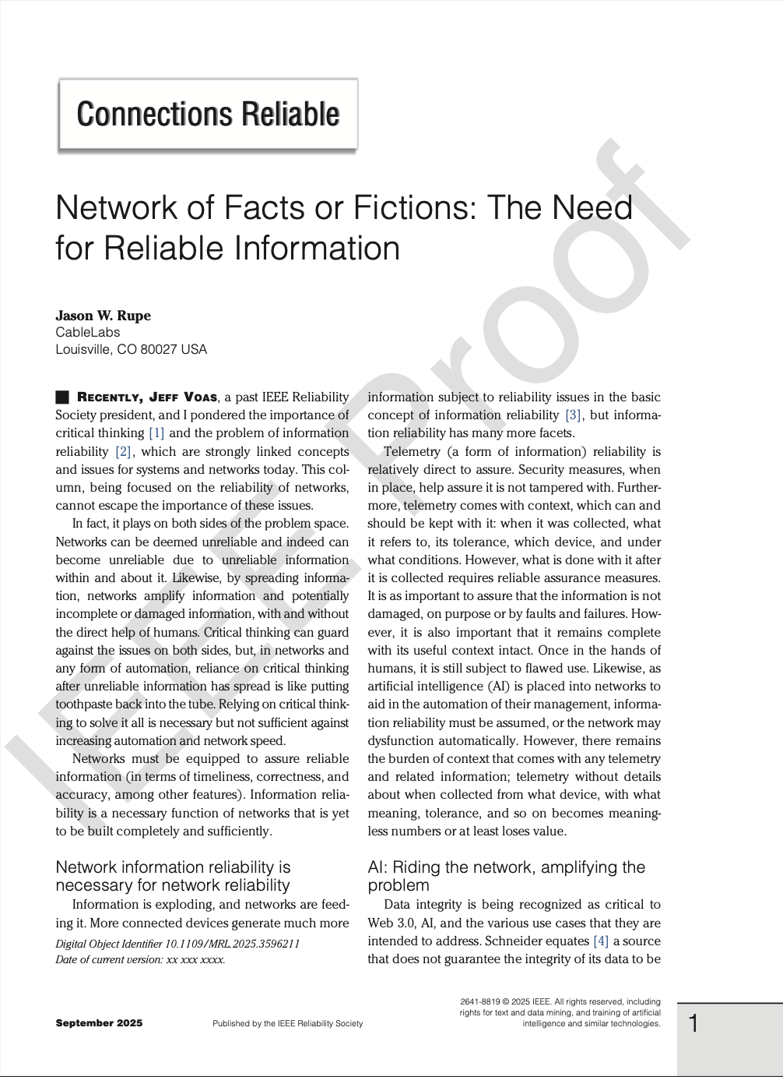
Information reliability
In network telemetry and control
Over the network

Slide 13
Reliable network information
More devices, more telemetry, more information
Network automation feeds on telemetry
Telemetry features: secure, complete context, assured proper use

Slide 14
Reliably networked information
Networks amplify GAI automation
Networks must guarantee data integrity
Importance of critical thinking with GAI use
Rationalization ≠ Explainability
AI tools to increase trust in GAI – Wikipedia, Fake News Detection,
Network functions for information reliability ?
Sequester fact from generative
Detect tampering, detect unreliable information
Incorrect information damage to networks, lives, infrastructure
Security equivalent
Increased automation and (possible) efficiency, refocus to critical thinking and information reliability assurance

Slide 15


