Slide 1

©2025 Taraxa Labs LLC
All rights reserved.
The Ecosystem Illusion:
Why Emergency Communications Platforms Make Terrible Roommates

Slide 3






Discussion
NG911 Aspirations
The Standards Fallacy
Tech
Known Unknowns
The
Ecosystem
Illusion
Inorganic
Growth Tensions
De-risking
Trans-formation
©2025 Taraxa Labs LLC
All rights reserved.

Slide 4


Expectations vs. Reality
©2025 Taraxa Labs LLC
All rights reserved.

Slide 5
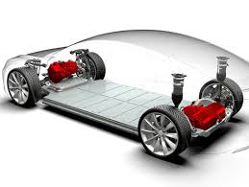
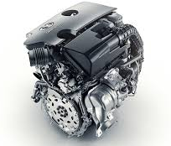
Transformation is Hard
©2025 Taraxa Labs LLC
All rights reserved.

Slide 6

Good News… AI Will Fix Everything!
©2025 Taraxa Labs LLC
All rights reserved.

Slide 7
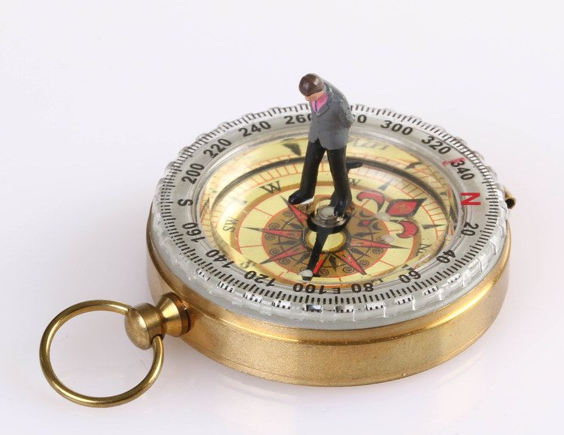
We’re Not All on the Same Journey
Technology: not all at the same starting point, architectures
Funding fits and starts
  Business case and ROI often unclear
What applications are we designing for?
  Edge/IoT?
  Victim-initiated and/or proactive intervention
This Photo by Unknown Author is licensed under Creative Commons
©2025 Taraxa Labs LLC
All rights reserved.

Slide 8
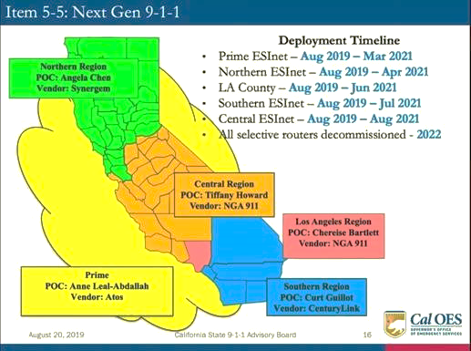
Ecosystems: Not a Panacea
If everyone owns it, no one owns it
  Demarcation?
  Handoffs?
i3 Capable ≠ Interoperable
End-to-end starts at the beginning
Listen to your IT team…they knew
©2025 Taraxa Labs LLC
All rights reserved.

Slide 9
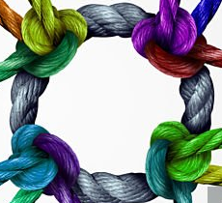
Look Behind the Curtain
“Solutions”
“Integrated”
“Suite”
“Framework”
“Hub / Core”
“Platform”
©2025 Taraxa Labs LLC
All rights reserved.

Slide 11
What’s the Impact?
Municipalities
Solution Provider
9-1-1 Center
Telecommunicators
Tension MappingTM
Regulators
Public
Tension MappingTM is a trademark of Taraxa Labs LLC
©2025 Taraxa Labs LLC
All rights reserved.

Slide 12
Investment Returns vs. the Mandate to Protect the Public
Accelerated revenue growth
Margin expansion
Predictable revenues, scaling
Cash flow optimization
Exit readiness
Product investment horizons
KPI/dashboard-driven
Solution Provider
To provide every person with fast, reliable, and equitable access to emergency services…
Public
…Ensuring responders get accurate information to protect life, health, and property.
©2025 Taraxa Labs LLC
All rights reserved.

Slide 13

Rethinking Ecosystems: Standards as the Roots
©2025 Taraxa Labs LLC
All rights reserved.

