Slide 1


Real-Time AI Voice Agents over WebRTC
A Practical Playbook
Alberto Gonzalez Trastoy
Notes:
Did you know that a 2 seconds delay in respond reduces trust and usability for 35 to 50%? That means that half of your users will be hating your app and stop using it!
Today, we’ll break down how to build real time voice AI apps.
I’m Alberto Gonzalez, CTO at WebRTC Ventures, where we focus on creating live video and audio applications. In this talk I’ll share my insights on three voice AI key topics: WebRTC, small language models, and open-source software. Let’s dive in! Sources:
Latency is the Silent Killer of Voice AI—Here's How We Solved It
Comparing Alexa and Google Home Voice Assistants | MoldStud
Why Low Latency Matters for AI Agents | Retell AI
The Impact of Latency in Speech-Driven Conversational AI Applications
The Influence of Response Time and Feedback Type on the User Experience of Voice Interaction among Older Adults | Request PDF

Slide 2

Agenda Items
Introduction to Real-Time Voice AI
Voice AI Architectures
Optimizing Prompts for Real-Time Voice AI
Benchmarking Real-Time Voice AI Performance
Demo: Customizable Open-Source Voice AI Assistant
WebRTC.ventures 2025
Notes:
In this presentation, we will first introduce the concept of real-time voice AI and its significance in various industries. Next, we will delve into small language models and their advantages. We will also cover standard AI architectures and external tools, followed by benchmarking performance techniques, and conclude with a live demonstration of an AI-powered WebRTC assistant.

Slide 3
Introduction to Real-Time Voice AI
Key Concepts, Technologies, and Use Cases
WebRTC.ventures 2025
Notes:
Real-time voice AI is transforming how industries interact with technology. This section will explore what voice AI entails and its applications across various sectors, highlighting the importance of low-latency interactions.

Slide 4

Current State of Main Voice AI Industries
Voice AI in Customer Service
AI for customer service market is projected to reach 10x in 7 years.
Voice AI in Healthcare
90% of hospitals are expected to utilize AI-powered technology for diagnosis and remote patient monitoring by the end of 2025.
Voice AI in Education and Entertainment
The Media & Entertainment segment holds the largest share, accounting for 31% of the AI voice generators market.
Sources: Market Research Future, 2025; Deepgram State of Voice AI Report, 2025; GlobeNewswire/SNS Insider, March 2025
WebRTC.ventures 2025
Notes:
Healthcare/Call Center Applications:
60% of callers hang up if left on hold for more than one minute
WebMD found that latency above 1 second increases abandonment by over 40%
10x growth in 7years
Sources:
Why Low Latency Matters for AI Agents | Retell AI
The Impact of Latency in Speech-Driven Conversational AI Applications

Slide 5

Challenges in REAL TIME VOICE AI
End-to-End Pipeline Optimization
Model Efficiency and Resource Demand
Rapid Model Evolution
Error Propagation Across Pipeline
WebRTC.ventures 2025
Notes:
OPTIMIZATION/LATENCY
Latency adds up across ASR (STT), LLM processing, and TTS. Optimizing each component and reducing inter-service overhead is essential.
COSTLY/resource demand
Some Large language models are very powerful but often too slow or costly for real-time use without optimization.
FREQUENT EVOLUTION AND CONSTANT EVALUATION REQUIRED
New models are released monthly, often outperforming previous ones in speed or quality. Constant evaluation is required to stay competitive.
ERROR PROPAGATION
Mistakes in speech recognition or synthesis can compound, especially in noisy environments or multilingual setups, degrading the user experience.

Slide 6
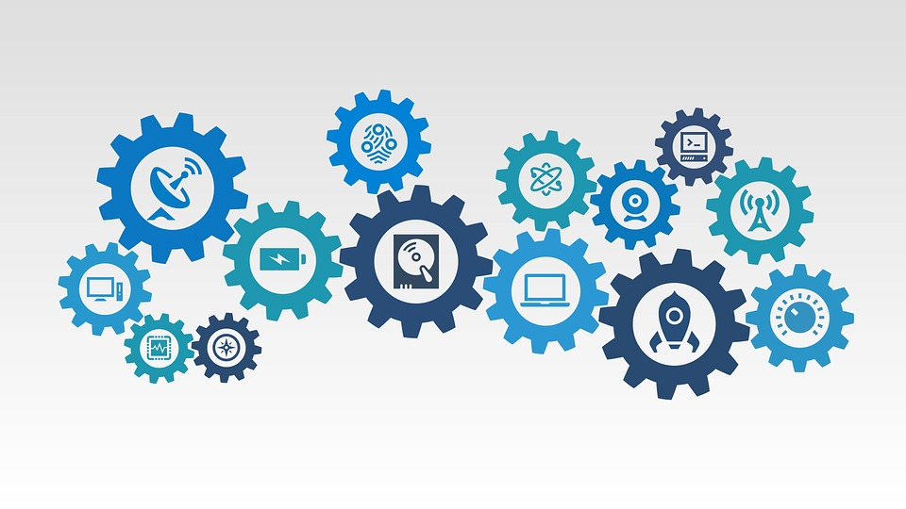

The Role of WebRTC in Real-Time Voice AI
Widely Supported and Secure
WebRTC is the backbone of most real-time communication platforms today.
Low-Latency Audio
Enables full-duplex, real-time audio with end-to-end latency as low as 100–300 ms. Critical for natural, responsive conversations in voice AI.
Adapts to the Network Conditions
WebRTC dynamically adjusts bitrate, handles packet loss, and includes built-in jitter buffers and echo cancellation maintaining clear audio even on unstable networks.
WebRTC.ventures 2025
Notes:
Why WebRTC for this? WebRTC (Web Real-Time Communication) enables peer-to-peer audio and video communication in web applications. Its low-latency capabilities make it an ideal choice for real-time voice AI applications ON THE WEB!

Slide 7
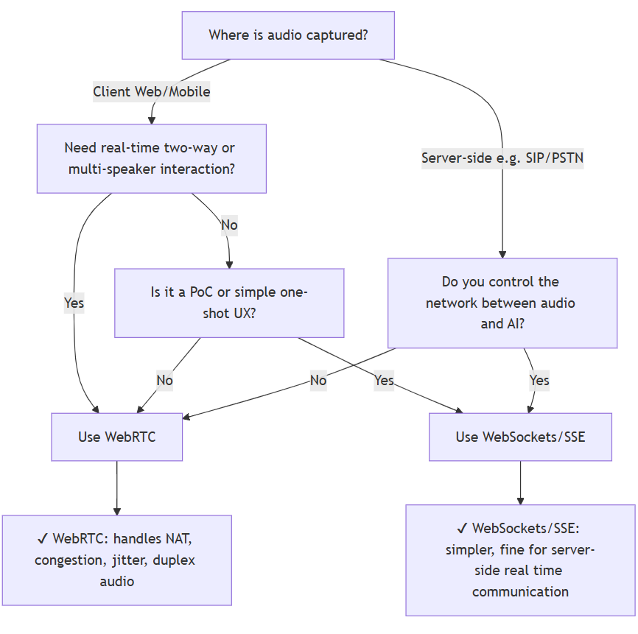
The Role of WebRTC in Real-Time Voice AI: When it Does (AND DOESN’T) MAKES SENSE
WebRTC.ventures 2025
Notes:
When? Depends on where the speech is captured AND if it needs to go through public internet
flowchart TD
A[Where is audio captured?] -->|Client Web/Mobile| B[Need real-time two-way or multi-speaker interaction?]
A -->|Server-side e.g. SIP/PSTN| E[Do you control the network between audio and AI?]
B -->|Yes| C[Use WebRTC]
B -->|No| D[Is it a PoC or simple one-shot UX?]
D -->|Yes| F[Use WebSockets/SSE]
D -->|No| C
E -->|Yes| F
E -->|No| C
C --> G[✔ WebRTC: handles NAT, congestion, jitter, duplex audio]
F --> H[✔ WebSockets/SSE: simpler, fine for server-side real time communication]

Slide 8
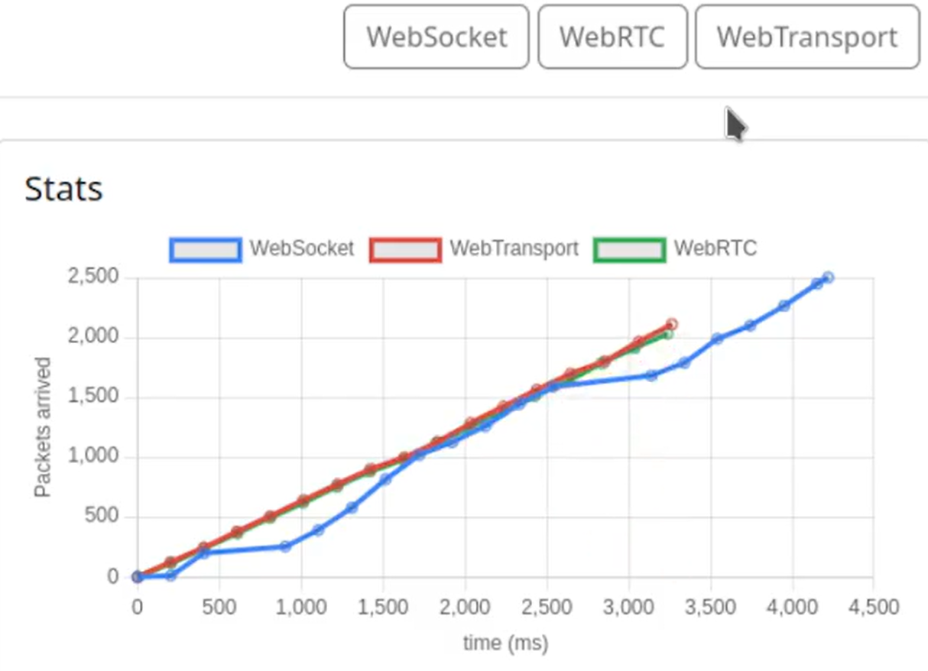
The Role of WebRTC in Real-Time Voice AI: Websockets vs webrtc vs webtransport
Sh3b0/realtime-web: Comparing WebSocket, WebRTC, and WebTransport under packet loss of 15%
WebRTC.ventures 2025
Notes:
Latency in this test increased 40% in a 15% packet loss network when using WebSockets
Experimenting with WebSocket, WebRTC, and WebTransport by streaming 2500 coordinates from server to client.

Slide 9
Standard Voice AI Architectures
Building Blocks for Voice Solutions
WebRTC.ventures 2025

Slide 10
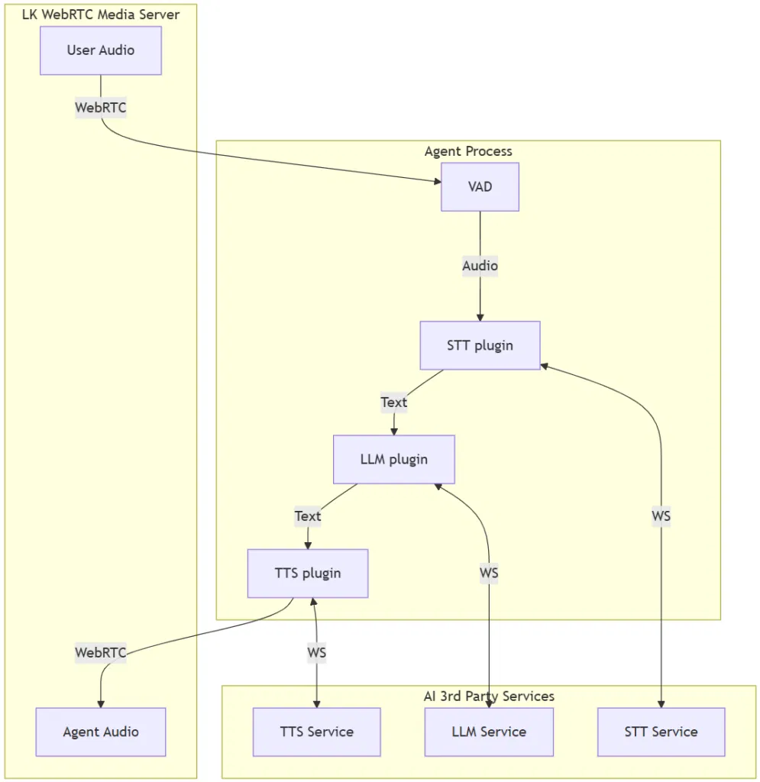
Overview of Common Voice AI Architectures
The “Traditional” Voice AI Pipeline in an application
Real-time systems typically use this sequential flow:
1. Voice Audio Detection (VAD)
2. Speech-to-Text (STT). Stream audio input, convert speech to text live (e.g.: Whisper).
3. Language Model (LLM/SLM). Generate a textual reply instantly from the transcript (e.g.: Llama, GPT-4o).
4. Text-to-Speech (TTS). Convert text response back to audio quickly (e.g: Kokoro).
5. Playback Stream synthesized audio to user/s with minimal delay (e.g.: WebRTC).
WebRTC.ventures 2025
Notes:
Pipecat and Livekit Agents are great options for a production grade open source low latency voice AI solution. These frameworks are helpful to manage the orchestration of multiple AI services. Not just necessarily TTS, LLM and SST.
Another new example of this orchestration framework is FastRTC from HuggingFace which also manages the streaming of media to AI services.

Slide 11
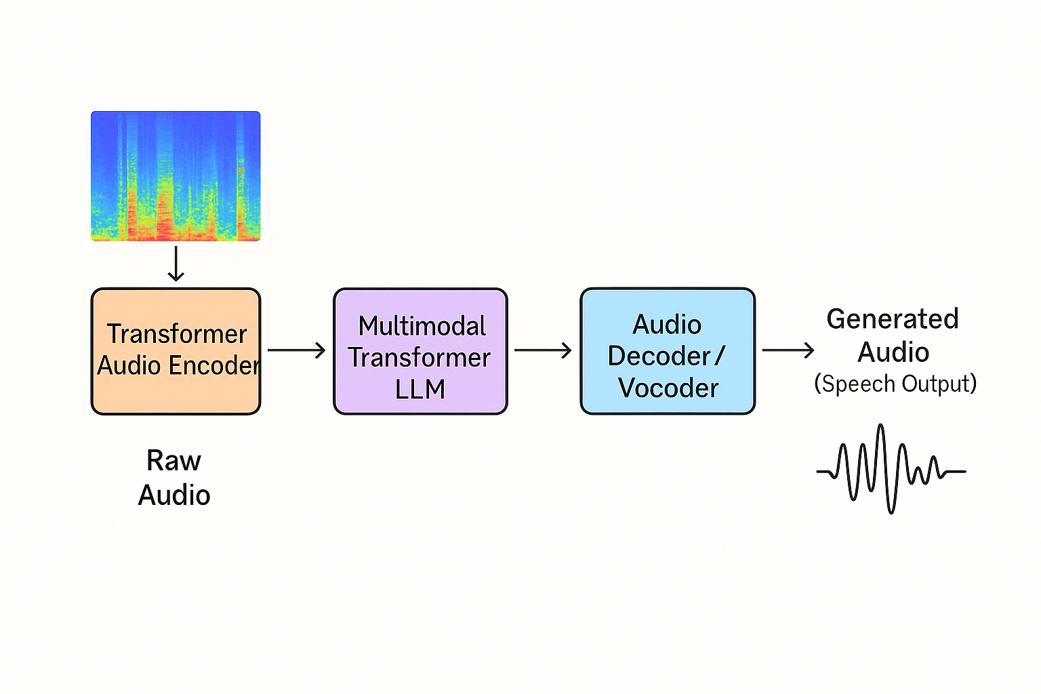
Overview of Common VOICE AI Architectures
The “modern” voice AI pipeline.
A Multimodal LLMs can process audio directly, reducing or eliminating the need for a separate Automatic Speech Recognition (ASR) stage. In will reduce latency and avoids error propagation.
Speech in → LLM → Speech out
Paralinguistic Awareness: Captures tone, prosody, and style directly from speech for richer intent understanding.
Expressive Speech Generation: Produces natural replies with controllable voice characteristics (emotion, timbre, style).
WebRTC.ventures 2025
Notes:
The MOVE IS toward models that can integrate and reason across modalities, not just process them independently. It is less modular but simpler to use by developers. Techniques:
CNNs: to detect spatial or temporal patterns, use convolution.
Transformer: is committee where every word or feature can look at every other word or feature and decide how much it matters.
in speech, it captures timing, tone, and context. So tone can be maintained between question/response VS traditional
A systems that follows this architecture is OpenAI real time. Other popular alternatives exist but that don't support WebRTC streaming out of the box like Ultravox, Gemini Live, Amazon Nova

Slide 12

Utilizing Open-Source Models for Voice AI Development
Benefits of Open-Source Tools
Flexibility: Fully customize models and pipelines to your needs.
Transparency: Inspect and improve code and data.
Community: Leverage shared innovation and support.
Some Popular Tools
Pipecat and Livekit Agents for voice AI orchestration.
Llama, Qwen and Gemma for LLMs
Whisper for Speech-to-text
Kokoro for Text-to-Speech
There are challenges too:
Open-source gives you flexibility and control, but it also means you have to be comfortable getting under the hood, investing time, and sometimes contributing improvements yourself.
WebRTC.ventures 2025
Notes:
To build this Voice AI you can use OSS! With these tools, you can avoid vendor lock-in, reduce costs, and benefit from a global community driving improvements!
To get the most value, be ready to participate and contribute—open-source success often depends on active involvement.
never fired someone for using a Google, Amazon or Azure service. But could be a big deal if it happens with open-source platform…
Potential Drawbacks of Open-Source Tools
Less polished UX: Many projects lack enterprise-grade interfaces or tooling.
Support can be inconsistent: You rely on community help or your own team’s expertise.
Ongoing maintenance: You’re responsible for updates, bug fixes, and security patches.
Integration and infra effort: More work to connect components compared to turnkey commercial APIs.
Quality variation: Not all models are equally well-tested across languages and scenarios.

Slide 13
Optimizing prompts for real time voice ai
Prompt Engineering for Accuracy and Speed
WebRTC.ventures 2025

Slide 14
Tackling prompt Latency
Prioritize Short Responses Over Short Prompts for Faster Conversations
LLMs process input faster than they generate output. Key lies in prompting the model to produce concise answers.
Prioritizing Information for Relevance
The order of information in a prompt significantly impacts the quality.
Leveraging Structured Input and Special Tokens for Voice Context
Example:
<speaker:user> "I'd like to book a flight to Miami tomorrow evening."
<context:intent=travel_booking; urgency=high>
WebRTC.ventures 2025
Notes:
Structured input can reduce total latency, but not by speeding up token generation (tokens/sec).
*Structured input reduces model reasoning time before first token* (can reduce total tokens needed too).
Improve grounding and reduce hallucinations.
To benefit from structured input in a Voice AI context:
You must parse and inject structured metadata before hitting LLM.
Use a lightweight NLU layer (Rasa, Hugging Face model, regex even which takes 10ms)

Slide 15
Benchmarking Real-Time Voice AI Performance
Latency, Accuracy, and User Experience
WebRTC.ventures 2025
Notes:
Benchmarking is essential to evaluate the effectiveness of voice AI systems. This section will cover techniques for measuring performance and comparing various AI pipelines.

Slide 16

Measuring ai Agent Performance
Latency Testing
Latency testing measures the time delay in responses, helping to optimize performance and user experience. We use custom or built-in logging/timestamping in AI frameworks.
Accuracy Evaluation
Accuracy evaluation assesses how well the voice AI system understands and processes commands, ensuring reliability. We use LLMs as a Judge.
User Satisfaction Surveys
User satisfaction surveys gather feedback from users, identifying strengths and weaknesses in voice AI interactions. We use tools like SurveyMonkey or custom-built surveys.
WebRTC.ventures 2025
Notes:
We will focus on latency for the sake of time and because we are in a real time comms conference, but happy to discuss accuracy and satisfaction after the talk!

Slide 17
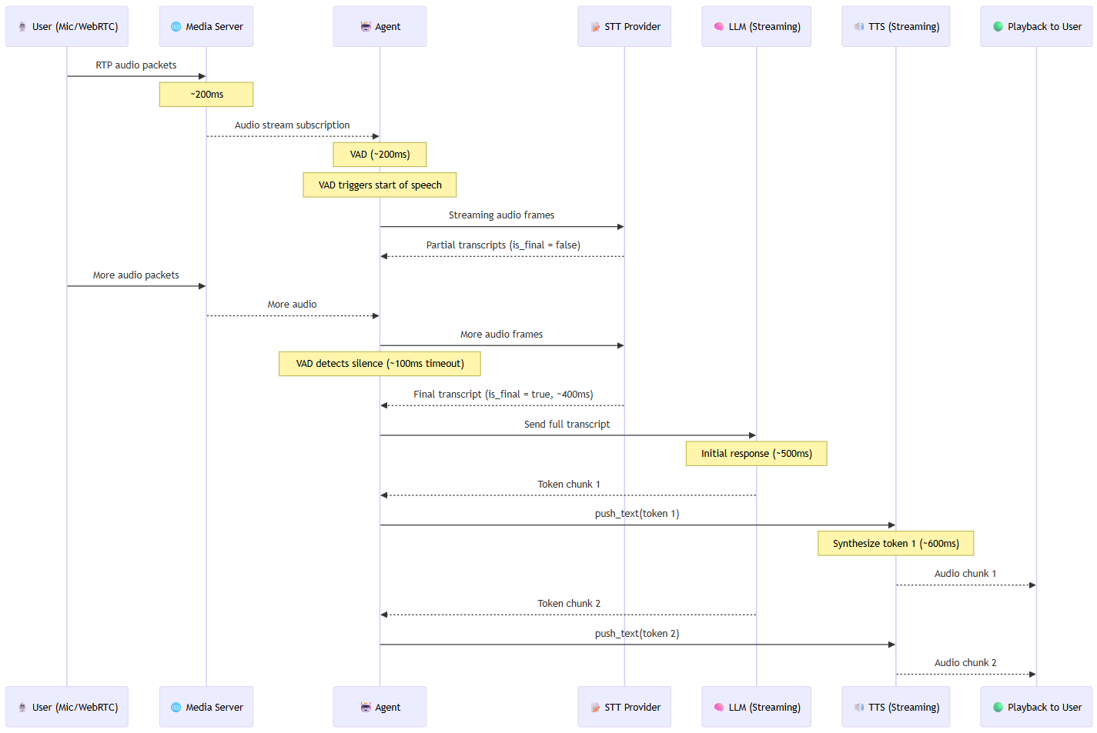
Typical Voice AI Pipeline latency
~1.6 seconds from end of speech to the first byte of audio back
WebRTC.ventures 2025
Notes:
Realistic example takes 1,600ms (~1.6 seconds) from end of speech to playback starting. 1.8s if we include internet meda round trip/RTP
sequenceDiagram
participant Speaker as 🎙️ User (Mic/WebRTC)
participant SFU as 🌐 Media Server
participant Agent as 🤖 Agent
participant STT as 📝 STT Provider
participant LLM as 🧠 LLM (Streaming)
participant TTS as 🔊 TTS (Streaming)
participant Playback as 🟢 Playback to User
%% Audio Capture
Speaker->>SFU: RTP audio packets
Note over SFU: ~200ms
%% Agent subscribes
SFU-->>Agent: Audio stream subscription
Note over Agent: VAD (~200ms)
%% VAD detects speech start
Note over Agent: VAD triggers start of speech
%% Audio to STT
Agent->>STT: Streaming audio frames
STT-->>Agent: Partial transcripts (is_final = false)
%% Ongoing speech
Speaker->>SFU: More audio packets
SFU-->>Agent: More audio
Agent->>STT: More audio frames
%% VAD detects speech end
Note over Agent: VAD detects silence (~100ms timeout)
%% STT final transcript
STT-->>Agent: Final transcript (is_final = true, ~400ms)
%% LLM processing
Agent->>LLM: Send full transcript
Note over LLM: Initial response (~500ms)
%% LLM streaming tokens
LLM-->>Agent: Token chunk 1
Agent->>TTS: push_text(token 1)
Note over TTS: Synthesize token 1 (~600ms)
%% Playback starts
TTS-->>Playback: Audio chunk 1
LLM-->>Agent: Token chunk 2
Agent->>TTS: push_text(token 2)
TTS-->>Playback: Audio chunk 2

Slide 18
Voice AI End-to-End Latency (Baseline Runs MAY25)
Model | STT/TTS | Infra | Provider | Total Latency
OpenAI GPT-4o | Deepgram/ OpenAI | OpenAI | OpenAI | Avg: 4.2 s
OpenAI GPT-4o-mini | Deepgram/ OpenAI | OpenAI | OpenAI | Avg: 2.5 s
Llama 3.3 70b | Deepgram/ OpenAI | Groq | Meta | Avg: 2 s
Llama 3.1 8b Instant | Deepgram/ OpenAI | Groq | Meta | Avg: 1.8 s
Gemma2 9B (with prompt and VAD optimizations) | Deepgram/ Groq(playAI) | Groq | Google | Avg: 1.4s
OpenAI Real Time (with prompt and VAD optimizations) | OpenAI | OpenAI | OpenAI | Avg: 1.4s
Llama 3.3 70b (with prompt and VAD optimizations) | Deepgram/ Groq(playAI) | Groq | Meta | Avg: 1.4 s
Llama 3.1 8b (with prompt and VAD optimizations) | Deepgram/ Groq(playAI) | Groq | Meta | Avg: 1.3s
WebRTC.ventures 2025
Notes:
Total latency means time from end of speech to speech heard back by user. Running things locally so includes roundtrips to all the different STT/LLM/TTS Services.
1)Prompt optimization and selecting the right Text to Speech model improves latency by ~300+ and prompt optimizations 100+ms.
Even the fastest cloud deployments (~1.3–1.4s) are above true real-time thresholds.
2)GPT‑4o / GPT‑4o-mini have much higher latency variability.
3)Llama 3.1 8B and Gemma2 9B hosted by Groq are the most consistent performers.
4) Sub-second latency requires:
On-premise or same-datacenter deployments.
Fast local models for STT/LLM/TTS.
Avoiding internet round-trips.

Slide 19

Recommendations for Sub-Second Latency
Co-locate all components and use network optimizations. STT, LLM and TTS each add ~100–200ms roundtrip latency over the internet
Use optimized prompt templates and caching
Deploy models on dedicated GPUs
WebRTC.ventures 2025
Notes:
STT , LLM and TTS each add ~100–200ms roundtrip latency over the internet.
Chose optimal cloud regions. Measure regional latency.
Optimizing prompt as we discussed and VAD with short audio chunks and faster early detection.
Dedicated GPU is the way to go. Some platforms exists to help you host those GPUs, all top cloud providers have services to deploy and test those services if needed!

Slide 20
Live Demonstration of AI-Powered WebRTC Assistant
From WebRTC Audio to Intelligent Replies
WebRTC.ventures 2025
Notes:
In this section, we will showcase a live demonstration of an AI-powered WebRTC assistant, providing a hands-on experience of its capabilities and functionalities.

Slide 21
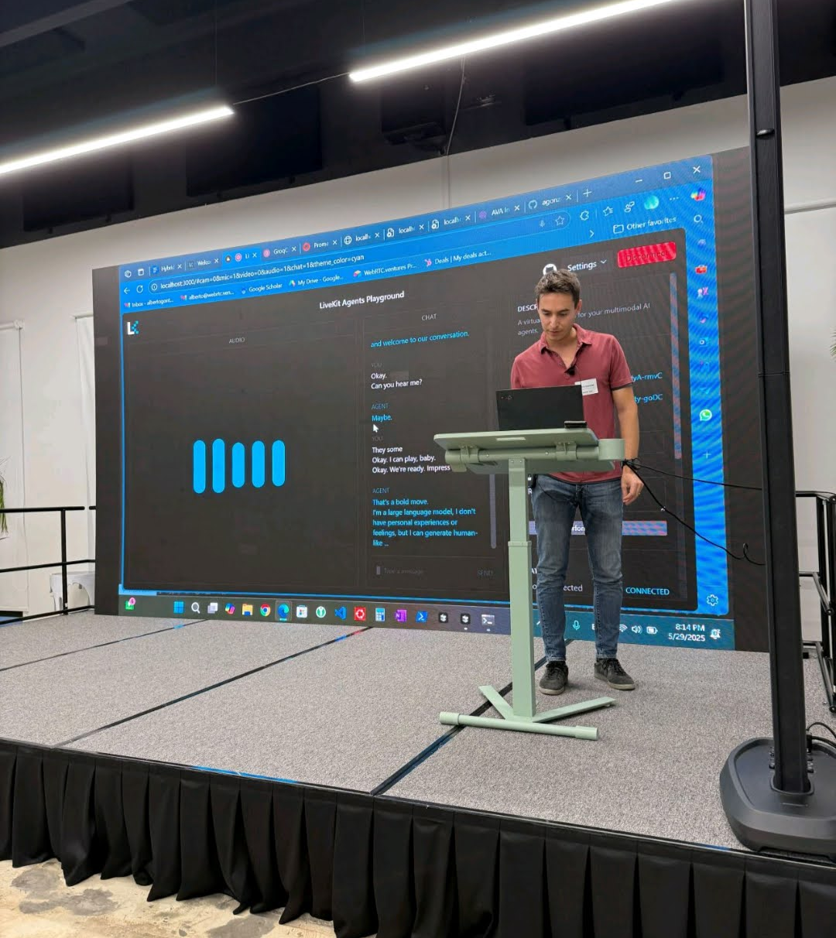
Walkthrough of the Demo
Real-Time Interaction
The AI-powered WebRTC assistant demonstrates seamless real-time interaction with users, showcasing its conversational capabilities.
System Capabilities
voice recognition and response generation during the demo.
WebRTC.ventures 2025
WebRTC.ventures 2025
Notes:
Situation: Building voice agents for some of our clients (call center space, enterprise,…)
Task: We encountered that it was hard to measure our improvements objectively. Still is so open to feedback!
Action: Built a demo with observability in place. Allow us to not just observe but test improvements like parallel LLMs running, different providers…We also have used Coval for simulation and evaluation but not part of the demo.
Result: Improved sub second voice conversations is possible!

Slide 22
Conclusion
Voice AI is ready for prime time
Near-human latency and quality. Already transforming healthcare, telecom, and more at a cost of ~$2/hour.
Breakthroughs in SLMs
Fast, affordable, scalable voice solutions you can build today.
Open-Source Tools
Be Realistic
Voice AI is probabilistic, like working with a skilled assistant, not deterministic code. Design for uncertainty.
Real-time streaming, multimodal capabilities, and flexible integration.
Try This:
Clone the demo: https://github.com/agonza1/webrtc-agent-livekit.
Experiment: Try swapping in different language models and STT/TTS engines to see the impact on cost and response time.
Benchmark your pipeline: Measure end-to-end latency and iterate to reach production-level performance.
WebRTC.ventures 2025
Notes:
In conclusion, real-time voice AI has the potential to revolutionize communication across industries. With advancements in WebRTC, small language models, and open-source tools, we can expect further innovations in this space.
The most innovative companies aren’t waiting for perfect AI, they’re designing for the incremental improvement.
Market is now demanding <1s performance with enterprise-grade!

Slide 23


Thank You & Questions
Notes:
Thank you for your time and attention.
If there’s one thing I hope you take away, it’s that real-time Voice AI is ready for production right now—latency, quality, and cost have crossed a threshold.
I invite you to clone the live demo and experience it yourself. And when you’re ready I am here to help!
it’s important to remember: this technology isn’t 99.99% deterministic like traditional software. It’s more like working with people or creative processes—probabilistic, adaptive, and sometimes unpredictable. The key is designing systems that can gracefully handle uncertainty while delivering great experiences.

