Slide 1
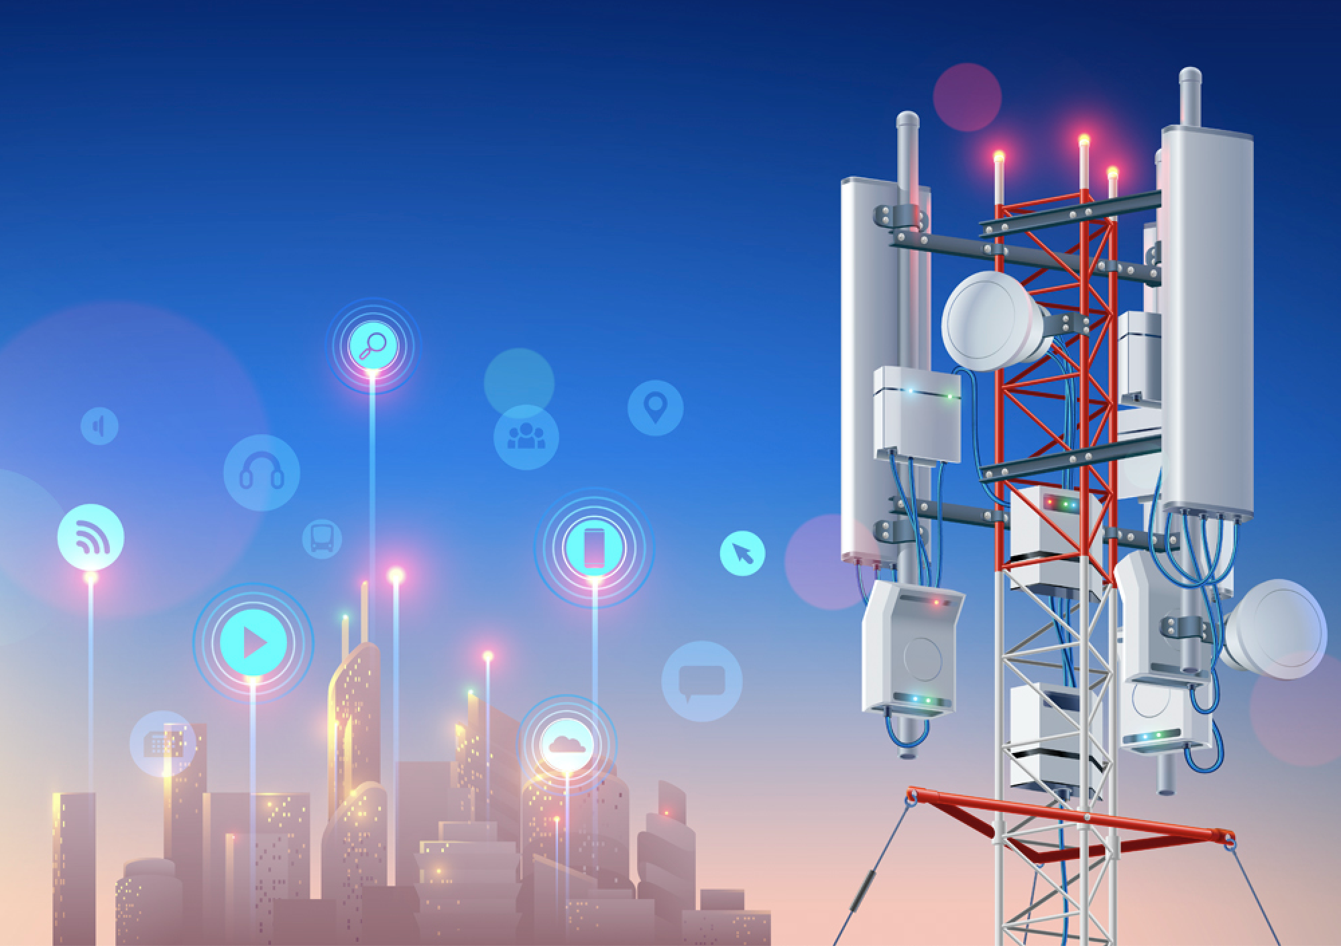
Artificial Intelligence in Mobility Network
Management
A Service Provider’s Experience
Jennifer Yates
AVP – Inventive Science
AT&T Labs
Notes:
Thanks for the intro. I am going to talk about some of the ways that we use Artificial intelligence and machine learning in managing commercial cellular networks – and specifically at AT&T. What you will notice is an emphasis on the network edge – RAN - this is of course due to personal experience, but also because I believe and have driven AI and ML within AT&T there first, because of the increased scale and complexity of the edge of the network – bigger impact - and also because of the lesser risk of introducing new technologies at the edge of the network as opposed to the core.

Slide 2
AI Foundational to 5G…
Networks that rely upon open platforms and data-powered automation
5G brings | AI/ML unlocks
Billions of devices Highly heterogeneous traffic Real-time network Diverse set of demanding applications Network densification | Ability to scale with network densification Learning of complex interactions in the network Holistic and adaptive control Proactive and autonomic operation New cost structure and revenue opportunities
Notes:
So why is AI so important to us? AI is not new – been using it for years. But we are getting more sophisticated with it over time, and expanding its usage. The fundamental challenge that we have had as cellular network technologies and services have evolved, is that the networks and services have become increasingly diverse and complicated. Revenue not growing at the same pace as traffic and devices! So cannot grow personnel at the same rate as we grow traffic and devices. So need to get smarter in how we design and operate networks.
With cellular networks today and how we expect them to evolve with 5G, we have 100s of millions and expected to grow to billions of devices connected. But the diversity of services continued to explode, placing increasingly diverse requirements on networks. And networks are becoming increasingly densified – with small cells and mmWave technologes. And of course traffic volumes keep growing tremendously.
AI and ML helps us, with the ability to scale our management whilst customers, bandwidth increase and network densification. As networks get more complicated, AI helps us learn the complex interactions in the networks. Proactive and autonomic.

Slide 3

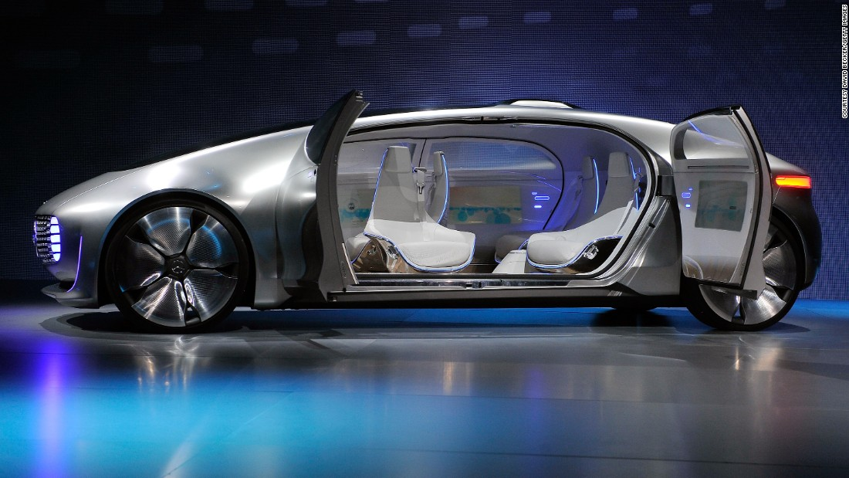


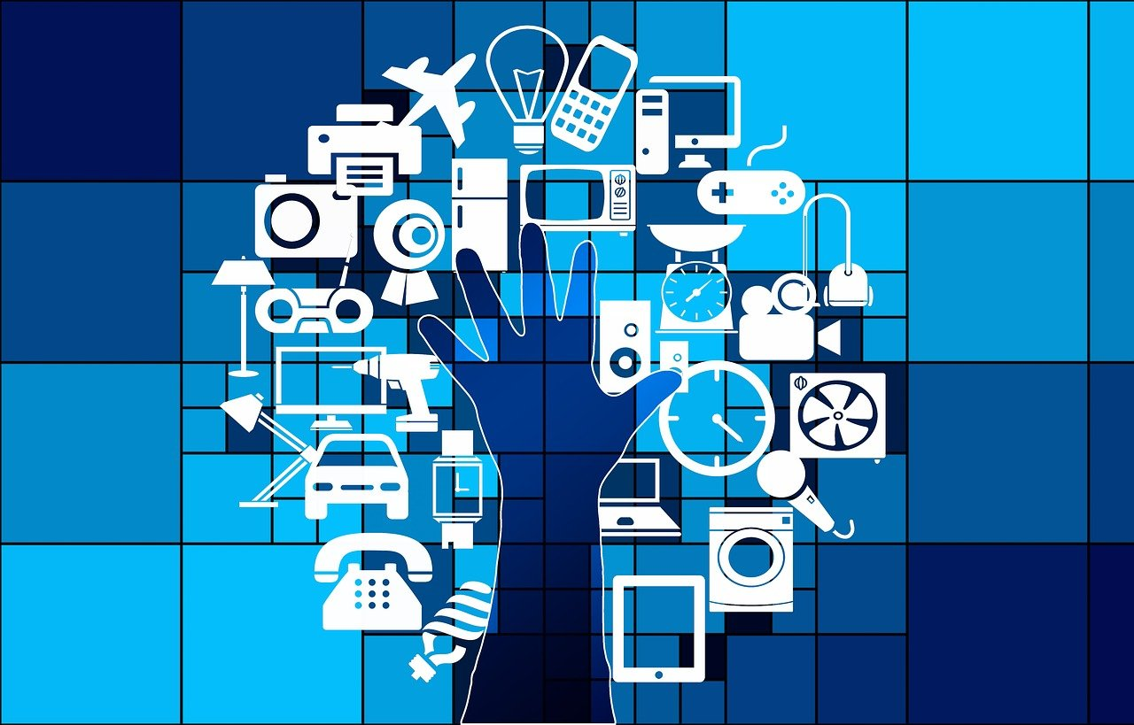
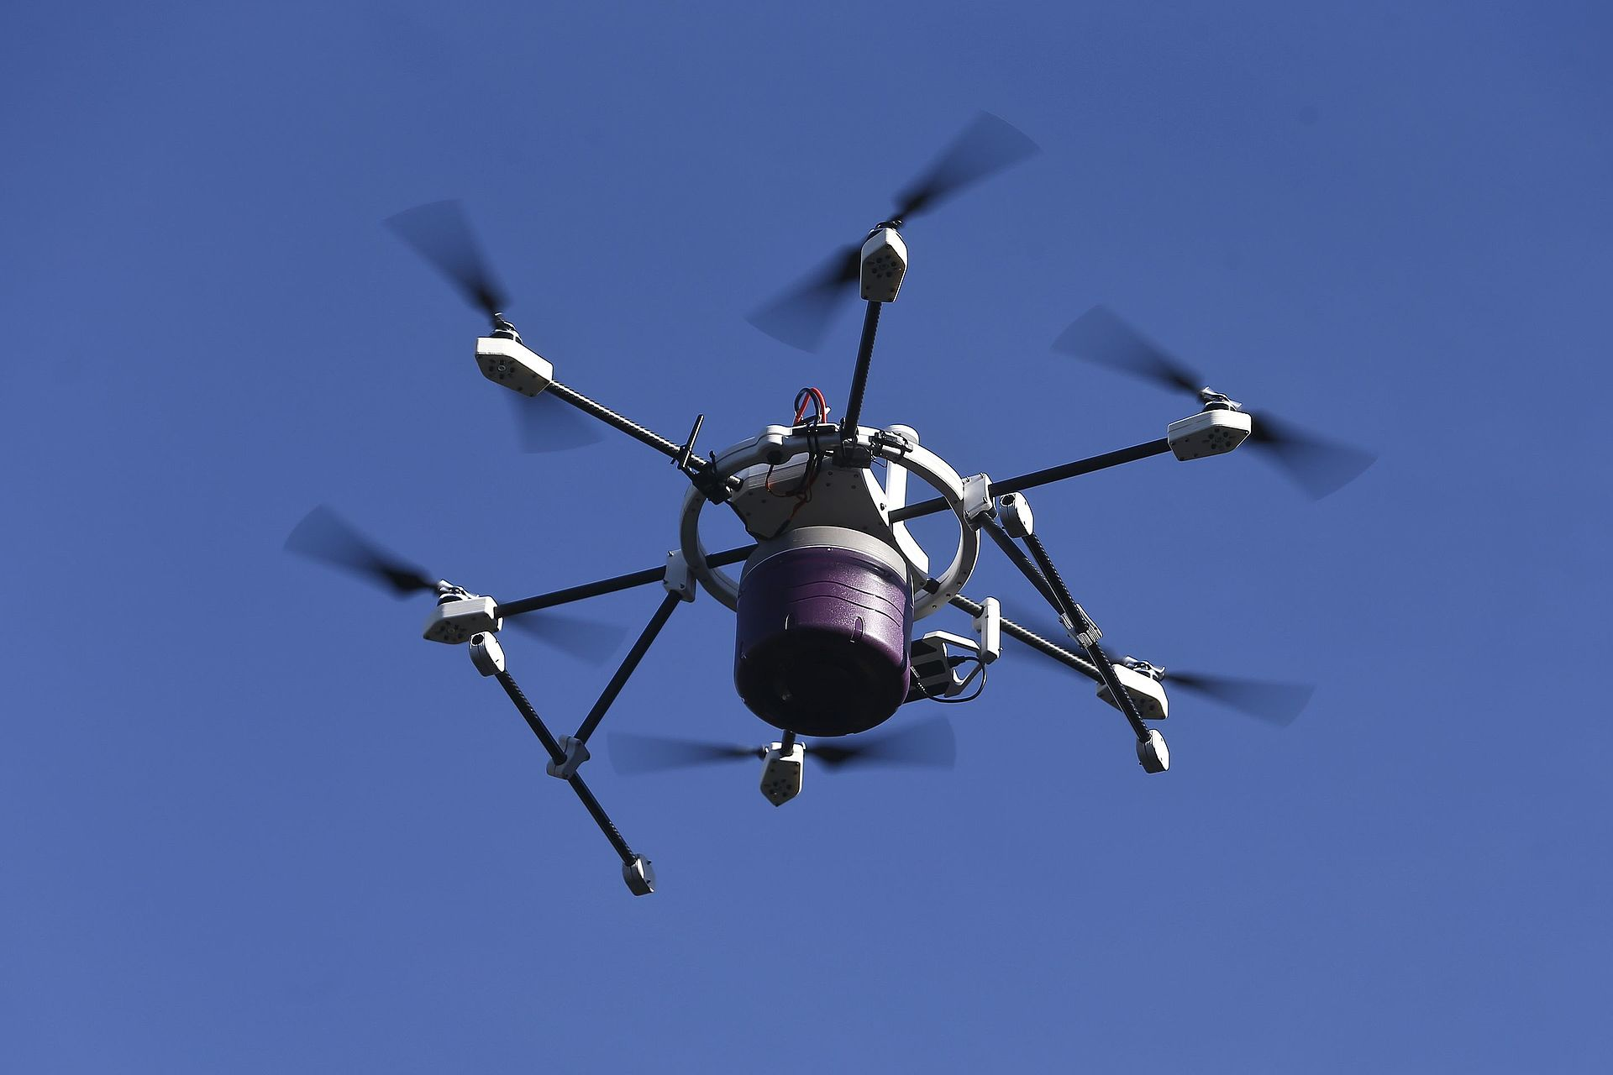
5G Networks – AI/ML and Application Synergy
AI/ML Playbook
Customer experience
Revenue
OpEx
CapEx
Emerging applications
Emerging applications
Autonomous cars
Data collection
& curation
Virtual reality
Applications
& experiences
Network design,
planning
& build
AI/ML
powered
Internet of things
Autonomous drones
Operations
automation
Network
optimization
Notes:
So now looking at the application level – we have a suite of new applications that have either become rather pervasive or are on the horizon. The type of traffic is considerably more heterogeneous – long gone are the days when voice was king. Video dominates traffic today on cellular networks, and has very tight requirements and uses significant bandwidth compared with historical voice. Autonomous cars, virtual reality, Internet of things, autonomous drones at different levels of maturity and scale. Conneced cars and IoT applications are well established today - even cows are being connected to cellular networks today! Place increasingly stringent requirements on the network. And we expect at some stage soon to see more autonomous cars, AR and VR and autonomous drones, to name but a few.
Now in terms of managing the network, we aim for AI and ML to help us in a number of ways – driving improved customer experience as we can react more rapidly to issues that occur, and we can constantly optimize the network at a scale and speed that humans being can simply not. We look to AI and ML to drive new revenue opportunities,. And we look at AI to help us optimize operational and capital expenditure – particularly as our networks, bandwidths and number of customers grow.
From a network management point of view, we think of multiple different aspects of network lifecycle built on a foundation of data collection and curation: start conceptually with network design, planning and build, we have to optimize the network, operate it and also increasingly use AI and ML to optimize how networks are built for ever increasingly applications – application design for networks and how networks are built for the applications.

Slide 4

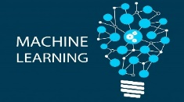

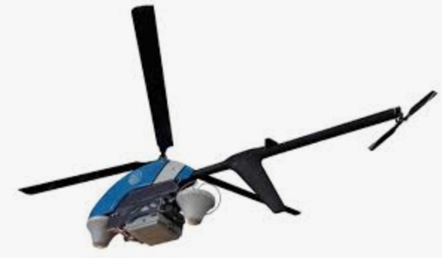





RAN Automation Evolution
Proactive and predictive
Auto-heal and optimize
Energy efficient
Operator-defined
intent
Closed loop automation
Sophisticated AI/ML (e.g., GenAI, RL)
Analyze
Decide
Service Management & Orchestrator (SMO)
Open interfaces (I-RAN)
Data
Actions
Drones, autonomous cars,
Robots …
Confidential
Notes:
When we dream of the future for mobility RAN networks, we envision a network which has fully automated network control where the network operators simply specify their intent on how the network should operate, and the machines then automatically learn through sophisticated machine learning and real time analytics to translate that intent into actions taken into the network that realise that intent. Some of this vision is without question here today – but networks will become ever increasingly intelligent and autonomous over time. Evolving open architectures and interoperability specifications are also maturing, which should enable technology to be more rapidly deployed along with enabling more real-time control of the network. But these advances in terms of intelligence and architectures today are focused on functions that can be performed remotely –if we look a good number of years out, we dream even further to envision a future where we have increasing automation out in the field as well, from drones to even robots involved in deploying and repairing equipment.

Slide 5
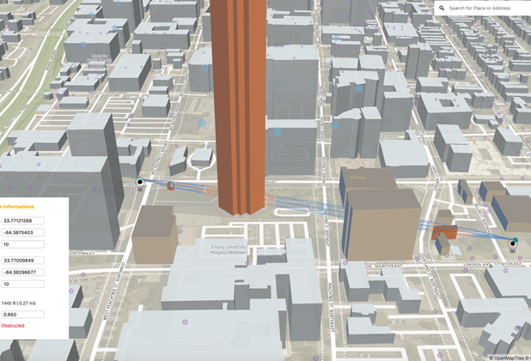



AI Across Network Design, Planning and Build (“Day 0 and 1”)
Small cell
Macro
Small cell
Small cell
Design and Asset Acquisition
Spectrum auctions
Site selection
Site leases
Planning
Forecasting
Capacity planning
Build and validate
Provisioning
“Backhaul on demand”
“Zero touch” carrier / site insertion
Notes:
AI is used throughout this process.
Traffic forecasting – ML to estimate traffic density in geobins, STEM + IQI data. Estimate traffic density (STEM doesn’t have precise location). Build model to estimate precise location of UE and then trend out to forecast. ML = estimating current location. Train on IQI (Android) ML to estimate locations for Apple.
Site selection – CDO model, forecast financial return from new site based on historical data
RAN propagation (Rhea)
CDO model for carrier adds – financial return, rest more deterministics
For example, with mmWave small cells, we now have a massive number of new sites that we need to deploy. One of the biggest challenges is determining where these new sites should be located – which depends on the customer demands, terrain, building locations and more. AI is critical in understanding that environment, and in determining what locations would make viable and best candidates for deploying new cell sites.
Similarly, as we reach the other end of this process, AI is critical to scaling out the configuration and validation of new site and carrier deployments. For example, there are thousands of parameters that need to be configured on each gNodeB - we are using ML to determine the best values for these parameters, based on how neighbouring gNodeBs are configured and then on tuning these parameters.

Slide 6
AI Across Network Operations and Optimization (“Day 2”)
Small cell
Macro
Small cell
Small cell
Network Operations Automation
ML-based control loops
ML fault management
Outage customer impact quantification
Change management
Security
Resource management
Traffic management
Performance optimization
Energy: Cell site sleeping, anomalous energy consumption
Decommissioning
Planning
Customer experience management

Slide 7

ML-Based Performance Optimization (Auric)
Challenge: configurations for thousands parameters per site?
New carrier
Performance optimization
New carrier
Similarity:
Hardware/software
Carrier frequency
Channel bandwidth
Location
Morphology
Traffic characteristics …
…
“Popular” parameters for “similar” carriers / sites
L.A.
Philadelphia
“Effective” parameters for “similar” carriers / sites
Notes:
Collaborative filtering

Slide 8

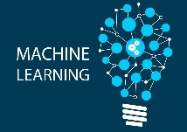

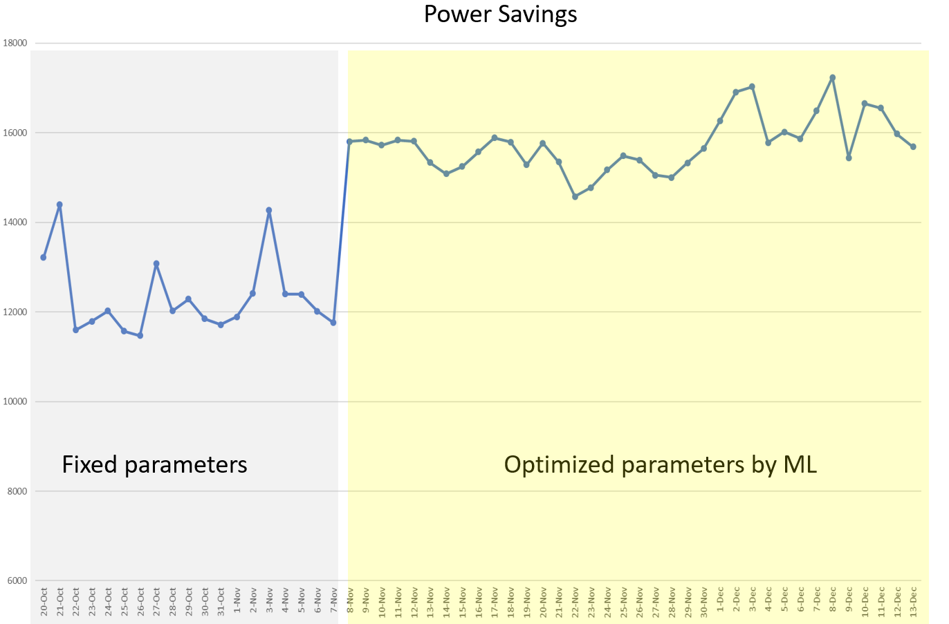
ML-Driven Energy Savings
Conserve energy: carriers (capacity) sleep under low loads
Z
Z
Cell site intelligence
Machine learning optimizes sleeping w/ minimal customer impact
Z
Fixed
parameters
ML-based
parameters
Reinforcement
learning
Notes:
Neural network regression

Slide 9
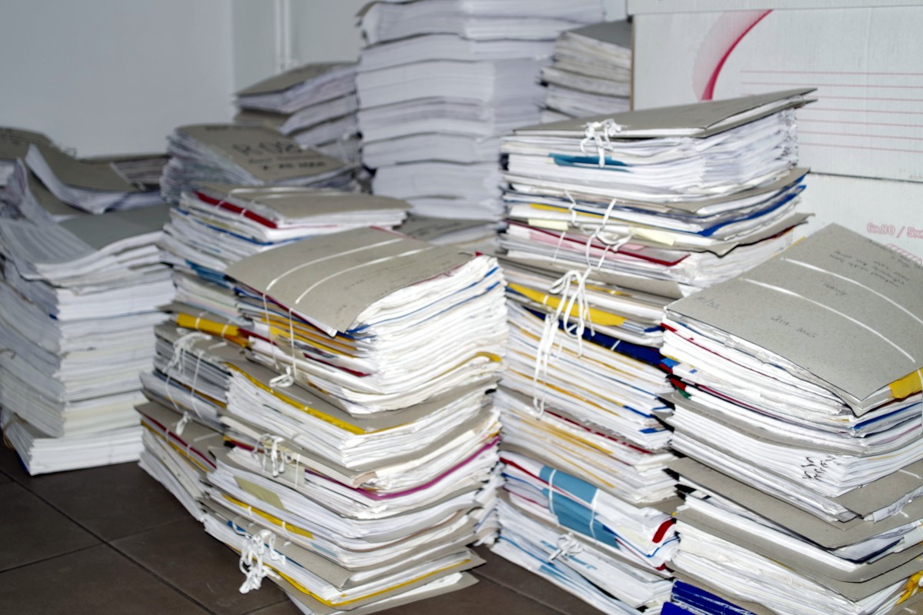
GenAI: Opening New Opportunities…
Opens new opportunities
Example use cases:
Software development
Customer care interactions
Vendor technology changes impacting automation
Operator identifying commands
Summarizing and analyzing tickets
Identifying automation opportunities
...

Slide 10




Network Foundation Model (Multi-modal)
Downstream
Applications
Config (Tabular)
KPI (numeric time series)
Performance optimization
STEM/IQI/ALARM
(event time series)
Config Audit
Drive Test
(event time series)
Pre-Training
Fine-Tuning
EDR/CDR
(tabular time series)
Synthetic data generation
LLM
Logs (text)
Tickets/Alarm (text)
Network
Foundation
Model
Documents (text)
….
Images
Anomaly Detection
Audio
Geo and Topo
Root Cause Analysis
Notes:
All the data sources are now represented in the same semantic space with the same dimensionality

Slide 11

With AI and Automation Comes Risk… “Safe Automation”
Automation risks
Software bugs, flawed policies / intent
Malicious abuse
Bad data, AI “bad decisions”
Competing automation actions
…
Safe Automation: Partnerships building safe(r) automation & trust
A journey together…
Solution design, automation intelligence (“AI watching AI”), test and rollout
Explainable AI….
Notes:
Lots of promise – but comes with risk
So what can go wrong?
Risks – what can go wrong in the automation…
This can cause negative impact in the network – poorly designed and operated automaton going awry could, in theory, shut down networks, constantly reboot network elements, black hole traffic and more. And this can then result in negative customer impact and operations teams overhead when they need to recover it…
All sounds scary – and believe me I have had sleepless nights worrying about it in the early days! Until we put a real focus on managing that risk – through a tight partnership with our Operations and network partners…

Slide 12
Conclusions
AI used across 5G networks
And growing…
GenAI opens new opportunities
Safe automation as first class citizen
Trust built on partnerships
Notes:
So in conclusion, for us, building trust in the automation was first about building tight collaborations across teams and going on a journey together to drive automation that our partners could trust into the network. And it was about making “safe automation” a first class citizen when designing and building our automation and associated processes. IT was a considerable investment in terms of time and software development, but it is necessary as the risks are too high to ignore.

